Slide 1
WELCOME to the UWW Supervision Summit 2018 Please sit in your internship sections!!

Slide 2
Welcome
Introductions of UWW faculty and staff
Notes:
Brenda

Slide 3
Ice Breaker
Notes:
Brenda

Slide 4
Counselor Education Mission Statement
To prepare professional counselors who advocate for social justice and apply their knowledge and skills to develop effective counseling relationships that serve to improve the human condition.
Notes:
Jeff
Social Justice
Western MC
International MC
Academic, experiential, self-reflective – as a part of the culminating internship experience
Professional standards and contemporary research (social media) that continue to help to solidify our identity
Embrace so that we might have safe environments that inspires us to be authentic

Slide 5
Our Vision:
We strive to educate leaders and advocates who will transform the profession of counseling and the schools and communities we serve.
Notes:
Jeff
Social Justice
Western MC
International MC
Academic, experiential, self-reflective – as a part of the culminating internship experience
Professional standards and contemporary research (social media) that continue to help to solidify our identity
Embrace so that we might have safe environments that inspires us to be authentic

Slide 6
Counselor Education Program
Accredited by CACREP (Council for Accreditation of Counseling and Related Educational Programs, 2016) Standards
School Counseling
Clinical Mental Health Counseling (CMHC)
Notes:
Jeff
Social Justice
Western MC
International MC
Academic, experiential, self-reflective – as a part of the culminating internship experience
Professional standards and contemporary research (social media) that continue to help to solidify our identity
Embrace so that we might have safe environments that inspires us to be authentic

Slide 7
Counselor Education Program
School Counselors – licensed through Wisconsin Department of Public Instruction (DPI)
60 Credit program prepares student for licensure as a school counselor in WI
CMHC – licensed through Wisconsin Department of Safety and Professional Services (DSPS)
60 Credit program is an approved pathway for licensure as an LPC-IT
Notes:
Jeff
Social Justice
Western MC
International MC
Academic, experiential, self-reflective – as a part of the culminating internship experience
Professional standards and contemporary research (social media) that continue to help to solidify our identity
Embrace so that we might have safe environments that inspires us to be authentic

Slide 8
Agreements!!!!
Notes:
Jeff
Social Justice
Western MC
International MC
Academic, experiential, self-reflective – as a part of the culminating internship experience
Professional standards and contemporary research (social media) that continue to help to solidify our identity
Embrace so that we might have safe environments that inspires us to be authentic

Slide 9
Affiliation Agreement
Agreement specifying the roles /expectations for:
Internship Site
and
University of Wisconsin – Whitewater
Agency to Agency Agreement
Notes:
Jeff
Social Justice
Western MC
International MC
Academic, experiential, self-reflective – as a part of the culminating internship experience
Professional standards and contemporary research (social media) that continue to help to solidify our identity
Embrace so that we might have safe environments that inspires us to be authentic

Slide 10
Supervision Agreement:
Agreement specifying the roles /expectations for:
Intern
Site supervisor
Faculty supervisor
Notes:
Jeff
Social Justice
Western MC
International MC
Academic, experiential, self-reflective – as a part of the culminating internship experience
Professional standards and contemporary research (social media) that continue to help to solidify our identity
Embrace so that we might have safe environments that inspires us to be authentic

Slide 11
Dept. / Faculty Supervisors
The Counselor Education Department agrees to provide necessary training (during the annual Supervision Summit) for internship site supervisors and to keep the internship site advised concerning the objectives of the program.
Will place at the internship site those students who have satisfactorily completed the prerequisites necessary for the internship experience.
Will inform the site supervisor about the academic requirements of internship and will coordinate with the internship site on how these requirements can be fulfilled
Provide the site-supervisor with a copy of internship syllabus
Will coordinate and complete a minimum of three site visits (with intern and site supervisor) during the 9-month internship experience (fall and spring semesters).
Provide group supervision (internship class) for 2.5 hours on a weekly basis during the internship experience (while the academic semester is in session).
Shall notify each intern of their responsibilities during internship both professional and academic.

Slide 12
Interns
Must conduct themselves in a professional manner and abide by the ACA Code of Ethics or ASCA Code of Ethics.
Complete 20 hours per week at the internship site for the duration of the 9-month academic year.
Complete a minimum of 600 hours at the internship site (approximately 300 per semester). A minimum of 240 hours of direct service with clients (300 hours for interns planning to pursue license as Marriage and Family Therapist) is required.
Complete audio/video recordings in a manner that is legally and ethically appropriate and agreed upon by the site supervisor.
Alternatively → arrange for the faculty supervisor to do an observation or work with the faculty supervisor towards meeting this requirement in another way
Will attend both group supervision (class) and on-site supervision with their site supervisor on a weekly basis.
Will meet with their site supervisor and discuss any concerns/issues they are having with their internship.
Will maintain the confidentiality of all patient/client records and information.

Slide 13
Internship Site / Site Supervisor
The internship site agrees to allow interns to audio/video record counseling sessions with client consent.
Alternatively: on-site observations by faculty supervisors can be completed or other arrangements are made so that faculty can properly evaluate students.
The site supervisor agrees to meet with the intern for a minimum of one hour per week to provide supervision for the intern.
The internship site shall, at the commencement of an intern’s placement, provide the student with a thorough orientation about the internship site’s policies, procedures, standards and practices relevant to the intern’s placement.
The site supervisor shall promptly advise the faculty supervisor if they have any reason to believe that the intern is not making satisfactory progress toward completion of their internship experience and/or not complying with the internship sites policies, procedures, standards and practices.
In all cases, the internship site shall retain ultimate responsibility for the care of its patients or clients.

Slide 14
UWW Expectations
The goal of the internship experience is to provide the intern with opportunities to observe and participate in all counseling functions outlined by the Council for the Accreditation of Counseling and Related Educational Programs (CACREP), as direct service.
Notes:
Anene

Slide 15
UWW Expectations
For both CMHC and School interns this might include:
Individual and group counseling
Working with parents and/or family counseling
Career planning
Consultation & staffings
Student advisement
Working with student organizations or clubs
Staff development & in-service
Developmental programming & delivery
Prevention or remediation interventions
Notes:
Anene

Slide 16
UWW Expectations
Opportunity for Social Justice
Counselors-in-training/Interns have the ability to provide services:
Schools
Community agencies
Universities/Colleges, etc.
to clients that might not otherwise have the opportunity to be seen
Financial constraints
Limited resources at the site
Notes:
Anene

Slide 17
CACREP/UWW Expectations
THE NUMBERS:
Minimum of 600 hours at the internship site
240 direct client contact hours (LPC, School Counselors)
300 direct client contact hours (MFT licensure)
Record, Record, Record or
Observations from Supervisors
Notes:
Anene

Slide 18
CACREP/UWW Expectations
1 hour of formal individual / triadic supervision per week → observing their work and providing feedback
Hopefully much informal supervision and consultation
NOT: Team staffing or Team meeting or training
2.5 hours per week of group supervision provided by faculty supervisors
Hopefully much peer to peer consultation
In addition the student will become knowledgeable about:
The site organization’s policies & procedures
The role of counselors at the specific internship sites
Notes:
Anene

Slide 19
Supervision …
Seeks to foster the supervisee’s professional development
Ensures client welfare
Is an intervention
Is evaluative
Differs from consultation
Extends over time, and
serves as gatekeeper for those who are entering a particular profession
Bernard & Goodyear, 2014

Slide 20
Vicarious Liability
Person in position of authority is responsible for acts of their supervisees/trainees/interns
Supervisors are ultimately responsible for the welfare of clients counseled by their supervisees
Therefore, supervisors:
Ensure that supervision occurs
Are familiar with each case of your intern
And may even conduct fact-to-face meetings with each client → allows clients to meet you and aids in informed consent
Bernard & Goodyear, 2014

Slide 21
What is Supervision?
Supervision is the foundation of counselor training (Crunk & Barden, 2017).
Functions of supervision are:
Provide support and instruction to supervisees (interns)
Ensure the welfare of clients and the counseling profession (Bernard & Goodyear, 2014).

Slide 22
Models of Supervision
Psychotherapy-Based Models of Supervision
Psychodynamic, Humanistic, Cognitive-Behavioral, Systemic, Constructivist, and Integrative
* Focus on passing on one therapy approach
Developmental Models → the developmental process trainees go through to becoming counselors
Focus on the intricacies of the learning process of the supervisee
Supervision Process Models → an interest in supervision as an educational and relationship process
Primary focus is to step back and observe the supervision process itself
Bernard & Goodyear, 2014

Slide 23
Discrimination Model
Supervision is viewed as both an educational and a relationship process (Bernard & Goodyear, 2014)
We learn through relationships …

Slide 24
Discrimination Model (Bernard & Goodyear, 2014
Utilizing this model a supervisor focuses on:
(1) Assessing the supervisee’s skills
(2) Choosing a supervisor role based on your interns needs/goals at a particular time

Slide 25
Discrimination Model (Bernard & Goodyear, 2014
Skills:
Intervention: (observable behaviors → counseling skills and interventions that the intern is demonstrating in session)
Conceptualization: (cognitive processes → interns ability to recognize client themes / patterns and their level of understanding of what is occurring in the counseling session)
Personalization: (intern self-awareness and ability to adapt personal style of counseling, while being aware of personal issues and countertransference)
Professional behaviors: how the intern approaches legal and ethical issues

Slide 26
Discrimination Model Roles
Teaching role: has an evaluative function and focuses on imparting skills and knowledge
Includes: instruction, modeling and providing feedback
Consultation – more collegial role when the supervisor wishes for supervisees to trust their own insights and feelings about their work, or want to challenge supervisees to think and act on their own.
Counseling – examining behaviors, thoughts, or feelings that are stimulated by the client (particularly those that create a barrier)
Enhance supervisee reflectivity, especially about their own internal reality
Bernard & Goodyear, 2014

Slide 27
Discrimination Model
Focus of Supervision | Teacher | Counselor | Consultant
Intervention | Models or teaches a specific skill that supervisee is struggling with | Asking supervisee to reflect on why they are struggling with “confrontation” | Would like to use art / music → provides resources or brainstorms
Conceptualization | Problems identifying primary concern → Having supervisee look at session and pointing out aspects of the session to intern | Helping supervisee identify what is “blocking” her from having empathy for client | Wants to think about different approaches to address a client concern → brainstorming
Personalization | Pointing out countertransference | Identifying need to be perfect and how this might impact work with client | Attraction to client → supervisor is sounding board and helping supervisee to handle appropriately

Slide 28
The Supervisory Triad
Intern
Clients
Site
Supervisor
Faculty Supervisor

Slide 29
Supervision as a 3 – person system
The supervisory relationship is a relationship about a relationship about other relationships
Two manifest relationships
Client – Intern
Intern – Supervisor
Person common to all
these relationships → Intern
Intern
Clients
Site Supervisor
Faculty

Slide 30
Supervision as a 3-Person System
The processes in this 3-Person system area quite complex → because each of the three people involved in system influence the other two people in the system
Bernard & Goodyear, 2014
Notes:
Jeff
“the reflection process in which the processes at work currently in the relationship between patient and therapist are often reflected in the relationship between therapist and supervisor
Supervision can be a process that teaches counselors how to use themselves in the counselor/client relationship

Slide 31
Processes in 3-Person System
Parallel process – supervisees (albeit unconsciously) present themselves to their supervisors as their clients have presented to them
It is a re-enactment in one dyad (client – intern counselor) of the processes occurring in the other (intern – supervisee)
Bernard and Goodyear, 2014
Notes:
Jeff
“the reflection process in which the processes at work currently in the relationship between patient and therapist are often reflected in the relationship between therapist and supervisor
Supervision can be a process that teaches counselors how to use themselves in the counselor/client relationship

Slide 32
Processes in 3-Person System
Parallel processes when recognized can be used as a way to intervene.
Isomorphism – focusing on the similarities between therapy and supervision
Identify the repetitive or similar patterns
Altering the way we are working in supervision → alter the way the intern is working with their client
Bernard and Goodyear, 2014
Notes:
Jeff
“the reflection process in which the processes at work currently in the relationship between patient and therapist are often reflected in the relationship between therapist and supervisor
Supervision can be a process that teaches counselors how to use themselves in the counselor/client relationship

Slide 33
The Working Alliance
It is the quality of the client-therapist relationship that consistently predicts outcomes – regardless of theory (Norcross & Wampold, 2011) → Therapeutic relationship or the Therapeutic Alliance
The therapeutic alliance appears to be the most frequently studied process of change (Castonguay, Constantino, Holtforth, 2006).
It’s been argued that the therapeutic alliance plays such an important part of “…what good therapy entails that not paying attention to its quality during practice or supervision could be viewed as unethical” (p. 271)
Notes:
Jeff
“the reflection process in which the processes at work currently in the relationship between patient and therapist are often reflected in the relationship between therapist and supervisor
Supervision can be a process that teaches counselors how to use themselves in the counselor/client relationship

Slide 34
Working Alliance Cont…
Supervision → is a “working alliance” between the supervisor and intern (Inskipp & Proctor, 2001, p. 1)
It has been strongly suggested that the alliance between a supervisor and supervisee is also one of the most important factors in supervision
Bernard & Goodyear, 2014
Notes:
Jeff
“the reflection process in which the processes at work currently in the relationship between patient and therapist are often reflected in the relationship between therapist and supervisor
Supervision can be a process that teaches counselors how to use themselves in the counselor/client relationship

Slide 35
What our Experiences Tell Us
What kind of supervision did you get:
As an intern, a beginning counselor, and/or in past non-counseling positions
Identify a time when you had a good supervision experience …
What made your supervisor a good supervisor?

Slide 36
The Working Alliance Cont…
A key task in early supervision is building a strong working relationship that will endure when future dilemmas in supervision need managed
Ongoing maintenance of the alliance is the supervisor’s responsibility throughout the course of the relationship
Need for understanding the factors that influence the working alliance
(see Bernard & Goodyear, 2014)
Notes:
Jeff
“the reflection process in which the processes at work currently in the relationship between patient and therapist are often reflected in the relationship between therapist and supervisor
Supervision can be a process that teaches counselors how to use themselves in the counselor/client relationship

Slide 37
Predictors of Quality Supervisory Working Alliances (SWA)
Three Factors:
Supervisor Factors
Supervisee Factors
Supervision Process

Slide 38
Supervisor Factors
Supervisory style: interpersonally sensitive (consultant) and counselor (attractive) style
Use of expert and relevant social influence: the greater the use of expert role (i.e., the perception that the supervisor has knowledge and expertise) and being referent (i.e., perception that supervisor is similar to supervisee on some dimensions important to the supervisee
Supervisor self-disclosure: level of disclosures from the supervisor (i.e., personal issues, neutral counseling experiences, and counseling struggles)
Attachment Style – ability to form healthy adult attachments
Supervisors’ unethical behavior is a NEGATIVE predictor

Slide 39
Supervisee Factors
Supervisee’s attachment style (mixed)
Emotional intelligence
Level of stress-in-general or work related stress, supervisee anxiety (Negative predictor)
Higher level of supervisee’s coping resources

Slide 40
Supervision Processes
Clear expectations and evaluative practices
Role conflict or ambiguity (Negative predictor)
Role ambiguity - when supervisee is unsure about the role expectations
Role conflict - being required to engage in 2+ roles with inconsistent /competing behaviors (e.g., personal weaknesses and needing to present as competent to pass practicum)

Slide 41
Supervision Processes that predict a quality SWA Cont…
Openly and honestly discussing supervisor and supervisee race/ethnicity differences and similarities
Supervisor and supervisee advanced racial identity levels
Supervisor – supervisee complimentarity → issues of power → cooperation → will vary according to stages of counseling and development

Slide 42
Outcomes of SWA
Positive correlation:
Supervisee’s willingness to disclose
Quality of supervisee’s working alliance with clients
Greater satisfaction with supervision

Slide 43
Break Out Discussions
Interns → stay in here in room 118 and talk about what they want/need in a supervisor
Two groups: School & CMHC
Site-supervisors → Room 119 and 120 (School & CMHC) and discuss:
Expectations of interns
Switcheroo → Switch Lists and Discuss
Notes:
Jennifer & Brenda
Groups
As Interns
As Supervisors

Slide 44
Welcome Back
Interns: What did you learn about expectations supervisors have of you?
Supervisors: What did you learn about what interns need from you as a supervisor?
Notes:
Jennifer & Brenda
Groups
As Interns
As Supervisors

Slide 45
Final Activity
Interns & Site-Supervisors break into Dyads:
Interns share what is something you want/need from your supervisor in order to have a successful experience
Supervisors – what is an expectation you have of your intern
Interns without your site-supervisor → Meet in your internship groups to discuss:
How can you share the information you got here at the summit with your supervisor
How can you advocate for your needs
Notes:
Jennifer & Brenda
Groups
As Interns
As Supervisors

Slide 46
Supervision Summit Evaluation
Don’t forget to do an evaluation of the Summit before you leave!!!!

Slide 47
For more information …
Clinical Coordinator: Dr. Cindy L. Anderton at andertoc@uww.edu
Department Chair: Dr. Brenda Rust O’Beirne at obeirneb@uww.edu
Notes:
Brenda

Slide 48
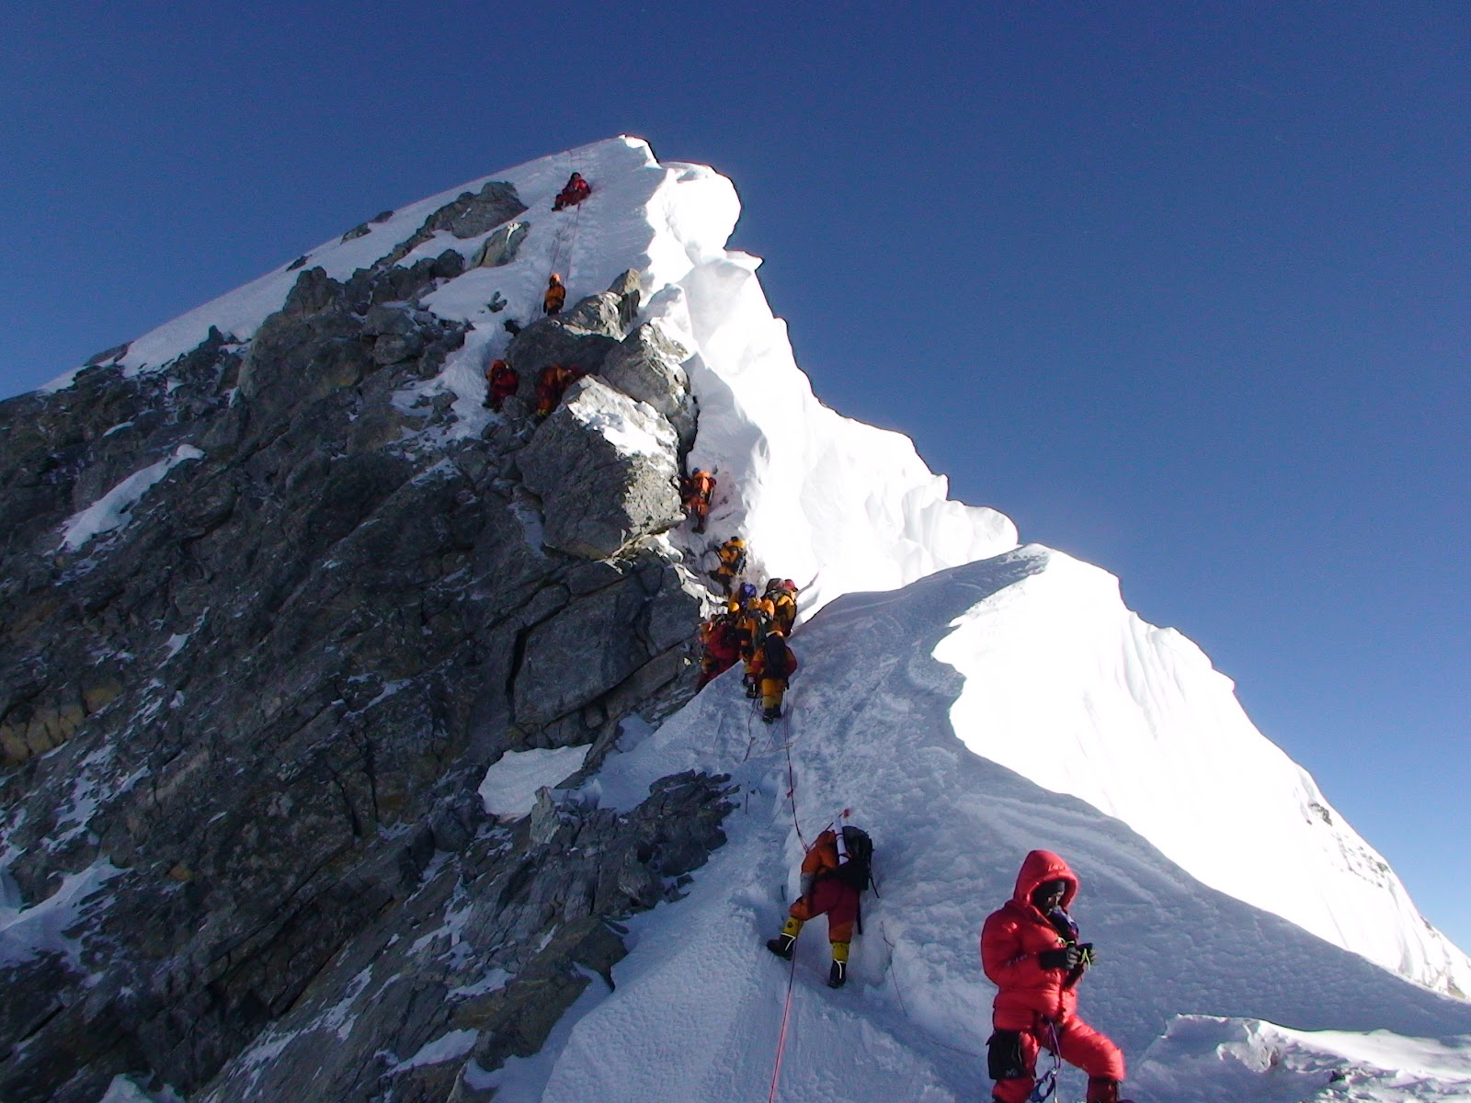
To a successful year
Thank you for Attending!!!

