Slide 1
How to Apply as a Special Student and Earn a UW-W Credential
Just follow these steps to start enrolling in classes soon!

Slide 2
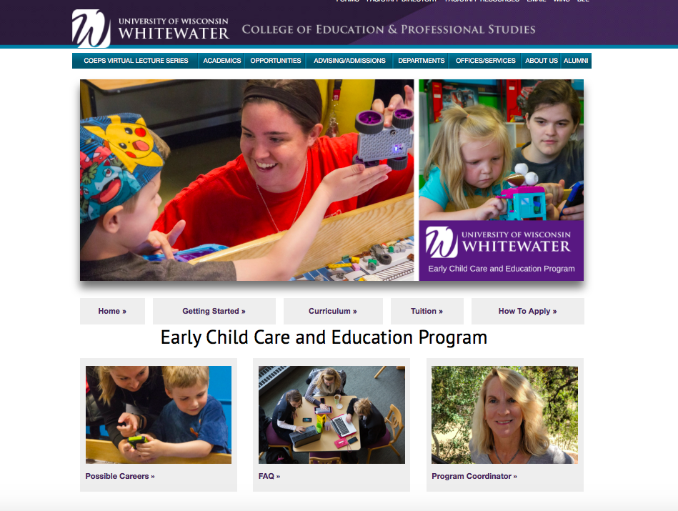
You can start at the ECCE Home Page on the UWW Website: https://www.uww.edu/coeps/departments/early-child-care

Slide 3
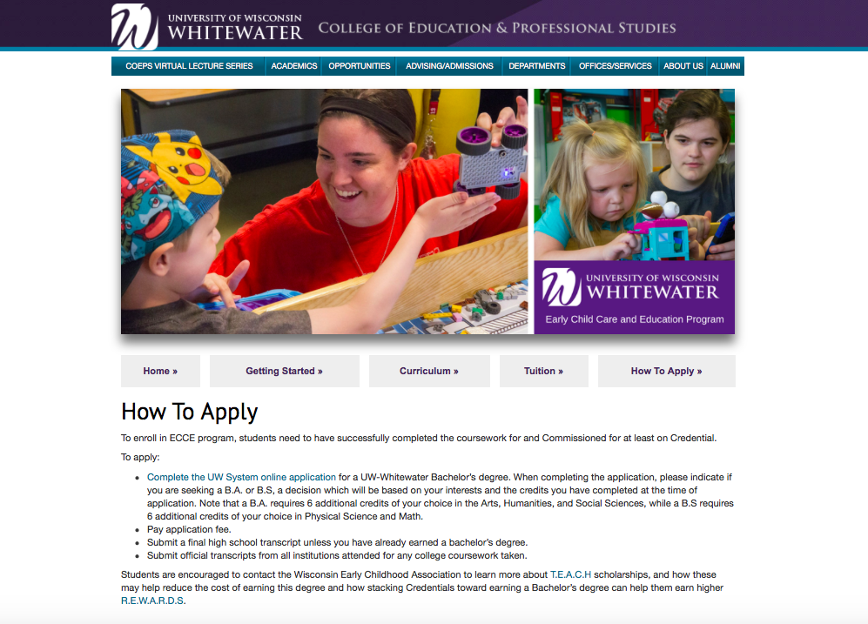
Click on the How to Apply tab in center right of page

Slide 4
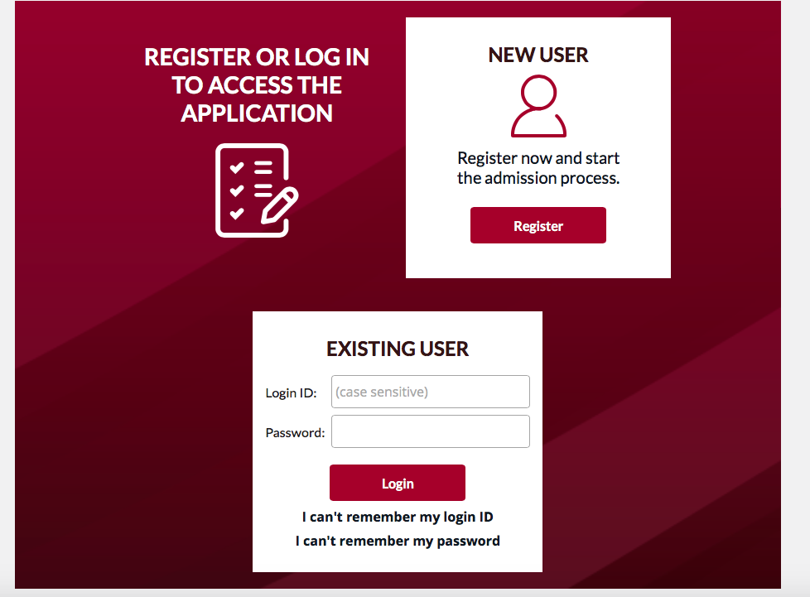
Indicate if you are a new user, or if you already have an account with the UW System.
If you don’t yet have an account, click on Register. If you have ever applied to the system before, enter your existing Login ID and password.

Slide 5
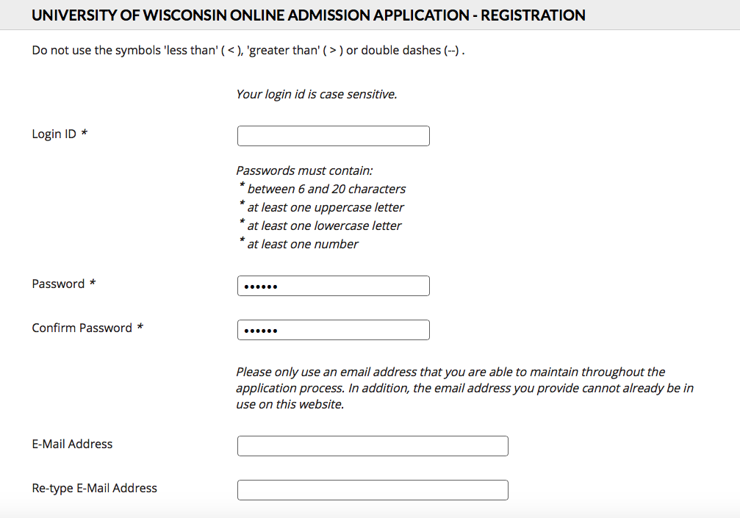
If you are a new user, establish an account within the UW System. Save your login information in case you need to get into the system again someday.

Slide 6
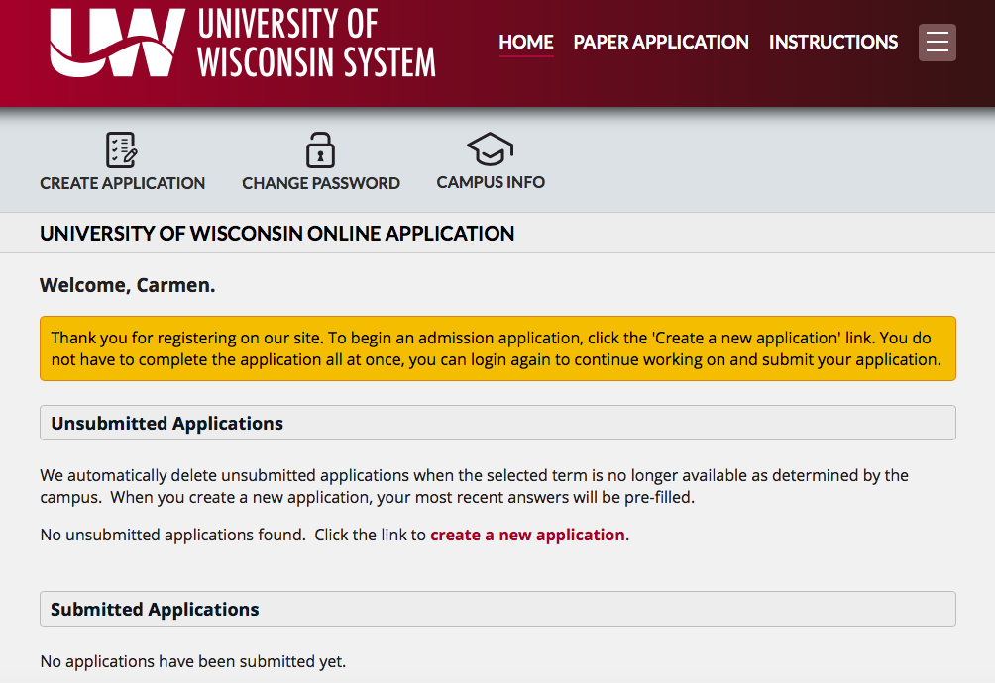
Once you are registered and logged in, the next page should welcome you to create a new application.

Slide 7
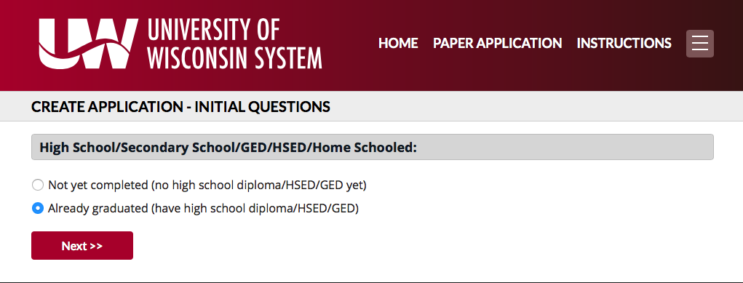
To enroll in classes to earn a Credential, you need to have already earned a High School diploma. Indicate that here. You will be asked to get official transcripts from your school and have them sent to our Admissions office.

Slide 8
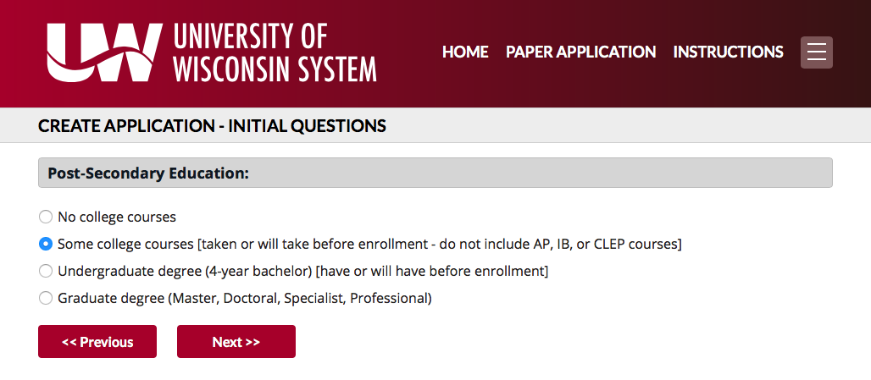
Indicate whether or not you have taken any college courses yet.
If you have earned any a Credentials or completed some or all of the courses for an Associate’s Degree, choose “Some college courses”.
If you already have a Bachelor’s Degree in some other field, choose “Undergraduate degree”

Slide 9
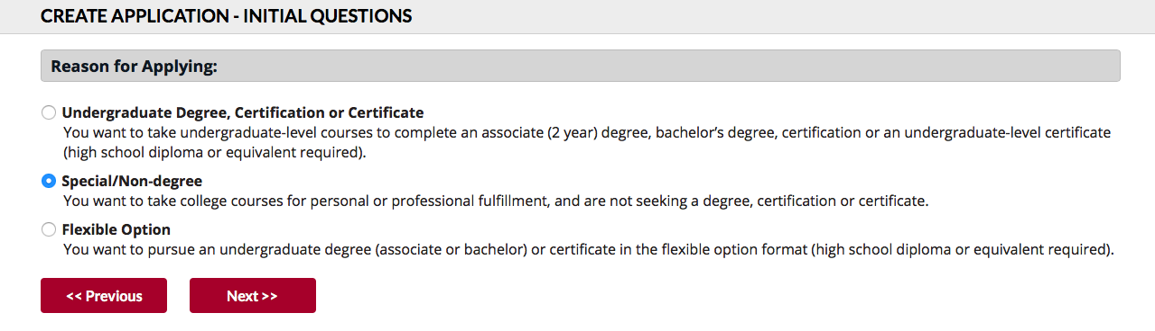
You are applying as a Special/Non-degree seeking student.

Slide 10
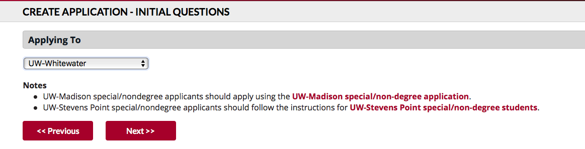
Indicate you are applying to take classes through UW-Whitewater.

Slide 11
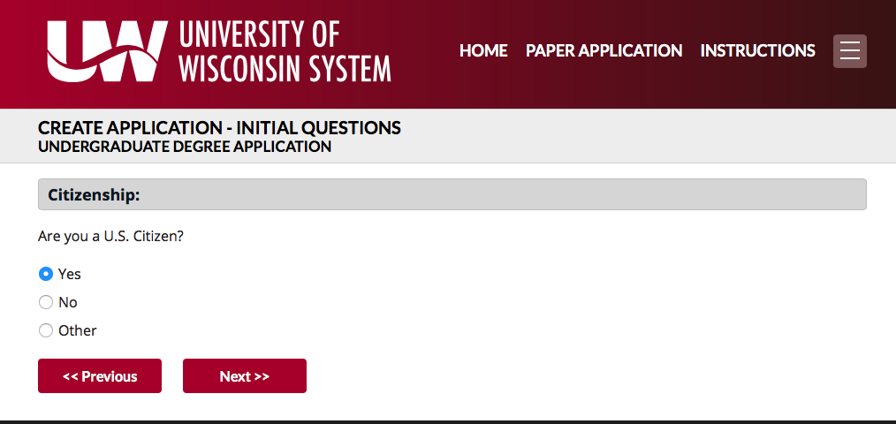
Indicate whether or not you are a US Citizen.

Slide 12
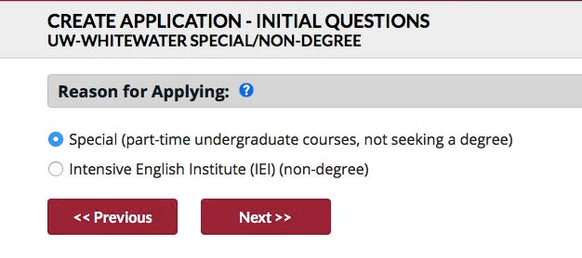
Since you are applying to enroll in classes toward a Credential, not a degree, indicate that here.

Slide 13
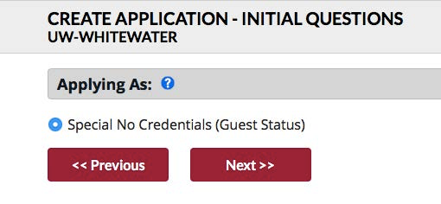
Confirm your Special, No Credentials Status here (even though you are working toward a Credential through The Registry).

Slide 14
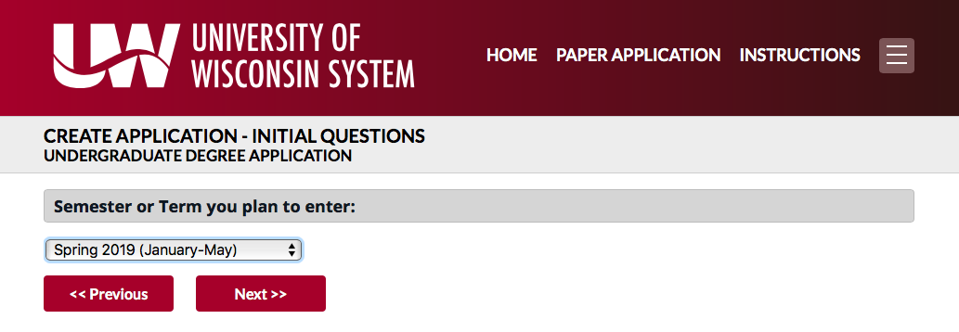
Choose the semester you want to start in the program. It will take at least one week for your application to be processed and approved, so give yourself enough time.

Slide 15
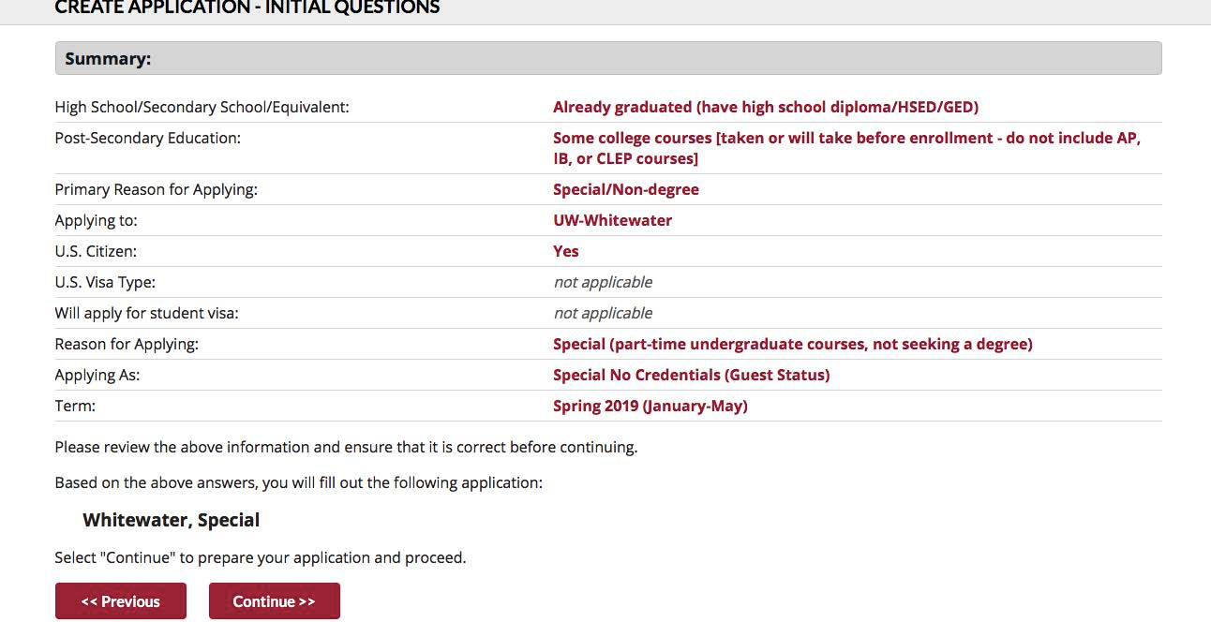
Always review your responses when asked to, and go back to make changes if needed.

Slide 16
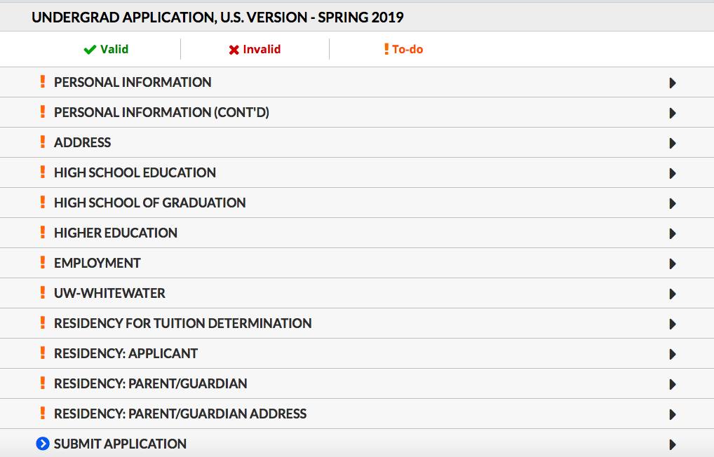
This application requires a LOT of information, just take it one page at a time.

Slide 17
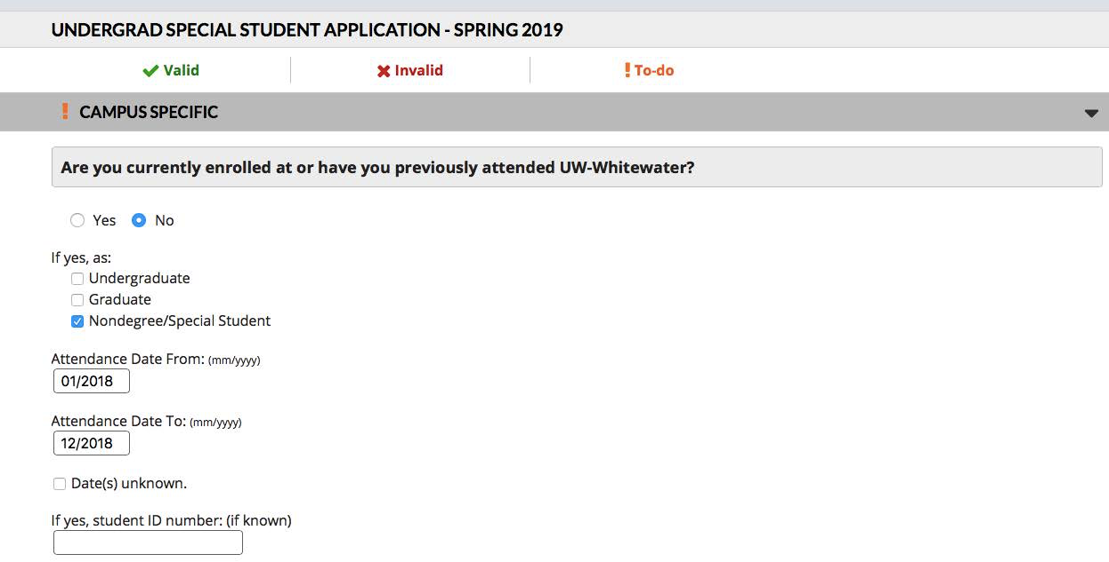
Answer these questions, including both semesters it will take to complete your Credential classes.

Slide 18
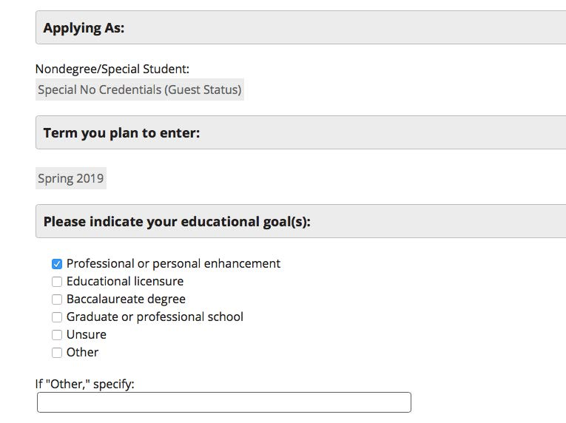
As a special student, taking courses for a Credential only, choose the right “Professional or Personal Goal”.

Slide 19
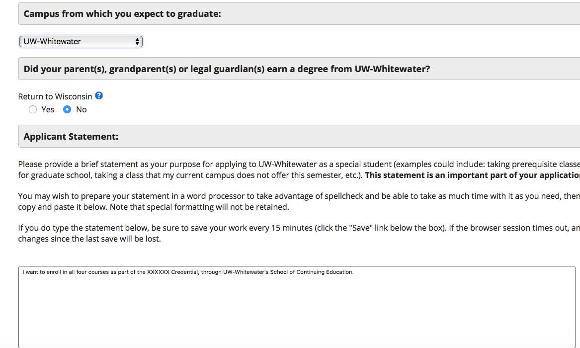
You WILL need to provide a brief statement explaining why you are applying as a special student. Just explain the Credential you want to earn by taking these courses.

Slide 20
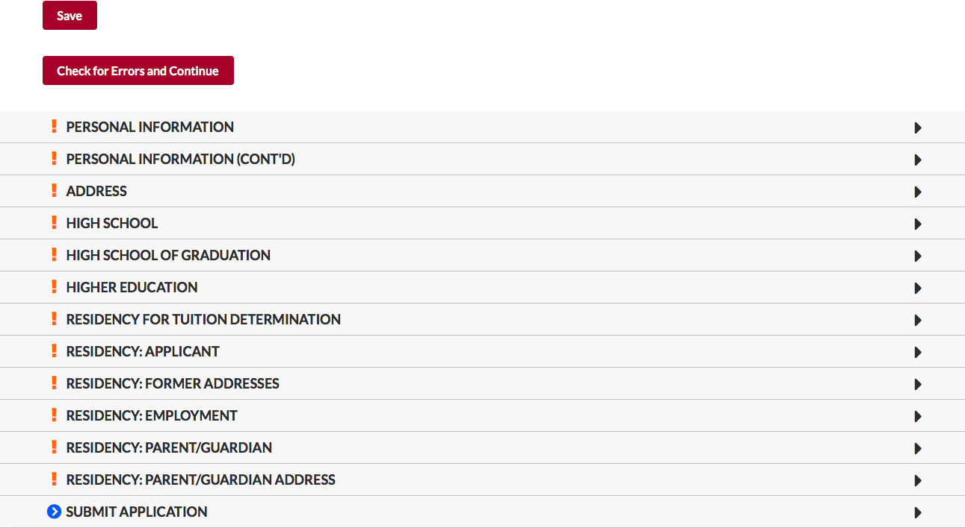
Continue to Enter information in each field, clicking Save often, and Check for Errors and Continue at the end of each page.

Slide 21
Need Help???
If you have any questions about the application process, please contact:
Carrie Lencho
Outreach Program Manager II
Roseman 2013
lencho@uww.edu
262-472-5208
For questions about the Credential or the ECCE
degree program, please contact:
Carmen Rivers
ECCE Program Coordinator
262-472-1802
riversc@uww.edu

Slide 22
Then what???
It should only take a week or so to process your Special Student application.
After you have been admitted, please do the following:
  Using the information received on your admission letter, log into your WINS account on the UWW website and accept the Terms and Conditions for enrolling at UWW
  E-mail Carrie Lencho at: lencho@uww.edu. Send her your name, UW-W student ID and the names of the courses you want to be enrolled into.
    Course One – Introduction to Dual Language in Early Childhood
      First 8 weeks of spring 2019
    Course Two – Components of a Quality Dual Language Program
      Second 8 weeks of spring 2019

