Slide 1
Invisible Wounds of War: Traumatic Brain Injury and Post-Traumatic Stress Disorder Affected Student-Veterans & Military Service Members
Richard Harris, MSW, APSW
Coordinator of Student-Veterans & Military Services
Last Updated: 02/04/2019

Slide 2
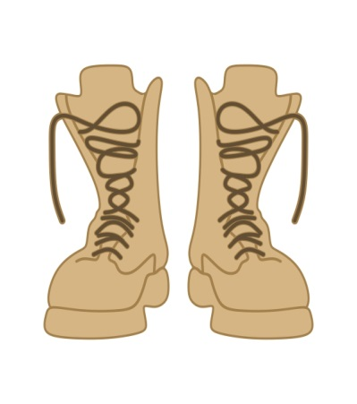
Combat2
It has been estimated that there is as much as a forty percent chance that individuals serving in Iraq and Afghanistan will acquire a cognitive injury prior to completing their tour of duty (Kato, 2010; Milliken, Auchterlonie, & Hoge, 2007; Tanielian, 2008; Radford, 2009; Shea, 2010).
The most prevalent of these cognitive injuries are Traumatic Brain Injury (TBI) and Post-Traumatic Stress Disorder (PTSD) (Kato, 2010; Shea, 2010).
University records and self-identification indicate that there are Veterans/Military Service Members that have returned from the battlefield and onto our campus in pursuit of a college degree with a TBI/PTSD, but are facing significant learning barriers to academic success.

Slide 3
Factors Impacting TBI/PTSD Affected Student-Veterans/Military
Service Members Enrollment, Retention and Academic Performance
Experiencing medical
and
mental health challenges
Reduced attendance & Poor Academic Performance
Inability to effectively communicate with faculty & other students

Slide 4
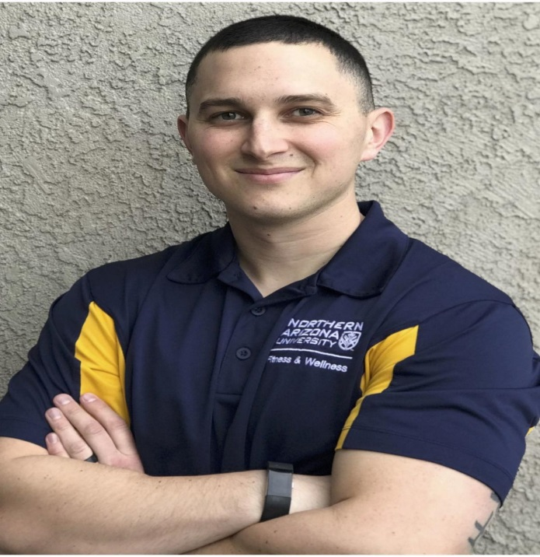
Taking Brain Injury From Combat to College
Army Veteran, Brian Hawthorne (George Washington University): “I would read one page and forget what I’d just read.” Fearing flunking out of college, Brian sought help on campus and was referred to the local Veterans Affairs Medical Center where doctors quickly diagnosed a mild TBI caused by his proximity to bomb blasts.
Marine Corps Veteran, Richard Gilbert (University of California-San Diego): Richard was diagnosed with a traumatic brain injury while he was deployed in Iraq. “Having a broken body – break your arm, put it in a cast, you’ll be fine…But with your brain, you can’t put a Band-Aid on it. You can’t put a brace on it before you take a test. It doesn’t work like that.”
Army Veteran, Brandon Corrales (Northern Arizona University): "The traumatic brain injury has made going to school very, very difficult, because it takes me a lot longer to process this information.

Slide 5
Game Changer!
The Department of Communication Sciences and Disorders has the unique ability to provide services that can lead to academic and social success for Military Veterans. This includes, but is not limited to, Veterans who are experiencing cognitive and/or linguistic deficits associated with Traumatic Brain Injuries.

Slide 6
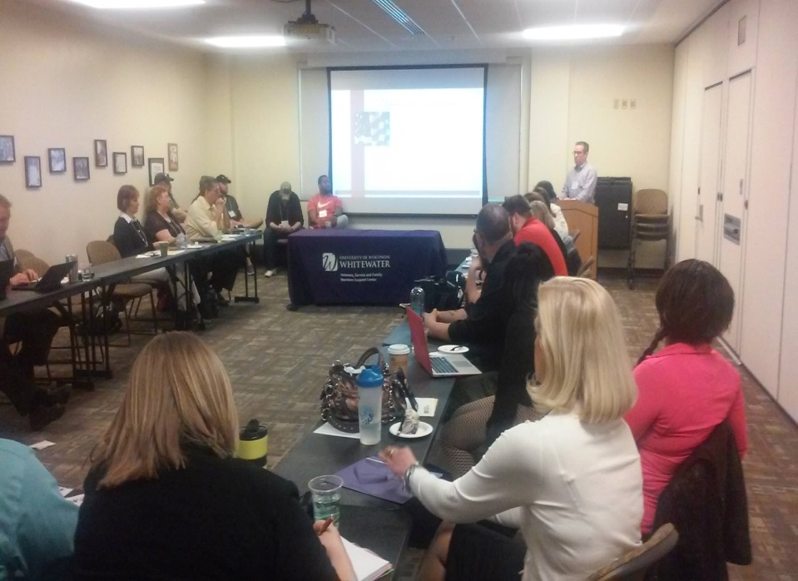
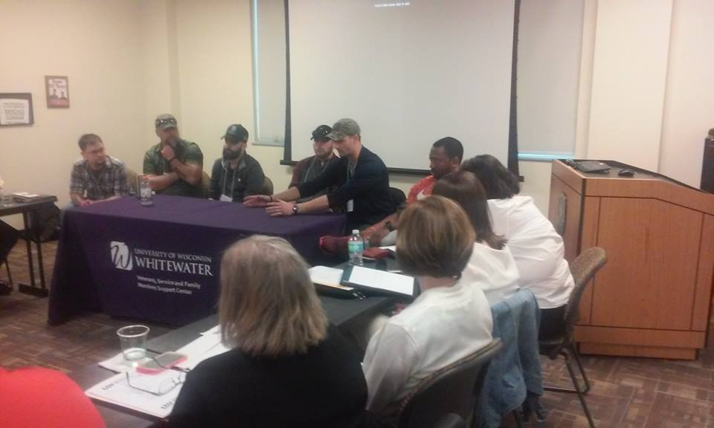
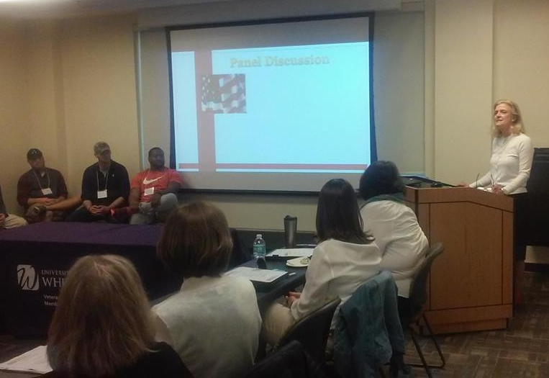
Campus Panel Discussion

Slide 7
Case Study #1
Student-Veteran (SV) states that he is a retiree from the US Navy and has prior service with the US Marine Corp. SV further states that he has been deployed to both Iraq and Afghanistan. SV also states that he has been diagnosed with traumatic brain injury (TBI) and post-traumatic stress disorder (PTSD). According to SV he receives medical/mental health care at the Madison VA Hospital and uses UW-Whitewater Center for Students with Disabilities services due to memory deficit. SV presents as being at-risk for poor academic performance and homelessness (several months behind in rent and received an eviction notice from his landlord).
Coordinator of Student-Veterans/Military Service Members (CSVMS) referred SV to HUD-VASH program for housing assistance, Madison VA Hospital to address issue of anxiety, Veterans Service Members Organization (CVSO) for academic support, University CARE Team Case Manager for counseling and Center for Students with Disabilities (CSD) for reasonable accommodations.
Outcome: SV received support from both on-campus and off-campus resources that met his needs. SV graduated with a Bachelor of Arts Degree as scheduled and recently reported being gainfully employed by a Veteran serving agency in the State of Wisconsin.

Slide 8
Case Study #2
Student-Veteran (SV) states that he is experiencing migraine headaches and having nightmares because of several concussions that he suffered during his deployment to Afghanistan. SV further states that he has been diagnosed with traumatic brain injury (TBI) and post-traumatic stress disorder (PTSD) and that he is not receiving medical/mental health care from any provider. SV presents as being at-risk for poor academic performance and homelessness as he is currently “couch surfing.”
Coordinator of Student-Veterans/Military Service Members (CSVMS) referred SV to HUD-VASH program for housing assistance, Madison VA Hospital to address TBI and PTSD, Veterans Service Members Organization (CVSO) for academic support, University CARE Team Case Manager for counseling and Center for Students with Disabilities (CSD) for reasonable accommodations.
Outcome: SV received support from both on-campus and off-campus resources that met his needs. SV graduated with a Bachelor of Arts Degree as scheduled and recently reported being gainfully employed by a local law enforcement agency in the State of Wisconsin.

Slide 9
Case Study #3
Student-Veteran (SV) contacted CSVMS by phone and seemed to be in distress stating, “I tried my best to handle my school stuff on my own, but I should have asked for help sooner.” SV stated that he has been having trouble sleep for the past several weeks and staying awake to avoid nightmares. SV further states that he was diagnosed with PTSD because of his combat tour in Afghanistan where several of his “buddies” were killed in action. SV went on to state that he went through depression recently when a close friend of his (who happens to be the same age) died of a heart attack. SV informed CSVMS that he receives medical/mental health services from the Milwaukee VA Medical center. SV presents as being at-risk for poor academic performance as he is concerned that he has failed a class and will not graduate on time and difficulty sleeping.
Coordinator of Student-Veterans/Military Service Members (CSVMS) referred SV to Milwaukee VA Center to address PTSD and depression, Veterans Service Members Organization (VSO) for academic support, University CARE Team Case Manager for counseling and Center for Students with Disabilities (CSD) for reasonable accommodations.
Outcome: SV received support from both on-campus and off-campus resources that met his needs. SV graduated with a Bachelor of Arts Degree as scheduled and recently reported being gainfully employed by a business firm in the State of Wisconsin.

Slide 10
Cross-Campus Collaboration
Goal | Objectives
Utilize Campus-Based resources to address the concern reported in recent research findings that indicate the transitioning population of OEF/OIF/OND Student-Veterans/Military Service Members may face potential learning challenges associated with TBI and PTSD | Collaborate with the following Campus-Based resources to bring awareness of medical and mental health services available to the Student-Veterans/Military Service Members on the University of Wisconsin-Whitewater’s campus affected by TBI/PTSD: Center for Communication Sciences and Disorders Beth Swanson, Director swansonb@uww.edu (262) 472-5204 University of Wisconsin-Whitewater Health & Counseling Services (UHCS) Jim Freiburger, Director freiburj@uww.edu (262) 472-1305 Center for Students with Disabilities Elizabeth Watson, Director watsone@uww.edu (262) 472-1630

Slide 11
Community-Based Collaboration
Goal | Objectives
Utilize Community-Based resources to address the concern reported in recent research findings that indicate the transitioning population of OEF/OIF/OND Student-Veterans/Military Service Members may face potential learning challenges associated with TBI and PTSD | Collaborate with the following Community-Based resources to bring awareness of medical and mental health services available to the Student-Veterans/Military Service Members on the University of Wisconsin-Whitewater’s campus affected by TBI/PTSD: Madison VA Hospital Jay White, LCSW Transition & Care Program Manager John.Whitefb57b@va.gov (608) 256-1901 ext. 11952 Cell: (920) 515-3918 Madison VA Hospital Jeff Johnson Patient Advocate (608) 256-1901 ext 17422 Cell: (920) 222-1231

Slide 12
Service Delivery Model
Step #1
Coordinator of Student Veterans Military Services is Contacted
Step #2
Engagement and Needs Assessment Documented
Step #3
Appropriate Referrals are Made

Slide 13
Coordinator of Student-Veterans
& Military Services Outcome Measurement
Total Referrals Made to CSVMS | Self-Referrals Made to CSVMS | Third Party Referrals Made to CSVMS | CSVMS Referrals Made to Campus-Based Resources | CSVMS Referrals Made to Community-Based Resources
9 | 6 | 3 | 9 | 9

Slide 14
Q & A
University of Wisconsin-Whitewater HarrisR05@uww.edu (608) 718-6120

Slide 15
Works Cited
Church, T. E. (2009). Returning veterans on campus with war related injuries and the long road back home. Journal of Postsecondary Education and Disability, (22)1, 43–52.
Kato, L. (2010). The psychological adjustments of veterans returning from Afghanistan and Iraq. (Doctoral dissertation). Retrieved from ProQuest Dissertations and Theses database. UMI (3426110).
Madaus, J. W., Miller, W. K., & Vance, M. L. (2009). Veterans with disabilities in postsecondary education. Journal of Postsecondary Education and Disability, (22)1, 10–17.
Milliken, C. S., Auchterlonie, J. L., & Hoge, C. W. (2007). Longitudinal assessment of mental health problems among active and reserve component soldiers returning from the iraq war. JAMA: The Journal of the American Medical Association, 298(18), 2141–2148.
Radford, A. (2009). Military service members and veterans in higher education: What the new GI Bill may mean for postsecondary institutions Washington, DC: American Council on Education.
Shea, K. (2010). The effects of combat related stress on learning in an academic environment: A qualitative case study. (Doctoral dissertation). Retrieved from ProQuest Dissertations and Theses database. UMI (3438652).
Tanielian, T. (2008). Invisible wounds of war: psychological and cognitive injuries, their consequences, and services to assist them (T. Tanielian & L. Jaycox, Eds.). Santa Monica, CA: Rand Corporation.

