Slide 1
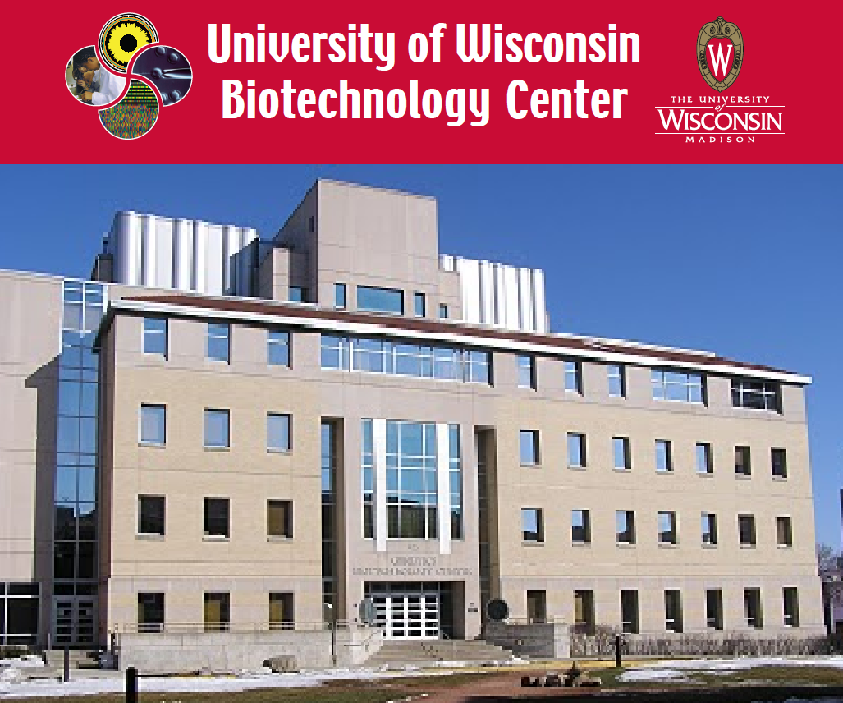

Slide 2
Chris Bradfield, PhD
Professor, Department of Oncology
Director, University of Wisconsin
Biotechnology Center
Email: bradfield@oncology.wisc.edu
Telephone: 608/262-2024

Slide 3
About UWBC:
Employs roughly 60 faculty, staff, and students
FY19 Fee-for-service receipts: $5.4 million
400 Customers
6,661 orders
29 Non-UW-Madison University System Faculty (No Indirect Costs)

Slide 4
Core Facilities:
Bioinformatics Resource Center
DNA Sequencing Core
Gene Expression Core
Mass Spectrometry Core
Gene Editing Core
Animal Models Core
BioGarage (In Development)

Slide 5
Bioinformatics Resource Center (BRC)
Next-gen sequencing data analysis
Genome assembly
WGS resequencing analysis,
mRNAseq
ChIPseq
Metagenomics
Project specific data analysis (Pathway analysis, meta-analysis, data integration, etc.)
Consulting and training
Consult for experiment design and data analysis
Grant application support
Workshops and in-person training
Computing
Host and maintain servers for remote use by labs or centers.
Free access to two Linux servers with 8-cores & 40GB RAM
Install and maintain software for data analysis
Notes:
<data analysis>
BRC has built several pipeline to analysis common next-gen sequencing data. for example, DNA resequencing pipeline for finding variation in the genome; ChIPseq to reveal DNA-protein binding patterns; mRNAseq pipeline to identify deferentially expressed genes; and metagenomics workflow to analyze microbiome data. Current we are building a few new pipelines for other types of NGS application.
Large portion of NGS data analysis do not fall into these "common" data analysis, BRC works with investigators to plan data analysis strategies for their specific projects. We often work on projects that integrate results from different types of experiment. Researchers on campus are really creative in using cutting edge technology in new ways, and we are able to work with them to solve the question they are after.
<consulting and training>
BRC also spends significant amount of time meeting with researchers for experiment design consultation, and consult on the analysis strategies for their data. We have been providing this consulting service for free.
Sometime these consultation turn into grant application opportunities, and BRC provides all level of grant supports, from fully participation in the grant application to just providing a letter of support.
Other times, these consultation also bring up the training requests. BRC meets those requests by training researchers to analysis their own data set in hand-on training sessions. And BRC host data analysis workshops each semester. So far every workshop has been over-subscribed, and additional workshops had to be made available to meet the needs. The upcoming workshop information is posted on BRC's website. check out if interested.
<other information> On a related note, BRC is updating its web pages. currently you will see the BRC contact information, types of service BRC offer, and resources you can access through BRC. Soon you will see these information in a better organized format. and examples of data analysis results.

Slide 6
DNA Sequencing
Offers DNA extraction, quantification, sequencing, and genotyping services
Sanger (one million base pairs per day)
ABI 3730xl
Next-Generation (3 trillion base pairs per day)
Sequencer | # sequences | Read length | Turnaround
Illumina NovaSeq | 10B+ | Short/medium | Short
Illumina MiSeq | 15-20M | Medium | Short/med
PacBio Sequel | ~0.5M | Long | Short
Oxford Nanopore GridION | 1-2M | Ultra-long | Short
Notes:
Is the process of reading the nucleotide bases within a DNA molecule.

Slide 7
DNA Sequencing
UW Collaborations:
Clinical Sequencing: State Lab of Hygiene, UW Hospital and Clinics
Ancient DNA: Department of Defense
National Institute of Standards and Technology (NIST)
Protocol Evaluations (Broad based)
Whole Exome Comparison
Hi-C Library Prep for Genome Assembly and Chromatin Looping
High Throughput / Low Cost Plasmid Sequencing and Assembly
Cas9 targeted Enrichment for Long Read Libraries, 5kb+
Notes:
Whole Exome – five library preps (Agilent, Roche-Nimblegen, Ion Torrent, Illumina) across two platforms (Illumina and Ion Torrent)
Single Cell – tumor cell profiles, microbiome - identification of rare organisms, embryos for in vitro fertilization
Circulating Cell Free – fetal cells/prenatal, circulating tumor DNA (ctDNA)

Slide 8
Gene Expression Center (GEC)
-RNA extraction (cell, PMBC, tissue, etc.), quantification and integrity analysis
-10X Genomics Single Cell RNA (scRNA)- 3’ scRNA expression, Immune profiling V(D)J (human and mouse), single cell ATAC, Hash tagging and Feature barcoding
-Illumina RNA Seq (short-read sequencing)- RNA standard and ultra-low RNA input (mRNA and rRNA reduced) and miRNA library preparation
-PacBio and Oxford Nanopore (long-read sequencing)- RNA standard library preparation
Notes:
This Center enables investigators to study an organism’s entire transcriptomtiongenotype gives rise to the phenotype. qPCR – quantitative real time polymerase chain reaction

Slide 9
Gene Expression Center
-Illumina Microarray- genotyping and methylation
-UW Collaborations- Clinical Microarrays: State Lab of Hygiene, Dept. of Pathology, UW Hospital and Clinics
-Technology Evaluation- Visium Spatial Transcriptomics (spatial gene expression)
-Consulting and Training-
-Consult for project experimental designs
-Train clients for independent usage of GEC
instrumentation

Slide 10
Mass Spectrometry
Proteomics, Metabolomics, Lipidomics, Intact Proteins, Drugs/Small Molecules
Comprehensive Biomolecule Analysis
Discovery phase (untargeted) and validation (targeted) experiments with a wide variety of instruments
Qualitative and quantitative proteomic, metabolomic, and lipidomic profiling of complex mixtures and biological matrices
Extensive assistance with experimental design and data interpretation for publication and grant support

Slide 11
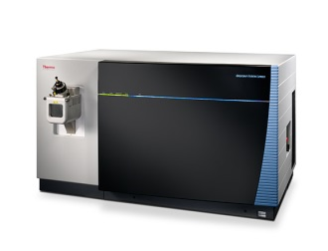
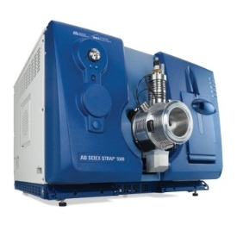
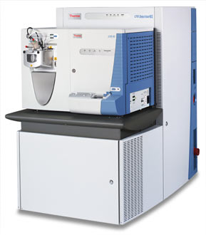
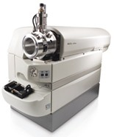
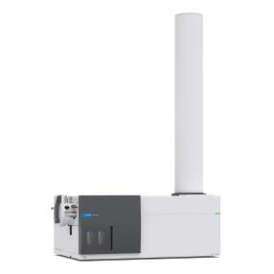
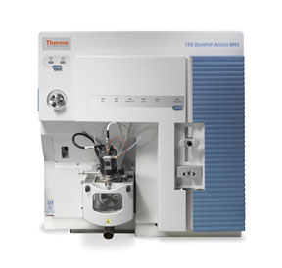
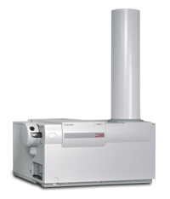
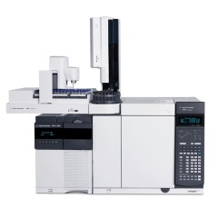
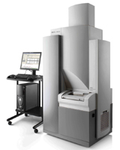
Mass Spectrometry
AB Sciex 5500 QTRAP (Proteomics, metabolomics, small molecules)
ThermoFisher Orbitrap Fusion Lumos (Proteomics)
ThermoFisher Orbitrap Elite (Proteomics)
Sciex 3200 QTRAP (Metabolomics, small molecules)
Agilent 6546 ESI-QTOF (Lipidomics, metabolomics)
ThermoFisher TSQ Quantum Discovery Max (Metabolomics, small molec.)
Agilent 6210 ESI-TOF (intact proteins, metabolomics, small molecules)
Agilent 7890/5977 GC/MS (small molecules, metabolomics)
Sciex 4800 MALDI TOF/TOF (Proteomics, intact proteins)
Notes:
Oligo – Greek for having few – is a short nucleic acid polymer, typically with 50 or fewer bases.
Oligosaccharide – Greek for Oligo “few,” sacchar “sugar,” is a saccharide polymer containing a small number (typically 2 to 10) of component sugars.

