Slide 1
Export Control, Fundamental Research and Award Clauses
Wisconsin Research Administrators Network Symposium
October 2019

Slide 2
What is Export Control?
Export control consists of a group of federal laws / regulations that control certain commodities, technologies, information and data
Limits what can be shipped out of the country and to whom it can be shipped
Can limit access to information for certain foreign nationals and/or organizations
Determines when a license is required to ship items or information abroad

Slide 3
Export
Physical Export: Sending or taking anything out of the United States in any manner, except mere travel outside of the U.S. by a person whose personal knowledge includes technical data; including:
Shipping – commercial shippers or hand-carry
Verbal transfer of technical data (i.e., phone, Skype)
Electronic transfer of technical data (i.e., e-mail, fax, text, social media)
Items: computers, equipment, biological agents, materials, substances, etc.
Deemed Export: Transfer (oral or visual disclosure) of technology, information or data to a foreign person within the U.S. is deemed to be an export to that person’s home country

Slide 4
Regulations

Slide 5
Restricted Parties
Lists of persons, organizations, governments, and Universities that US Universities can have limited, minimal, or no contact with
Over 40 lists across multiple government agencies including Commerce, State, Treasury, and the FBI
Ex. Beihang University, UESTC
Federal Regulations Impacting Research at US Universities
Controlled Unclassified Information(CUI)
National Archives
Identified information that is prohibited from public release, but not classified
NIST standards govern the protection of CUI
Ex. HIPPA data
Foreign Asset Control Regulations(FACR)
Treasury Department through the Office of Foreign Asset Control(OFAC)
Oversees embargoes and sanctions on a variety of countries
Significantly limits interactions with Iran, Syria, Sudan, North Korea, and Cuba
Export Administration Regulations(EAR)
Commerce Department through the Bureau of Industry and Security(BIS)
Dual-use items
Commercial Items that could have a military purpose
Laptops, lasers, semiconductor equipment
International Traffic in Arms Regulations(ITAR)
State Department through the Directorate of Defense Trade Controls(DDTC)
Controlled military equipment
Tanks, guns, certain scientific equipment, spacecraft, satellite
Includes embargoes and sanctions prohibitions
National Defense Authorization Act(NDAA)
Yearly bill passed by Congress with requirements for obtaining research dollars from DoD
Nuclear Regulatory Commission(NRC)
Overseas import and export of nuclear equipment and materials
National Institute of Standards and Technology(NIST)
Commerce Department
Standards for protecting Controlled Unclassified Information(CUI)
Customs and Border Protection(CBP)
Homeland Security
Requires Automated Export System(AES) filings for licensed items and items worth more than $2500
Authorized to search electronic devices like phones and laptops at the border
Visas
Certain visas require export control review
Classified Research
Office of the President
Protects sensitive, military research
Defense Federal Acquisition Regulations(DFARs)
Implements NIST and CUI requirements on DoD contracts
Separate requirements for Controlled Technical Information(CTI), which is related to CUI
Select Agents
Potentially harmful biological agents
Ex. Ebola
Federal Acquisition Regulations(FAR)
General Services Administration(GSA), NASA, and Secretary of Defense
Prohibits Universities that receive federal funds from contracting with certain companies
Ex. ZTE, Huawei, Kaspersky
Foreign Corrupt Practices Act(FCPA)
Justice Department
Anti-bribery regulations
United States Patent and Trademark Office(USPTO)
Secrecy orders & certain licenses
Foreign Conflicts of Interest
Multiple agencies
Researchers must disclose their relationships with foreign parties
This information is not intended to be used for compliance determinations. Consult the applicable regulations to determine requirements
Dual Use Research of Concern(DURC)
Covers life science research that could be directly misapplied to pose public health and safety concerns. Ex. Select agents
AND MORE!

Slide 6
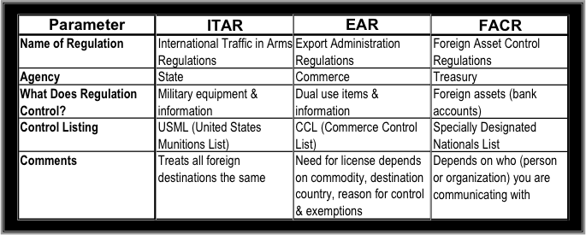
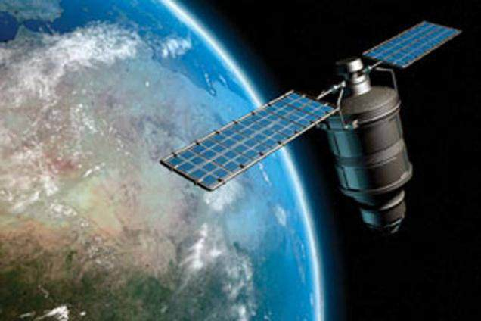
Key Regulations
Examples:
Satellites, select agents, lasers, laptops

Slide 7
Restricted Party Screenings
Restricted Party Screenings(RPS) are an important part of any export control program.
Screening ensures that restricted parties are identified prior to proceeding.
Interactions with SOME restricted parties are allowed if:
A license is granted
Only fundamental research is done
Only public domain information is discussed.
DO NOT proceed with interactions with a restricted party until a plan for the interaction is made.
There are paid tools for screening.
Visual Compliance(UW-Madison uses), and Amber Road
These screen against more than 60 different lists.
The Consolidated Screening Lists(CSL) is a free tool by the US government that screens against 8 lists.
https://www.export.gov/csl-search

Slide 8
Key Exemptions for Universities
Fundamental Research Exemption (ITAR, EAR)
No license is required to conduct fundamental research, “research in science, engineering or mathematics, the results of which ordinarily are published and shared broadly within the research community and fro which the researchers have not accepted restrictions for proprietary or national security reasons.
Public Domain Exemption (ITAR, EAR)
No license is required to export information or research that are generally available in the public domain. This does not apply to physical equipment, materials, substances, etc.
Education Exemption (ITAR, EAR)
No license is required to transfer information to students, including foreign nationals, concerning general scientific, mathematical or engineering principles commonly taught in schools, colleges or universities

Slide 9
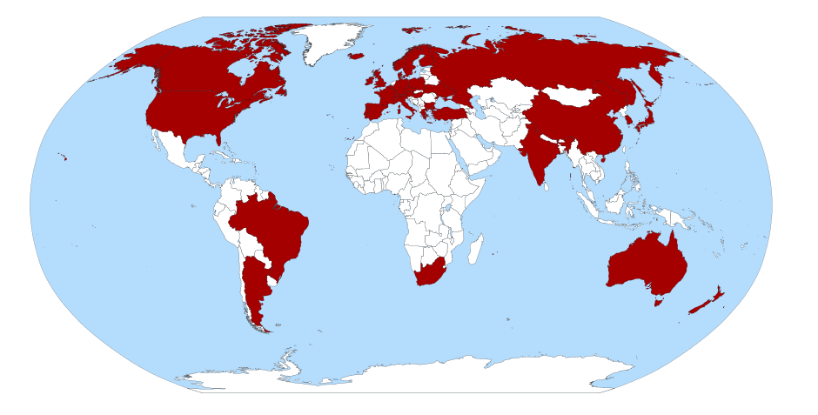
Potential Responses to Export Control Issues
License
Not the “end of the world”, but will take 1-2 months
Technology Control Plan
Implements a formalized system of security that is monitored on which all staff are trained
Training
Do Not Accept the Award-Extremely Rare

Slide 10
International Shipping and Travel
Key Points:
Is the item being shipped Export Controlled?
Are you engaging with a restricted party?
Hand Carry=shipping
There is no difference in taking an item on a plane in your bags and shipping it overseas from an export perspective.
E:1/E:2 Countries: Cuba, Iran, North Korea, Sudan, Syria – Major restrictions
North Korea is known as the Democratic People’s Republic of Korea
OFAC & US Embargo List: Balkans, Belarus, Burundi, Central African Republic, Cuba, Congo, Iran, Iraq, Lebanon, Libya, N. Korea, Somalia, South Sudan-related, Sudan, Syria, Ukraine-related (Russia), Venezuela, Yemen-related, Zimbabwe
ITAR Prohibited Countries (22CFR 126.1): Afghanistan, Belarus, Burma, Central African Republic, China, Congo, Cuba, Cyprus, Eritrea, Haiti, Iran, Iraq, Lebanon, Libya, N. Korea, Somalia, Sudan, Syria, Venezuela, Zimbabwe

Slide 11
Non-Compliance

Slide 12
Penalties of Non-Compliance
Civil and Criminal Penalties
May be levied against individuals as well as organizations
Loss of Research Funding
Loss of Export Privileges
Bad Press

Slide 13
Non-Compliance
J. Reece Roth-University of Tennessee (Sept 2008)
Retires professor in plasma physics
Convicted of 18 counts of conspiracy, fraud, and violating ITAR
Gave 2 grad students from China & Iran access to sensitive information
Accessed information in China
Sentence-48 months in prison
Worst case: 175 years in prison and $15.5 million fine

Slide 14
Award Clauses

Slide 15
Export Control Clause
Examples:
“The contractor hereby certifies that it will comply with all U.S. export control laws and regulations including but not limited to the International Traffic in Arms Regulations (“ITAR”) (22CFR 120-130), Export Administration Regulations (“EAR”) (15CFR 730-774) and regulations administered by the U.S. Treasury Department’s Office of Foreign Assets Control (“OFAC”) (31CFR 500-598).”
“UW certifies that no persons working on this project are on any country’s Restricted Party Lists.”
Actions:
This is a fairly straight-forward clause, but there is a requirement for restricted party screening.
Contact your Export Control Office for the screening.

Slide 16
Publication Restrictions
Example:
The sponsor shall approve any and all research findings (from this award) prior to those findings being published.
Key Points:
Approval is a bad term – can the sponsor limit what you can publish (substance-wise)?
Publication restrictions remove the fundamental research exemption
Short review (30-60 days) for patentability, IP or confidential information, or a review and comment period that does not affect the ability to publish OK
Actions:
Remove clause
All or significant portions of your research may not be publishable
If the clause cannot be removed
Determine whether the UW can accept a project with a publication restriction
If acceptable, how does the project need to be structured to ensure compliance to the export control regulations (i.e., licenses, staffing, location, security)

Slide 17
Personnel Restrictions
Example:
No foreign persons may work on this project without authorization of the sponsoring agencies program manager.
Key Points:
This does not necessarily remove the fundamental research exemption, but does present a red flag.
If the project really is export controlled, a deemed export license may be required for foreign persons to participate.
There are possible antidiscrimination issues that would need to be worked out with legal.
Mere authorization by the program manager may be inadequate.
Actions:
Remove clause
If the clause cannot be removed
Clarify whether the project is export controlled and its classification

Slide 18
Material Transfer Agreements (MTAs)
An export license may be required for:
Some items, such as select agents
The destination country
Persons or organizations that are listed in government restricted party lists
All international, outgoing MTAs should be reviewed PRIOR to shipping.
It’s important that the shipment happens AFTER approval is given.
The consequences of sending items without the necessary licenses are severe.

Slide 19
DoD Funding (DoD Financial Management Regulation Vol 2B, Chap 5)
If called out in the award, DOD funding classifications are:
Budget Activity 1 (6.1) – Basic Research
Budget Activity 2 (6.2) – Applied Research
Budget Activity 3 (6.3) – Advanced Technology Development
Budget Activity 4 (6.4) – Advanced Component Development and Prototypes
Budget Activity 5 (6.5) – System Development and Demonstration
Budget Activity 6 (6.6) – Research, Development, Test and Evaluation Management Support
Budget Activity 7 (6.7) – Operation System Development
Key Points:
Only Budget Activities 1 and 2 qualify as fundamental research
Sometimes DoD will award basic or applied research to universities from a larger project that is export controlled
Actions:
Sometimes clarifying the funding classification will tell you if the project is export controlled

Slide 20
Non-Disclosure Agreements (NDAs)
AKA: Confidential Disclosure Agreement (CDA), Confidentiality Agreement (CA), Proprietary Information Agreement (PIA), Secrecy Agreement (SA)
Does the award require that a NDA be signed to ensure confidentiality of the information being transferred between the parties?
Key Points:
What type of information requires confidentiality?
Confidentiality of technical information may prevent the awardee from publishing some or all of the paper, which can nullify the fundamental research exemption
Personal, health (HIPAA), educational, business (finance) and marketing information are not typically affected by export controls
Actions:
It would be prudent to discuss with the awardee the type of information that will be transferred and whether it will have an export control impact

Slide 21
Recent Developments/On the horizon
Foreign influence
A lot of concern from DC over how to handle foreign influence(specifically in regards to China) in research.
ZTE
Can’t purchase things from them
Huawei
On the restricted party list.
Thousand talents program
DOD not allowing funding to anyone who has been or is associated with one.
DOE and NIH have issued memos with similar requirements.
Emerging Technology Rules

Slide 22
Scenarios

Slide 23
Scenario- Export Control Clause
With regard to exports and re-exports, you represent and warrant that no (COMPANY) software or service supplied to Licensee will be provided, directly or indirectly, to any person or organization (i) in Cuba, Iran, North Korea, Sudan or Syria, or who is consisted a part of the government of those countries. (ii) who is involved in Improper development or use of nuclear weapons, or of chemical/biological weapons (CBW) or missiles, or in terrorist activities, or (iii) who is listed by the government of the United States, or of any other country as prohibited from receiving the product, technology or service, or as prohibited from participating in export transactions involving the product.
Places restrictions on distribution to certain countries
Places restrictions on distribution to persons involved in WMD development and terrorism
Requires us to screen persons receiving the software
Action: Contact Export Control Office so they can run the necessary checks.

Slide 24
Scenario– Non-Disclosure Agreement (NDA)
The Institute for Educational Achievement on your campus
receives an award that requires a NDA so the institute can
receive educational records that include student names, IDs, classes,
grades and birthdates as well as other information.
Action: There is no export control compliance issue.
This information is ok to keep confidential without it affecting export control considerations.

Slide 25
Scenario-Shipping
The Pathobiological Sciences Department wants to ship PR8 to
the University of Munich under a Material Transfer Agreement.
Action:
Find out what PR8 is and determine if an export licensee is needed for.
PR8 is Puerto Rico 8 virus and a license is not needed for shipments.
Do an RPS check to ensure the University of Munich is not on a restricted list.

Slide 26
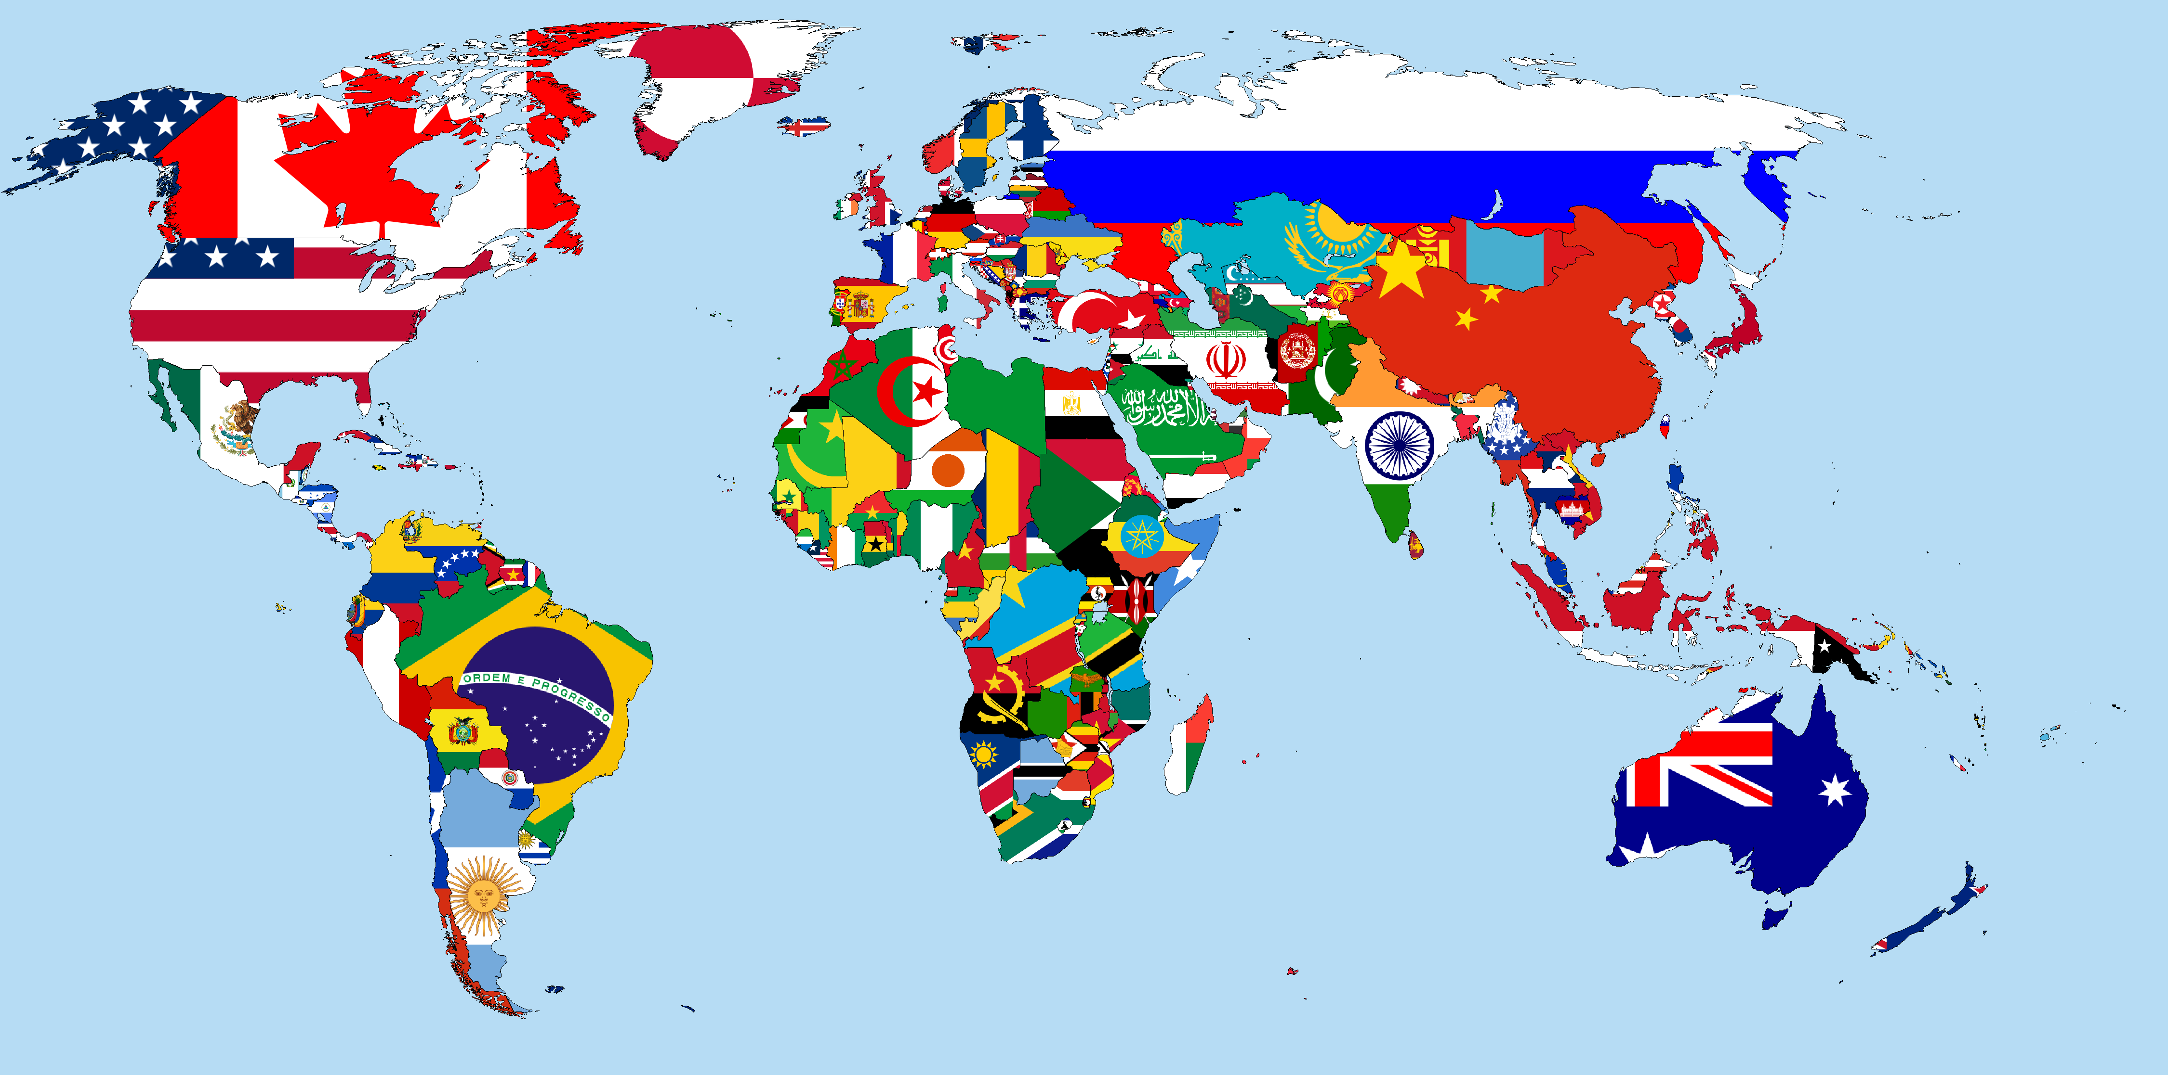
Scenario-International Travel
As part of an award, the PI is required to attend the annual
conference on biomaterials at Sichuan University, Chengdu, China.
Action:
Do a Restricted Party Screening to determine if Sichuan University is on a restricted list(it is).
Determine if there is anything that the PI is traveling with that would require a license.
What are the PI’s activities at the conference?

Slide 27
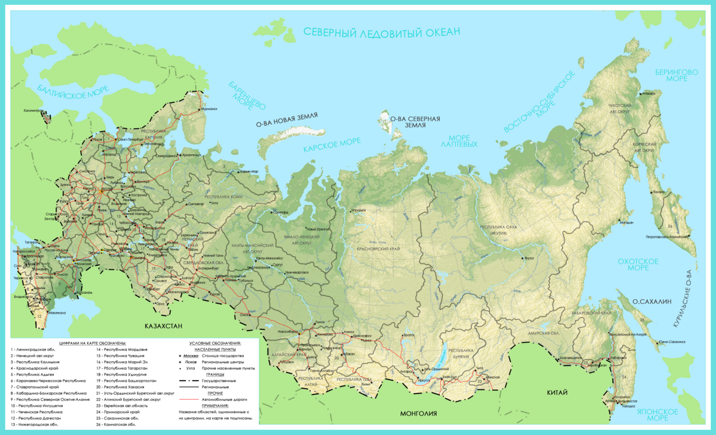
Scenario-Payment for Maps
The Geography department wants to purchase a series of maps
for publication in an upcoming book. The maps are only available
from state archives in Moscow, Russia. The archive only accept payment
through the Bank of Moscow.
Action: Contact the Export Control Office.
The ExCO will run a RPS check and discover that the Bank of Moscow is restricted.
Another payment method has to be pursued.
The ExCO may contact the Department of the Treasury to see if a license can be issued.

Slide 28
Presenters
Thomas A. Demke, D.D.S.
Export Control Officer
University of Wisconsin-Madison
tom.demke@ssec.wisc.edu
(608) 262-8659
Bethany C. Nelson, J.D.
Export Control Coordinator
University of Wisconsin-Madison
bcnelson2@wisc.edu
(608) 261-1128
You will find lots of free trainings and guidance on our website: https://research.wisc.edu/integrity-and-other-requirements/export-control/

