Slide 1
Conditional Admit Process
Welcome to UW-Whitewater!!

Slide 2
Conditional Admit Requirements
Summer 2019
Meet with your Disability Services Coordinator prior to program start
Attend SOAR and register for all developmental course work and Intraunv 104 New Student Seminar Course
Earn a cumulative grade point average of B (3.0) or above in Development Education Study Skills and Speced 201 Disability in Society
Have no unresolved university conduct sanctions including residence life

Slide 3
Fall 2019
Achieve a minimum 2.0 GPA for the fall semester
Note: This is not your cumulative GPA.

Slide 4
Fall 2019
Take all developmental course work (based on ACT scores)
Meet at least two times during Fall semester with your DSC
Cannot drop a course without DSC approval
Complete your Individualized Academic/Transition Plan

Slide 6
Fall Group Options
Did you and your DSC choose for you to attend a group as part of your Academic Transition Plan?

Slide 7
Fall Group Options
Details on group times for Study Skills, Well-being, and ON TASK groups will be e-mailed in September for groups starting in October

Slide 8
Fall Group Options
To join UHCS groups you would do an intake at UHCS this summer or early in fall, and let them know you want to join a group.

Slide 9
Complete your Individualized Academic/Transition Plan with your DSC, do the tasks you decided upon, get signatures and turn it in to your DSC!

Slide 10
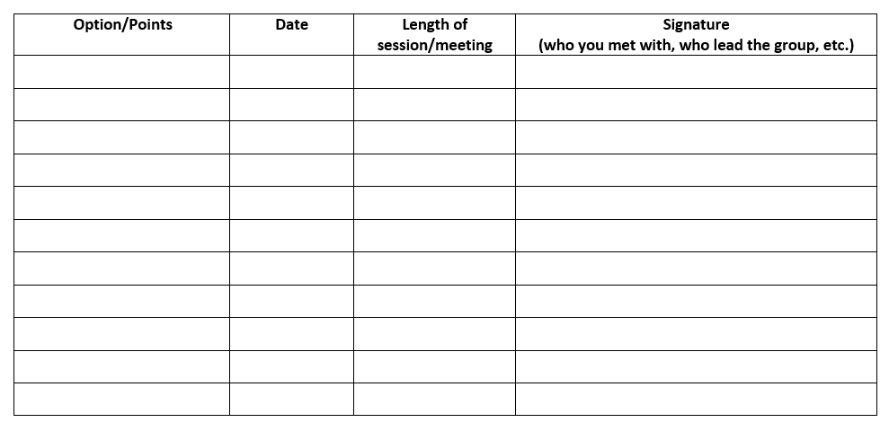
How can you keep track of this? Your DSC won’t have it until you turn it in… Ideas?

Slide 11
GYST Another resource for you!
What is it?
GYST is a program available to any student using CSD services for the first time. The purpose of GYST is to help you coordinate all of your CSD services and beginning of the year academic responsibilities. It gets you off to an organized start to the year!
GYST 1 consists of one approximately 30-minute meeting with your transition mentor. The two of you will double check that you have requested all your services and done all the necessary steps, review university systems (i.e. Canvas, WINs), and talk about some of the tasks you should be doing every day as a college student. If you attend a GYST 1 meeting, you will be given the option to have a GYST 2 meeting (to check in and see how things are going).
You have a GYST list in your fall orientation materials
E-mail your transition mentor to set up a time to meet

Slide 12
What happens when you have completed STP, your Academic/Transition Plan, and got the grades you need for summer and fall?

Slide 13
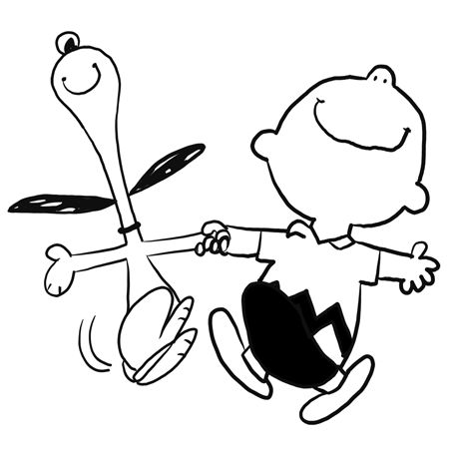
Conditional Admit Process
Once you have met all of the requirements and achieved 12 college level credits at a cumulative 2.0 or above, you are released from the contract.

Slide 14
What happens if you don’t make the grades that you need? But you are very, very close, and you have done everything else right?

Slide 15
You might be offered the opportunity to appeal to be reinstated… and if that happens here is what you will need to do:

Slide 16
Spring 2020
For students on academic probation or reinstated, you must:
Make and Complete an updated Individualized Academic/Transition Plan with your DSC
Meet at least 2 times with your DSC
Get DSC approval before dropping a course

Slide 17
Tips for success
Go through syllabi & add dates to calendar system
Put ‘study times’ in to your calendar
Check, read & delete email everyday
Check Canvas/D2L for any class updates
Attend advising meeting, schedule 2nd one
Turn things in on time
Study each day; 2-3 hours for every hour in class
Find the best place for you to study!

Slide 18
More tips for success
Utilize your resources!
Ask for help right away
Meet with your Disability Services Coordinator: we can help with anything, and we can help better if you come to us sooner

Slide 19
Questions?
Center for Students with Disabilities
Andersen Library, room 2002
(262) 472-4711

