Slide 1

Project ASSIST
What should you, as the student, know about the program?

Slide 2

What is Project ASSIST (PA)?
PA is a supplementary fee-based program
PA provides comprehensive and individualized support services to students
Our intention…
  empower students with the tools to find strengths, skills and abilities within themselves to become successful at the college level
$ 900 per semester
Notes:
We have reduced the price to make it more accessible.

Slide 3
Individual Academic Tutors
Assist students in identifying his/her "academic" learning styles and/or modes of learning and identify resources to meet these needs
Meet with you one-on-one
Paired with based upon:
  If he/she has taken the course
  If he/she has much experience/knowledge in certain field of study
Schedule specific times to meet during week
  What is the availability in both of your schedules?

Slide 4
Contacting/Meeting with Tutors
Receive tutor contact information (as they also receive yours) within the first two weeks of the semester.
  Phone # and e-mail address given
It’s in your best interest to contact tutor immediately
  Schedule an ‘introductory’ meeting to discuss schedules, syllabi, etc.
  Discuss how often you’d like to meet with your tutor
Remember:
  You need to schedule your meetings ahead of time…get a good start on projects/papers early on!
  Tutors cannot drop everything in their life in order to help you on an assignment that’s due the next day

Slide 5
How to Schedule Meetings
Set consistent schedule with tutor to meet each week, throughout the whole semester
  EX: meet every Tu/Th at 3:30pm in the Library
Both student/tutor mark calendar/planner as a reminder of meeting times
Know that this can be subject to change!
  Both parties need to be flexible when it comes to scheduling
  How often you meet with one another should not be ‘far-fetched’
    EX: Need to meet 4x/week, each session lasting 3 hours
    Such an example may question your reasoning for tutoring and your motivation to learn as a student
All meeting times will be recorded by Project ASSIST coordinator

Slide 6
Your Responsibilities
Supply information to tutors about education needs/learning styles
  How do you learn best?
Meet with my tutor on-campus (Project ASSIST, the Library, the UC, etc.)
  Permission must be given by Becca Harris to tutor elsewhere
Always bring class notes, books, or assignments to the sessions
Come to sessions prepared with homework attempted and questions to ask tutor

Slide 7
Your Responsibilities (Cont’d)
Come to sessions ready to work on strategies to improve your learning
During sessions, turn cell phone off or turn to silent
  If expecting an emergency phone call, let your tutor know at the beginning of the session
Notify tutor in advance (24 hours) if session cannot be attended
  If you wake up with the flu, or an emergency arises, inform your tutor ASAP!
  E-mail/text is not always the best form of communication…make a phone call!

Slide 8
Your Responsibilities (cont’d)
Notify Project ASSIST Tutor Coordinator of any concerns or problems when they occur
  E-mail: csdpa@uww.edu
  Phone: 262-472-1674
Submit tutor session summary sheets immediately to verify hours
  Can be found on your D2L account (Qualtrics Survey)
Tutors cannot assist you during quizzes, labs, or take-home exams
Tutors cannot read out loud or scribe for you (unless you have a combined contract)

Slide 9
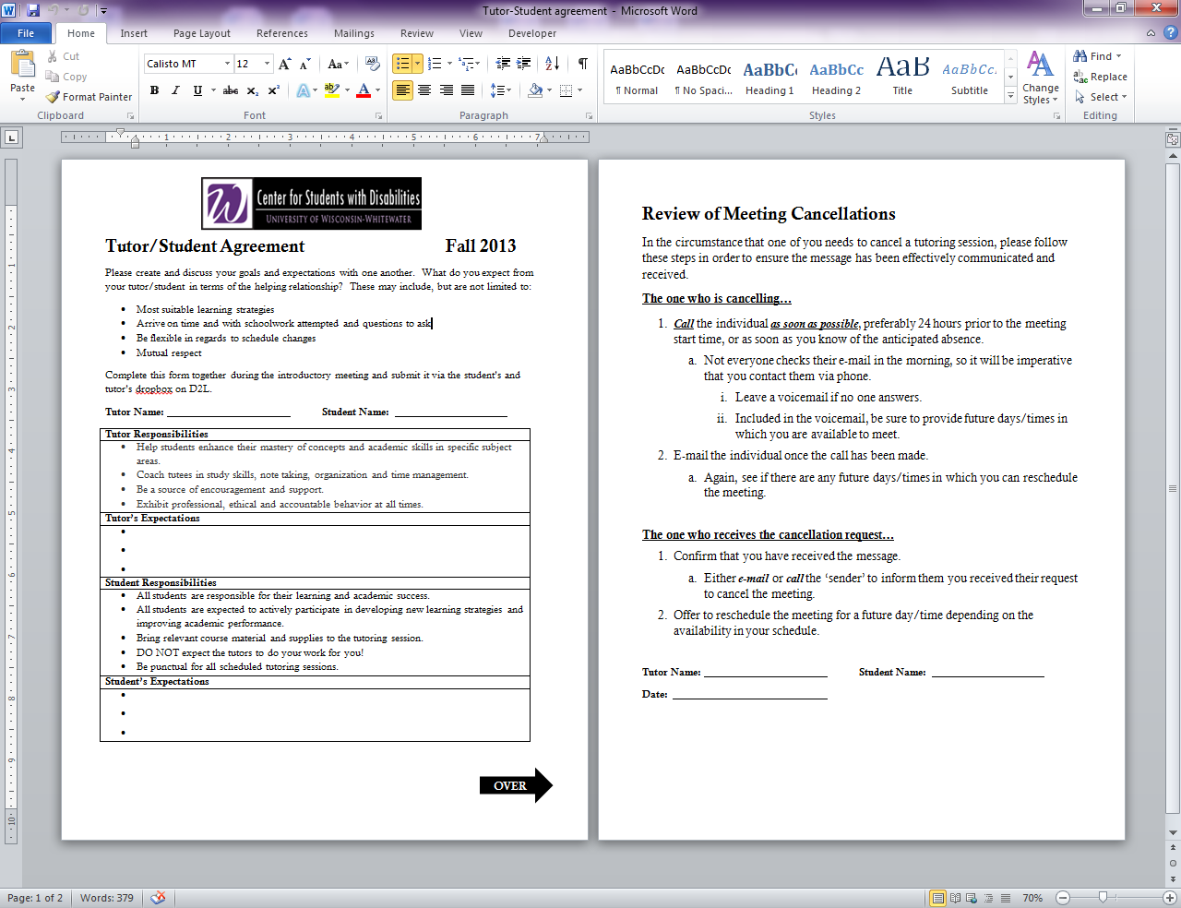
Tutor/Student Agreement
To be completed during introductory meeting.
Allows you to discuss goals, expectations and responsibilities with one another.
Also covers ‘Cancellation Policy’

Slide 10

Canceling Meetings
Canceling right before a tutoring session is disrespectful and impolite
  EX: How would you feel if a good friend cancelled going to the movies with you 10 minutes before you were going to leave?
Please do your best to make all scheduled sessions!

Slide 11
No-Show Policy
Policy is as follows:
  1st no-show→Tutor will immediately follow up with you via e-mail/phone to discuss reason for no-show and reschedule.
  2nd no-show→You will receive e-mail from tutor coordinator, reminding you of no-show policy.
  After 3rd no-show→You are not allowed to schedule another one-on-one meeting with your individual academic tutor until you talk/meet with tutor coordinator.
If you continue to miss your tutoring sessions without informing your tutor, it could result in the removal of one-on-one tutoring
AS A REMINDER:
  Your tutor is also a student who’s time can be limited!
  No-shows do not create and/or develop a genuine, good working relationship.

Slide 12

Drop-In Tutors
Available during daytime and evening hours; and Sunday evening
  Allows students the flexibility to receive assistance during the times they are not scheduled to meet with their individual tutors
Strives to provide coverage for all academic areas and organizational needs

Slide 13
Drop-In Tutor Hours
Located in the PA Lab (Andersen 2002)
Can enter through main entry of CSD or door located in the hallway
  When CSD closes for the night (4:30pm), students/tutors must enter through the hallway door
Monday 9 am – 7 pm | Tuesday 9 am – 7 pm | Wednesday 9 am – 7 pm | Thursday 9 am – 7 pm | Friday 10 am – 3 pm | Sunday 3 pm – 8 pm

Slide 14
Drop-In Lab
When entering the drop-in lab be sure to swipe your hawkcard at the card slider
Be courteous to others around you

Slide 15
Termination of Services
Can decide to cancel PA services
  Cancellation date stated on PA contract
    Usually the 5th week of the semester
  May be subject to service fee ($100, or more), depending on…
    When you decide to cancel
    How often you met with tutor
The fee will be charged to your student bill or forwarded to your DVR Counselor (if applicable)

Slide 16
A Few Reminders:
Be sure to utilize your tutors!
  EX: If you only meet with your tutor for 2 total hours for the semester, you’re paying $450 hour!
    Can you imagine paying for something else that costs that much per hour?
Remember, your tutors are students too!
  During mid-terms/finals week, please be respectful of their study time and schedule meetings ahead of time
  Refrain from scheduling meetings at the last minute
    EX: “I have a paper due tomorrow and I haven’t started it yet, we need to meet.” OR, “I have to review for an exam tomorrow, can we meet today?”
    Chances are, your tutor may not be able to comply to your request because they may have already made plans or were scheduled to do other things (i.e., work, attend group study, etc.)

Slide 17

Remember…
Tutors are here to guide and assist you to complete each class to the best of your abilities.
  This does not mean they’ll do the work for you!
YOU are responsible for your own success!
PA services may be terminated if the student does not meet his/her responsibilities.

Slide 18
Questions?

