Slide 1
Procurement Guide

Slide 2
State Purchasing Authority
UW Institutions obtain goods and services through the purchasing process governed by the Department of Administration’s State Bureau of Procurement.
§16.71, Wis. Stats., provides that the Department of Administration (DOA) “shall purchase and may delegate to special designated agents the authority to purchase all necessary materials, supplies, equipment, all other permanent personal property and miscellaneous capital, and contractual services and all other expense of a consumable nature for all agencies.”
The Designated Agents are required to attend DOA provided training and submit a Delegation Application (PRO-102 per the State Procurement Manual) in order to be granted the full authority to purchase for their institution or agency.
The procurement concepts included in training provide the foundation for state procurement, competition, consistency, integrity and openness.

Slide 3
Purchasing Delegation - Chapter
State of Wisconsin Chapter 16
DOA
UWSA Director of Procurement
UW Institution Procurement Directors
Delegated Purchasing Specialists
UW Madison Procurement Director
Delegated Procurement Specialists
Notes:
Chapter 16 authority comes from DOA→ System and Madison Directors→ University Directors→ Specialists or Agents

Slide 4
UW-W Purchasing Delegation
At UW Whitewater, Director of Procurement has been delegated the purchasing authority and has the responsibility to:
Review and approve all potential purchases greater than $5,000, and certain other purchases that require a PR.
Review, Revise and Sign contracts/agreements
Run official sealed bids(RFP/RFB/RFI/RPA)
Approve or deny any “sole source” request $25,000 and under
At the discretion of the Director of Procurement
Review activity on purchasing cards and ShopUW+ for appropriateness.
Notes:
Director of Procurement has delegated authority to Specialist
- Official bids
- PCard activity
-

Slide 5
What That Means for Departments
Purchases greater than $5,000, and those that require a purchase requisition, must be sent through ShopUW+ for review and approval PRIOR to an order being placed or purchase being made with the supplier
The purchase requisition is the official “order” for the goods or services, so cannot be prepared until all requirements are met.
The Procurement Office will help identify suppliers or develop bid specifications in order to ensure compliance with the appropriate procurement rules(as needed).

Slide 6
Procurement Process Decision Tree
Special Considerations and Requirements
Mandatory Contract
Non-Mandatory Contract
Procurement Process?
<$5,000
Best Judgement/
P-Card/ShopUW+
$5,000 to $50,000
Simplified Bid
>$50,000
RFB/RFP

Slide 7
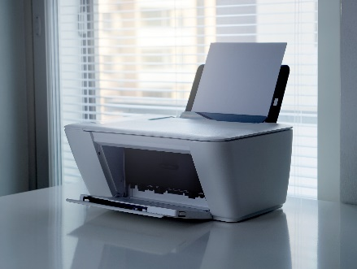
Special Considerations and Requirements
Examples of commodities and services with special considerations and requirements include:
Printing – Print Services has the first right of refusal, meaning that if Print Services can do this in-house, they will. If work is not able to be completed in-house, this will be sent to Do-It(UW Madison) for completion, use provided contracts or bidding (per PRO-303/304).
Before considering any bidding activity, state agencies will use the contracts provided by the Bureau of Procurement for the purchase of various classes of printing. Any time a bid is conducted in addition to the already three (3) vendors the agency shall include Badger State Industries and DOA Print and Distribution as potential bidders. Mandatory contracts MUST be used, if Campus or State-Owned printshop can’t be used.
Signage – The threshold for signage is $3,500. Any signage purchase exceeding this amount must be run as an Official Sealed Bid(RFB) by Procurement.
Vehicles
Legal Services
Notes:
Print – Print Service has the first right of refusal. Printing valued at $50 or more. Official sealed bids must be used for printing contracts over $50,000. When the estimated cost is $50,000 or less, the agency or campus must conduct a simplified bid.Signage – Signage per PRO-101 - Sign is interpreted to mean all interior or exterior items used to display a name, direction, warning or announcement posted for public display. This includes but is not limited to “Adopta”; ATV/Snowmobile; Banners; Plaques; Crime Prevention; Exterior; Fire Prevention; Highway and Traffic; Interior; Interpretive; NIMS; No Smoking; Park and Recreation; Street Name Signs.
Vehicle and Legal – RPA is required for all $$ amounts regardless of delegated authority

Slide 8
Examples
Signage – Wayfinding signage, Lettering, Light pole banners, Window graphics, Monument inserts, Murals, etc.
Printing - Postcards and/or folded notecards, Business Cards, Posters or Flyers, Brochures-with a few different folding options, Booklets, Plastic Spiral/Coil Binding and Envelopes (not all sizes can be printed)
Promotional Materials or SWAG items – Printed garments(t-shirts, sports wear, caps, etc.), Draw sting bags, Lanyards, Sport bottles, Koozie, Pencil stress reliever, Imprinted item they have usefulness(pens, rulers, binders, pencils, etc.)
Use of the Promotional Goods and Apparel Contract 22-5784 or PS-17-2662 Apparel Footwear and Accessory Rights is strongly encouraged
Notes:
Print Services – Can Not Provide
- Any prints, including posters or brochures larger than 19” long or 13” wide. No large format printing available at Printing Services.
- Sticker printing is limited to small squares (under 8.5x11 size). No plotter, therefore, no round edges.
- Envelopes with full bleed or envelopes too small for our machines (smallest is A2, largest is 6x9)
Any vinyl projects are outsourced, including banners, stickers, lettering, and signage (including corrugated or foamboard projects).
- Lamination is limited to 11x17 sheets. We only provide lamination with hot laminating pockets.

Slide 9
Procurement Process Decision Tree
Special Considerations and Requirements
Mandatory Contract
Non-Mandatory Contract
Procurement Process
<$5,000
Best Judgement/
P-Card/ShopUW+
$5,000 to $50,000
Simplified Bid
>$50,000
RFB/RFP
Notes:
Contracts identified as mandatory will be used by the procuring agency, regardless of dollar amount, unless a waiver (i.e., business case exception request) is granted by the contract manager

Slide 10
Mandatory Contract (Examples)
State and UW contracts exist for certain types of purchases, and MUST be used for those purchases. Examples include:
ALL UW Whitewater contracts
Ticketing software, Refuse and Recycling, Charter Bus Service
Office supplies and new toner
505ENTM19OFFSUPPLY01 (Staples)
Office furniture
505ENTM15BSIOFFURN01 (Bureau of Correctional Enterprises-BCE) –MUST used unless waiver is obtained
505ENTM20OFFURNITUR00 (Multiple suppliers)
Software
505ENT-M21-NASPOSVAR-00 (Insight Public Sector Inc., SHI and CDW-G)
Cleaning Chemicals
505ENT-M21-CLEANGCHEMS-00 (City Supply, Kranz, Nassco, Inc., North American Corp., San-A-Care and Schilling)
Pharmaceuticals
505ENT-M20-PHARMBIOLG-01 (Cardinal Health)
GLOVES, Non-Sterile, Disposable
505ENTU99DSPLGLOVES01 (Lakeside Curative Services-Racine)
Copiers
505ENT-M20-MFDCOPIER-00 (Ricoh, Canon, Sharp, Konica Minolta, HP Inc)
Electrical & Plumbing Supplies MRO
505ENT-M18-ELCPLSUPLS-00 (Viking, Crescent, Grainger, Fastenal, First Supply and Ferguson, etc.)
Facilities Maintenance and Repair Supplies MRO
505ENT-M19-FACILITMRO-00 (Fastenal, Grainger and MSC)

Slide 11
Procurement Process Decision Tree
Special Considerations and Requirements
Mandatory Contract
Non-Mandatory Contract
Procurement Process
<$5,000
Best Judgement/
P-Card/ShopUW+
$5,000 to $50,000
Simplified Bid
>$50,000
RFB/RFP

Slide 12
Non-Mandatory Contracts
Is what I need available on an existing contract or directly from another government entity?
UW System Contracts
UW-Madison Contracts
Campus Contracts(Cooperative)
Other State Agencies(Piggybacking) i.e. DNR, DOT, DOC

Slide 13
Procurement Process Decision Tree
Special Considerations and Requirements
Mandatory Contract
Non-Mandatory Contract
Procurement Process
<$5,000
Best Judgement/
P-Card/ShopUW+
$5,000 to $50,000
Simplified Bid
>$50,000
RFB/RFP

Slide 14
Best Judgement (PRO-302)
<$5,000
Does not apply to Printing Services
Obtain quotes to get the best pricing possible, and purchasing reserves the right to check for other sources.
Use MBE (Minority) suppliers whenever possible
No PR is required – use the best payment method or as required by supplier – PCard or Direct Payment
If PR is required by supplier or paying with a Direct Payment, and it is a new supplier, please use the Supplier Management tab within ShopUW+.
For more information go to ShopUW+ Essentials→ Training→ ShopUW+ Training Resources→ Requesters Resources→ Supplier Management

Slide 15
Procurement Process Decision Tree
Special Considerations and Requirements
Mandatory Contract
Non-Mandatory Contract
Procurement Process
<$5,000
Best Judgement/
P-Card/ShopW+
$5,000 to $50,000
Simplified Bid
>$50,000
RFB/RFP

Slide 16
Simplified Bidding (PRO-303)
$5,001 through $50,000
Three quotes – in writing
Same information MUST be provided to all suppliers-copy of email sent should be included in the PR documents
Price lists, Quotes of File, Phone and Verbal Quotes (confirmed in writing) and Written Bids
MUST be Apples to Apples comparison or comparable
Purchasing reserves the right to check for other sources
Simplified Bid Record
MUST be provided with PR Request
Identifies the specs you gave to suppliers to obtain quotes
Award to lowest responsible bidder
Serial or Split Transaction Contracting/Purchasing is prohibited

Slide 17
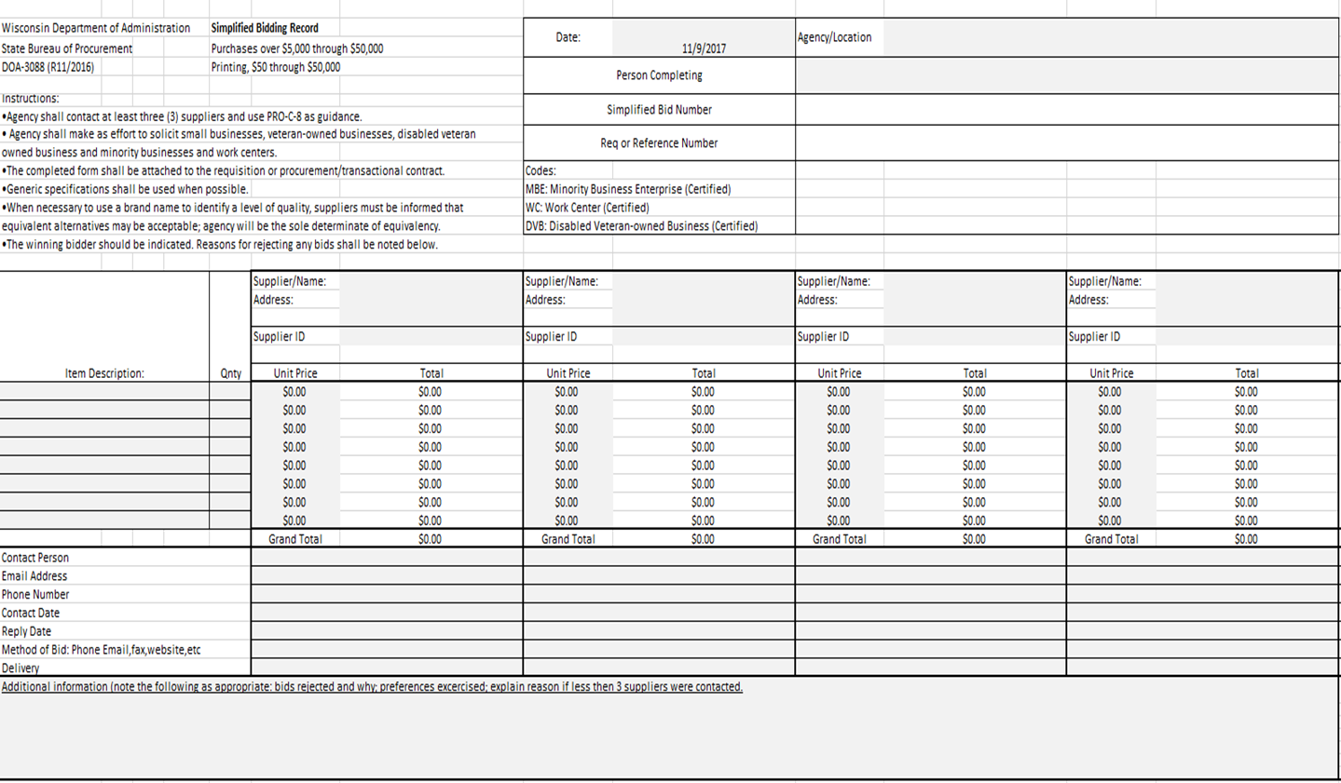
Simplified Bid Record

Slide 18
Sole Source (PRO-501)
$5,001 - $25,000
"Noncompetitive negotiation“ - this process may be used to purchase a product or service that can only be obtained from one source.
One or more of the following circumstances may be the basis for the request, but must be adequately justified:
The service is unique or of a proprietary nature available from only one source.
Grant monies are involved, that cannot qualify as an exemption, that require subcontracts and specify the contractor.
A public emergency exists (PRO-503)where the urgency for the required service will not permit competitive solicitation.
Substantial time pressure exists beyond the agency's control. (This does not include administrative delays or confusions in processing the necessary paperwork for purchasing approval.)

Slide 19
Sole Source- Continued
Sole source waivers for purchases under $25,000 can be approved by your campus Director of Procurement.
Sole source waivers for purchases over $25,000 requires a Request for Purchasing Authority(RPA) signed by the Governor.

Slide 20
Procurement Process Decision Tree
Special Considerations and Requirements
Mandatory Contract?
Non-Mandatory Contract?
Procurement Process?
<$5,000
Best Judgement/
P-Card/ShopUW+
$5,000 to $50,000
Simplified Bid
>$50,000
RFB/RFP
This Photo by Unknown Author is licensed under CC BY-NC

Slide 21
Request for Bid (RFB) vs. Request for Proposal (RFP)
Factor
Spec/Reqs
Award Basis
Analysis
Suppliers
Timeframe to complete
RFB
Detail Specs
Know what you need
Meet/don’t meet Specs
Lowest Cost
Purchasing Agent/User
Bidders
1 to 3 months
Depends on research time
RFP
Reqs/Deliverables
Proposers to you “how”
Evaluation criteria
Cost is only one factor
Evaluation committee
Procurement acts as chair for committee
Proposers
3 to 6 months average
Extensive develop/ research

Slide 22
Purchase Order (PO) Requests
Plan Ahead – Requisitions for a purchase occurs BEFORE a purchase is made. Departments should plan to include enough time for review/approval of the PR and supporting documents, PR sent to the supplier, and the order to be processed and shipped by the supplier before the product or service is needed.
Submit the PR – Requisition MUST be submitted within ShopUW+ by Requester. All needed supporting documents should be attached before the approval process.
Invoices do NOT accompany the PR, as the order cannot be placed until the review has occurred and the PR is approved.
Turnaround – Procurement will make every effort to process and complete PR within five (5) to seven (7) working days after being received in Procurement.
Higher Level Review – All purchases over $50,000 may require a higher level of review, so extra time should be allowed for review of these requests.

Slide 23
Approved Purchase Orders
Final Approval – When the review is complete and Procurement is satisfied campus has complied with purchasing rules, they approve the PR and distributes via email.
Placing the Order - The approved PR is sent directly to the supplier, department contact, Procurement and Financial Services.
Invoices – Invoices are sent to Accounts Payable directly by the supplier– wtwap@uww.edu, departments use - finsrv@uww.edu or Hyer Hall room 110.
Payment - When the invoice is received, Accounts Payable will contact the department listed on the PR to ensure the goods have been received. Department will enter a “cost receipt” for invoiced amount against the PR. Accounts Payable will make payment.

Slide 24
POs Create Encumbrances
The amount of money being obligated or committed for a purchase order is called an encumbrance.
Funding strings entered on the PR by the department assign the funding to be committed, so the person(s) authorized to spend those funds must approve the PR.
Once the PR is approved the funds are committed and the encumbrance will show up in Wiser in the funding department information.

Slide 25
Timing of PO Requests
Ideally, purchases for services would have coverage dates that coincide with the fiscal year. That is not practical and rarely happens. So PRs for service coverage that spans two fiscal years are entered in the year of the start of coverage, such as for copier leases, maintenance agreements, software licenses. Coverage for a future year will have a PR created in that year.
The “year end cut off dates” document distributed to campus in March each year contains the due dates for current fiscal year PRs, which is typically the end of May. Departments should plan accordingly to make your purchases by year end.
Just because funds are available near the end of the year doesn’t mean you can submit a PR to use them. PRs created in the current year are for goods or services to be received by June 30.

Slide 26
Year End
All standing orders are closed at year end, and those for which goods and services have been received should already be closed. Departments should start reviewing their encumbrances in May and June for any PRs that should be closed.
Occasionally, purchase orders are created for which goods or services have been delayed, backordered, etc. so will not be received by June 30. These PRs will remain open, and the encumbrance will “rollover” into the new fiscal year, along with the funding for the purchase. This carryover PR needs to be closed in the new fiscal year when the goods are received and paid for.
PRs for the new fiscal year may be entered beginning May 1, so requisitions can be submitted for approval after that date with the new “UW Fiscal Year” selected.

Slide 27
Questions?

Slide 28
Training
Purchasing and P-Card Training
Office Hours – Tuesdays 2-3pm
ShopUW+ Training - 2nd Thursday of the month from 10:00 am to 11:00 am
Procurement Training – 3nd Friday of the month from 1:00 pm to 2:30 pm
PCardholder and PCard Approver training is required and invited by Procurement
Contact purchasing@uww.edu for more information

Slide 29
Links
UW System contract page - https://www.wisconsin.edu/procurement/contracts/
SupplierNet - https://suppliernet.wi.gov/Contracts.aspx
ShopUW+ Essentials - https://shopuwplus.wisc.edu/
Ineligible suppliers list - http://www.bussvc.wisc.edu/purch/inel.html
Pcard Manual and Application - https://www.wisconsin.edu/financial-administration/special-topics/purchasing-cards/
UW Travel WIse - https://www.wisconsin.edu/procurement/contracts/travel-self-booking-tool-and-related-travel-management-services-13-2542/
Purchasing Forms - https://www.uww.edu/adminaffairs/finance/cashiers-office/forms#ProcurementForms

