Slide 1
Community-Based Learning
Jonah Ralston, Assistant Professor
University of Wisconsin-Whitewater

Slide 2
Which of the following is CBL?
You are giving a lecture on the Syrian refugee crisis and you invite in a refugee that lives in the community to speak about their experience
You take your students on a field trip to the state capital where they meet with their representatives and staffers to learn about the legislative process
A local school contacts you about a problem they are having with low enrollment in their free and reduced-price school lunch program in the high school; you apply for and are awarded a grant for you and a few students to research the problem
You create a partnership with a local nonprofit whereby your students conduct a policy analysis to propose potential solutions to the issue the non-profit works on; your students carry out their work in the classroom, not at the nonprofit organization
You require your students to spend 15 hours volunteering at a local homeless shelter
You require your students to work on a project with your city that seeks to increase the participation of college students in city council meetings; your students must spend at least 15 hours working on the project, a portion of which will be spent at city hall
You require your students to attend a local city council meeting

Slide 3
Defining Community-based learning
Definitions abound!
How we have defined it at UW-Whitewater is available on our website: http://www.uww.edu/ce/cbl/getting-started
I prefer a shorter definition: A mutually beneficial partnership between students, faculty/staff, and a community member that seeks to address a real community problem or need through civic action and applied inquiry
More practically, it is a continuum

Slide 4
Why do it?
What do students think? University of North Florida student reflections: https://www.youtube.com/watch?v=_epbTlrTnCw
It can enhance course learning outcomes (Jenkins 2011)
Able to bridge the gap between theory and practice
In political science CBL has been shown to increase civic engagement and improve student understanding of complex policy issues (Assendelft 2008)
Comment from one of my students: “Your class was one of the first classes I took in all of my college career that felt truly worth it. I actually felt like I learned something that would help me with my career and in the real world.”

Slide 5
What does it look like in POLISCI?
How does CBL vary across disciplines? Examples from UW-Whitewater: https://www.uww.edu/ce/cbl/impact
Political science example from Prof. Patrick McGuinn at Drew University: https://www.youtube.com/watch?v=Dy0-rulKnco
One of my goals today is walk you through guided steps to implement CBL in your classroom and provide you with a replicable model from my public policy analysis and advocacy course (POLISCI 330)

Slide 6
Step One
Be able to answer the question of why you want to incorporate CBL
  What is your motivation and what do you hope to accomplish?
Identify a course that would be well suited for CBL
  American Government vs. Model UN vs. Ancient Political Thought
Determine how CBL fits with course goals and desired learning outcomes
  e.g. civic engagement, the ability to apply class concepts to real situations, etc.

Slide 7
Course Description
Public Policy Analysis and Advocacy (POLISCI 330)
  Course Catalog: “A systematic introduction to the study of public policy through an analytical problem-solving approach and the use of that evidence-based approach to advocate for policy change. The course will also examine and explore public problems and policy issues.”
  Required Course in Public Policy and Administration major and Non-Profit Emphasis in Management; also included in programs such as Political Science
  Offered twice per academic year: once online, once in-person

Slide 8
Step Two
Identify a potential community partner and a problem facing the community
You can first identify a potential partner based on the likelihood of a successful partnership and a workable problem
OR
You can investigate problems in your community that are a fit for your course and seek out a relevant partner working in that area
Institutional setting and context matter
  Rural vs. Suburban vs. Urban
  Weak community relationship vs. Strong community relationship
  Institutional resources (lacking or present)

Slide 9
Community Partner & Problem
Partner:
  United Way of Jefferson & North Walworth Counties
  Megan Hartwick, Executive Director
Problem:
  ALICE Report (Asset Limited, Income Constrained, Employed)
  Policy Areas: Health Care, Housing, Child Care, Food, Transportation, Taxes, Employment

Slide 10
Step Three
Establish a partnership and set out the terms of that partnership
  Will students be expected to visit the partner’s place of work? If so, what kind of supervision will be provided? Is training required?
  Will you instead ask the partner to visit your classroom? If so, how often?
A suggested method of establishing expectations between the community partner, yourself, and students is a memorandum of understanding (MOU)
  Example language from the MOU I use in my course is on the following slide

Slide 11
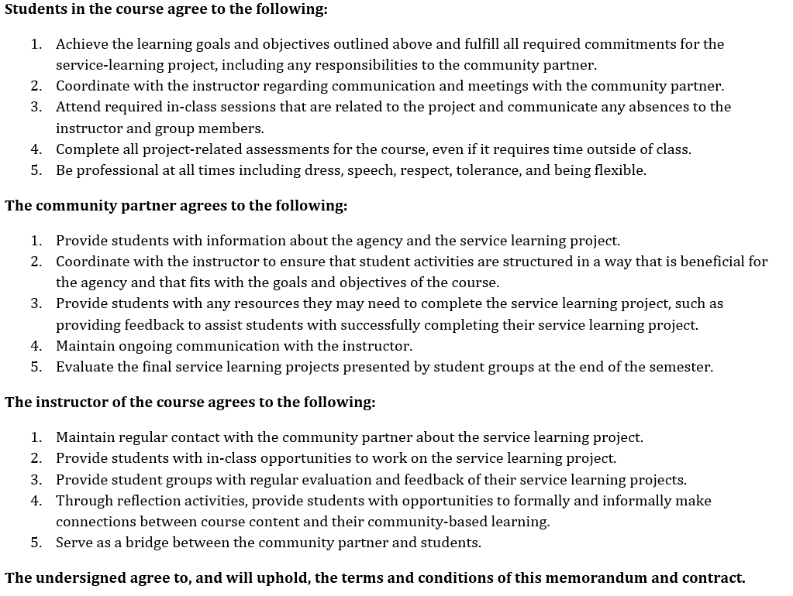

Slide 12
Step Four
What is the project the students will work on?
  Project-based or problem-based learning: A complex task based on a challenging problem in which students are involved in designing the project, have an opportunity to work autonomously to problem-solve, and which results in a realistic product or presentation
  “Tell me and I forget, teach me and I may remember, involve me and I learn."
How will the project be assessed?
  What percent of the course grade will be dedicated to the project?
What opportunities will be provided for reflection of the experience?
  Reflection is key for CBL

Slide 13
Course Structure
Usually ~35 students who are divided into groups of 5 based on policy area
  Based on preference students indicate on Memorandum of Understanding
Students complete all steps of the policy analysis process (Eightfold Path)
  Define problem; Assemble evidence; Construct alternatives; Establish evaluative criteria; Project outcomes; Confront tradeoffs; Decide; Make recommendation
  Final product is a presentation and memo; also a reflective exercise
Half of in-class time devoted to the project and 25% of course grade
  Class meets twice per week: one meeting for lecture, one for the project
  One week students meet in a computer lab, next week they present their work

Slide 14
Partner Feedback
Email from Megan Hartwick:
  “I think it would be wonderful to see the students dive further into the data for each category and then put together plans on the best way to address public policy related to each of these categories. I think having information available for our United Way and each of our partner agencies (and any other community organization) to utilize in conversations with government officials about how to ACTUALLY create change for the better, would be an incredible thing. We all know there are problems – big problems for a lot of families – but we don't know enough about HOW to implement lasting change (which I think has to come from the policy side of things).”

Slide 15
Comparing CBL VS. Non-CBL
Student evaluations:
Spring 2017: 4.68 out of a possible 5
Fall 2017: 4.82 out of a possible 5
Semester | Enrollment | DFW Rate | URM Total | URM DFW
Spring 2017 | 30 | 10% | 7 | 14.3%
Fall 2017 (CBL) | 31 | 12.9% | 6 | 0%

