Slide 4
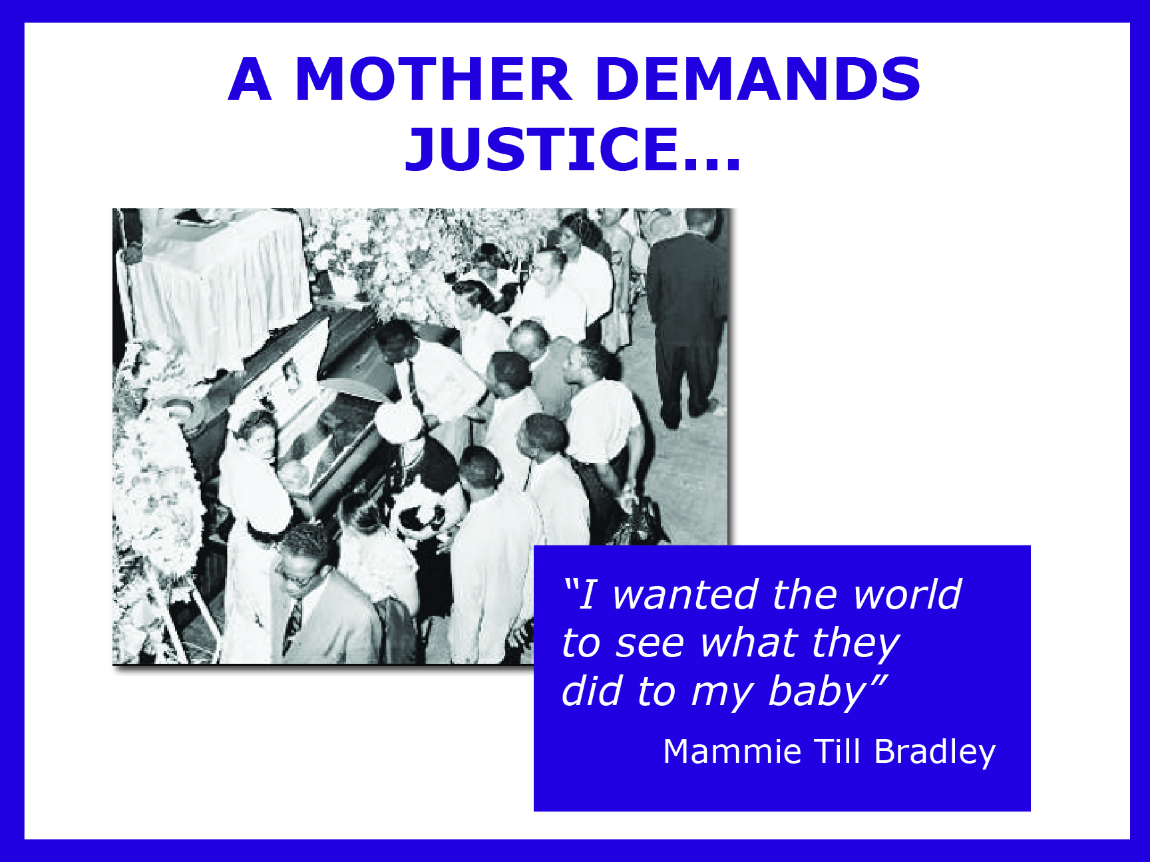

Slide 6
Learn More About: THE EMMETT TILL STORY
On-Line
Linder, Famous Trials: The Emmett Till Murder - http://law2.umkc.edu/faculty/projects/ftrials/till/tillhome.html
The Emmett Till Murder - http://www.emmetttillmurder.com/
Videos
Eyes on the Prize, produced by Blackside , Inc.. “Part I: Awakenings” –DVD Anderson Library call # E185.615 .E9 2006
Books & Articles
Sitkoff, Harvard. The Struggle for Black Equality. New York: Hill & Wang, 1981.
Morgan, Iwan and Davies, Philip, eds. From Sit-Ins To SNCC : The Student Civil Rights Movement In The 1960s. Gainesville: University Press of Florida, 2012.
Anderson, Elijah. “Emmett and Trayvon” Washington Monthly. Jan/Feb2013, Vol. 45 Issue 1/2, p31-33 [access through EBSCOhost database]

