Slide 1
WHITEWATER VOICES: SAY WHAT?
Sponsored by the UWW International Students Association, April 2015
foreign-born students reflect on things their American-born peers have said to them

Slide 2
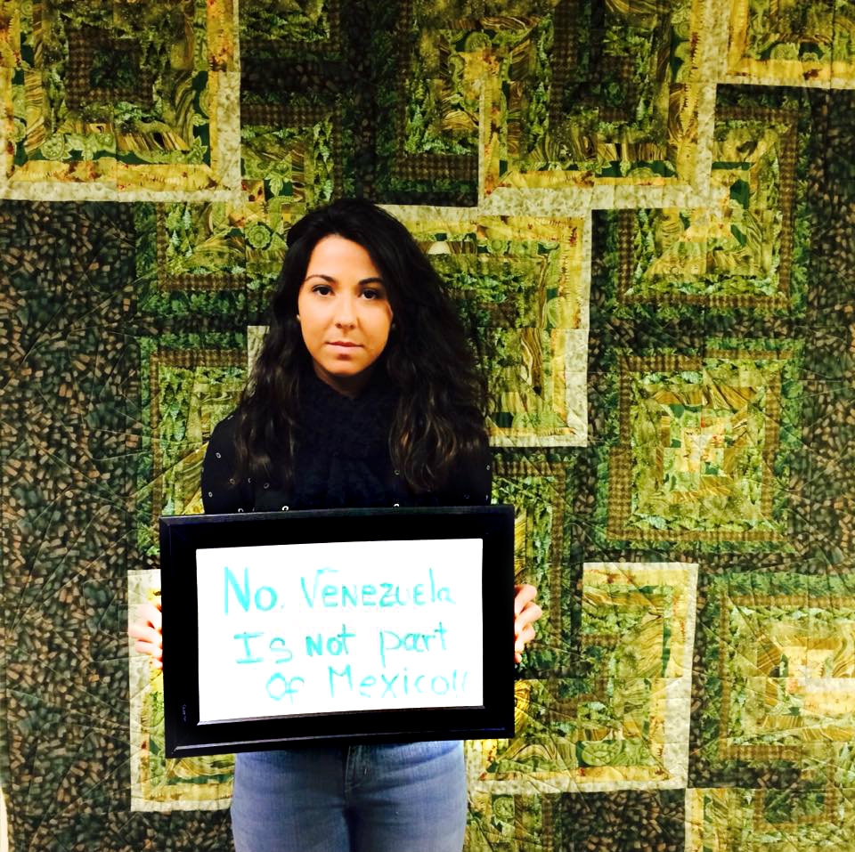
Eleana Alvarez
is from Venezuela. She is majoring in Finance with an Emphasis in Financial Planning and a minor in Economics. Eleana speaks Spanish and English.

Slide 3
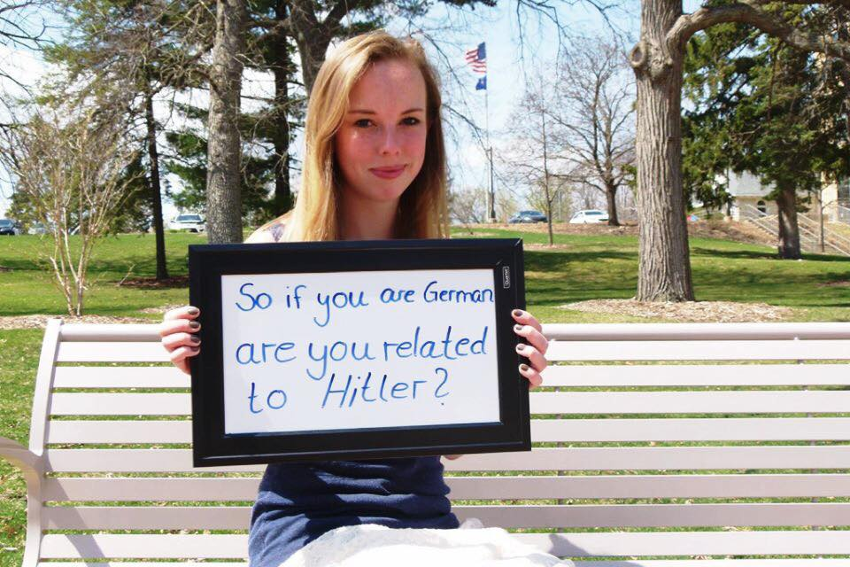
Toni Lohmeyer is from Bonn, Germany. She is currently pursuing her Master’s Degree in Communication science. She is planning on going back after this semester and continues her studies at Philipps-Universität Marburg. Toni speaks German, English, and some Dutch.

Slide 4
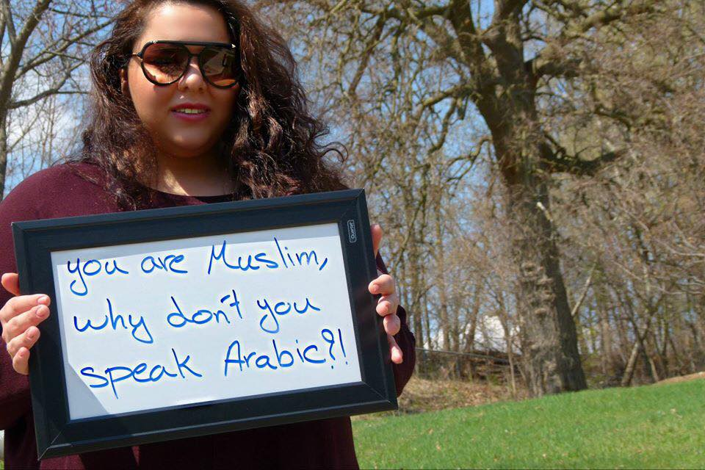
Shirin Bouzari is from Teheran, Iran. She is majoring in International Studies with an Emphasis in Public Diplomacy. Shirin speaks Farsi, English, and Arabic.

Slide 5
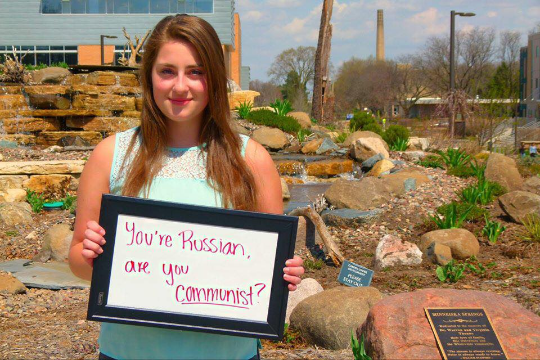
Lina Pashkova is from Russia. She is majoring in Accounting with a minor in French. Lina speaks Russian, English, French, and Spanish.

Slide 6
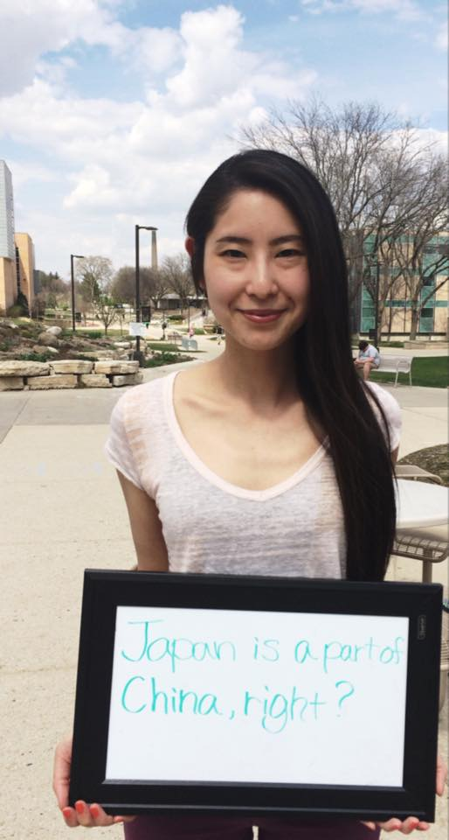
Yukiko Yamaguchi is originally from Japan. She is a Teaching Assistant for Japanese language here at UW-Whitewater. Yukiko speaks Japanese and English.

Slide 7
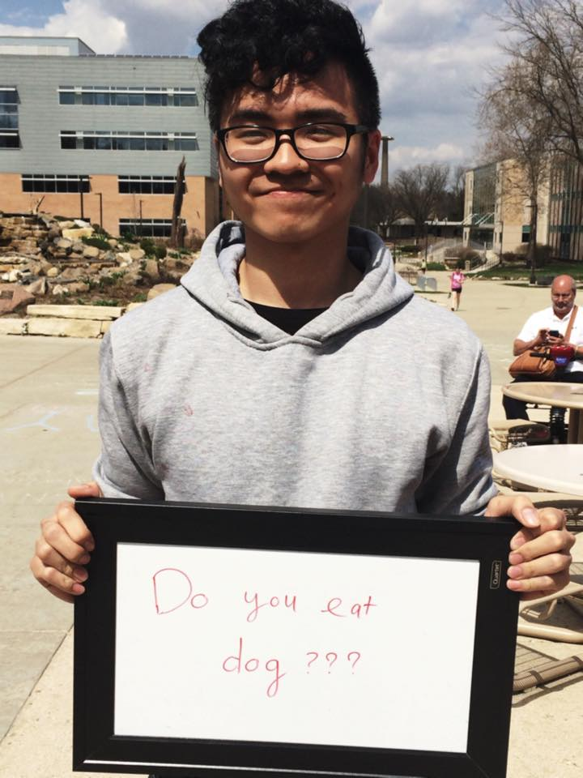
Phuong Nguyen is originally from Vietnam. He is majoring in Accounting and currently works at the tutoring center as a math tutor and he also works at the UC as an audit assistant.

Slide 8
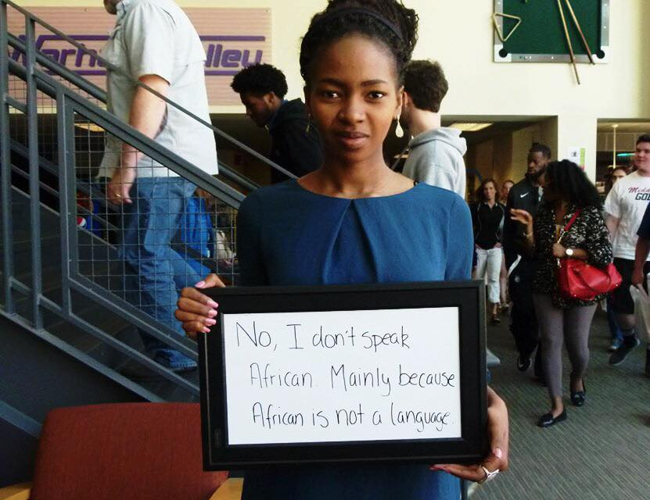
Nana Mariam is from Bamako, Mali. She is majoring in International Studies with an Emphasis in Public Diplomacy and a minor in Spanish. Nana currently works at the tutoring center as a writing tutor. Nana speaks English, French, Bambara and Spanish.

Slide 9
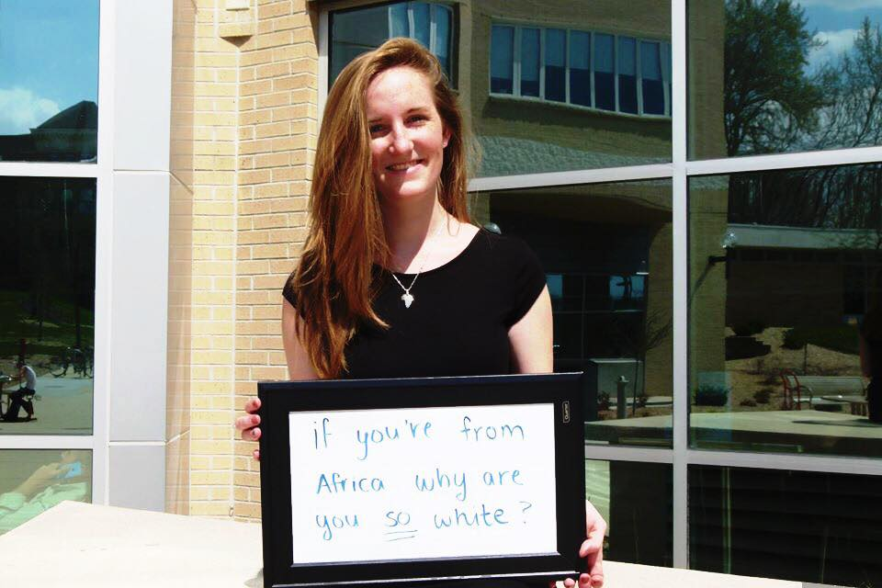
Leah Weltzien is originally from Mali. She is majoring in Elementary Education with a minor in French and ESL. She currently works at the children's center on campus. Leah speaks German, English, and French.

Slide 10
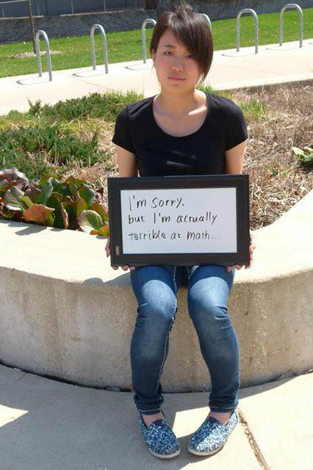
Ikumi Ohashi is from Japan. She is majoring in English and this is her last semester in Whitewater. Ikumi speaks Japanese and English.

Slide 11
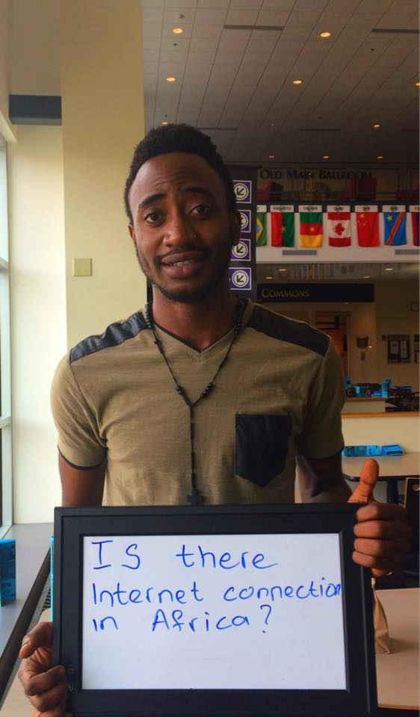
Dikalo Chie is from Bafoussam, Cameroon. He is majoring in IT/Supply Chain Management. He speaks French, and English. Dikalo will be graduating this spring. Congratulations!

Slide 12
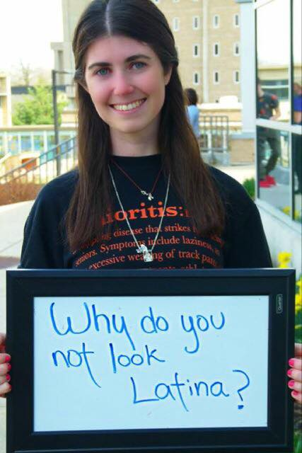
Carol Alvarez is from Venezuela. She is currently a junior majoring in Accounting with a minor in Mandarin Chinese language and culture. She currently works at the tutoring center as a Spanish tutor. Carol speaks Spanish, English, and she is in on the process of learning Chinese. She will be going to China this summer. Best of luck!

Slide 13
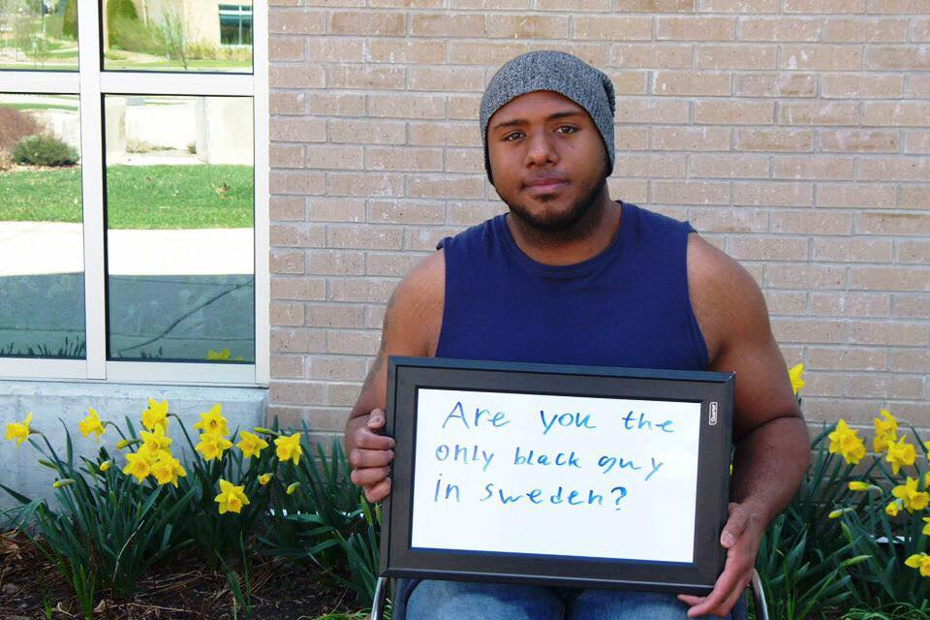
Christian Seidel is from Sweden. He is majoring in Physical Education and has been part of Wheelchair team since fall 2014. Christian speaks Swedish, German, Danish, Italian and English.

Slide 14
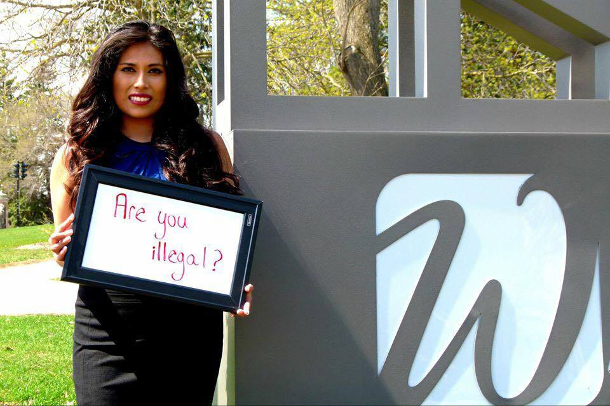
Estefania Mora is from Mexico. She is currently a junior pursuing a major in Accounting with a minor in Economics. She is currently working as a Fiscal and Economic Research Center Assistant. Estefania also works at the Elementary school and her success has led her to become a Corporate Management Intern at KPMG and a future Residence Hall here on campus. Estefania speaks Spanish and English.

