Slide 1

CENTER FOR STUDENTS WITH DISABILITIES
ADAPTIVE TRANSPORTATION

Slide 2

MEET OUR STAFF
    Transportation Coordinator: Cristin
    Undergrad Assistants: Parker and Katie
    Drivers/Dispatchers: Jed, Thomas, Alexa, Austin, Kasie, Brooke, James, Lizzy, Martin, Nicole, Alyssa

Slide 3

HOURS OF OPERATION
Monday……..7:15 am – 10:00 pm
Tuesday……..7:15 am – 10:00 pm
Wednesday..7:15 am – 10:00 pm
Thursday.....7:15 am – 10:00 pm
Friday…………7:15 am – 8:00 pm
By Appointment only
  Saturday…….4:00 pm – 9:00 pm
        * Hours are subject to change

Slide 4
ON CAMPUS VS. OFF CAMPUS RIDES
Class
Group meeting/project
Project ASSIST
Tutoring
Meeting with professor
Advising Appt.
Library
CSD(Test or meeting with Disability Services Coordinator)
Physical Therapy (Roseman)
On campus dining
Restaurants
Movie Theater
Hairstylist/Barber
Wal-Mart
Dog Park
Church
Walgreens
Almost anything within Whitewater city limits!

Slide 5
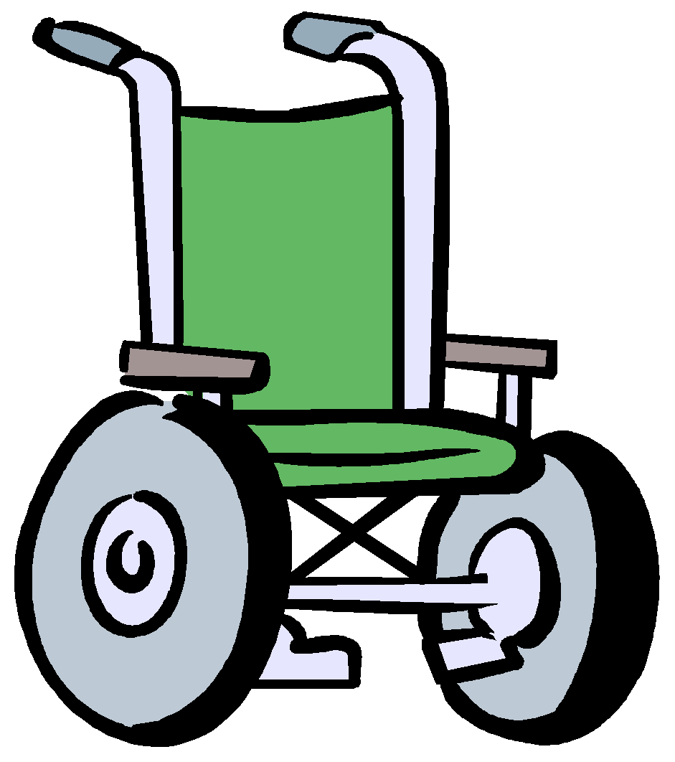
CONTRACT OPTIONS
On Campus Rides: Rides to ANY campus location whether you’re going to class, practice, work or the library.
  Options for On Campus Rides
    Full Year
    Winter Only Option
Off Campus Rides: Rides to locations within the city of Whitewater including religious centers, restaurants, Walmart, U.S. Cellular, etc.

Slide 6
SCHEDULING RIDES
The permanent schedule is based on the individual rider’s class schedule. All rides are scheduled on a priority basis and classified as priority 1-4.
Priority 1: rides from home to class
Priority 2: rides from class to class
Priority 3: rides from class to home
Priority 4: rides to other campus or off campus locations
Make sure you send in your class schedule as soon as possible (First come first serve)

Slide 7
GENERAL TIMELINE
August 2019 | Receive Ride Schedule for Fall Semester
September 2019 | Start of Fall Full Semester Academic Rides
November 2019 | Start Scheduling Winter Academic Rides
December 2019 | Receive Contract for Spring 2020 Spring Rides
January 2020 | Receive new ride schedule before the beginning of classes
March 2020 | Spring Break Closure and End of Spring Winter Rides
April 2020 | Spring Mini-Break & Receive Contract for Fall 2020 (Fall/Winter)
May 2020 | All permanently scheduled rides canceled at the end of exams.
*ALL final rides are on a call-in basis*
Closed for Thanksgiving Break(from 5:00pm on 11/26/2019 through 12/01/2019)
*Turn in academic schedule as soon as classes are determined*

Slide 8
RIDER POLICY/RESPONSIBILITIES
No Show Policy: The rider is responsible for cancelling any unwanted rides. Anytime you do not call to cancel a ride and do not show up, you will be considered a NO SHOW! Please consider the other riders and call the office to cancel. Riders with extensive no-shows will be contacted by the Transportation Coordinator and rides may be suspended.
Added Pick-ups: Call the Transportation Office at least 10 minutes before the desired pick-up. Pending availability, the dispatcher/driver will verbally confirm the ride.
Cancelling Rides: To cancel a specific ride, call the dispatcher at least 10 minutes prior to the ride. Be sure to let the dispatcher know if the cancellation affects any of your other scheduled rides for the day.
Missed Pick-ups: If you missed your ride, call immediately for the next available pick-up time. If the driver is late you can call for an estimated arrival time

Slide 9
RIDER POLICY/RESPONSIBILITIES CONTINUED….
Companion Rider Policy – One Companion rider will be permitted to ride, however, when the rider schedules the ride make sure you tell the dispatcher that there will be a guest on that ride.
Warhawk Wheels may be able to provide transportation for field placements that are a part of your academic program. This is decided on a case-by-case basis and is dependent on van availability, location of field placement, and timeliness of request.

Slide 10
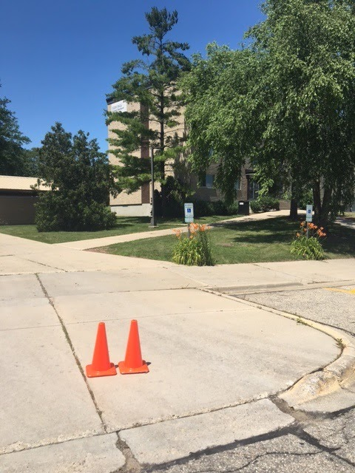
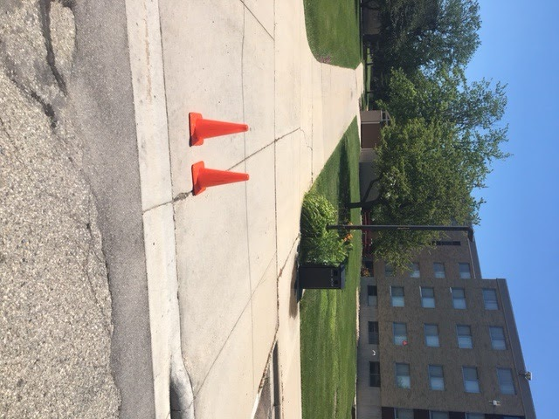
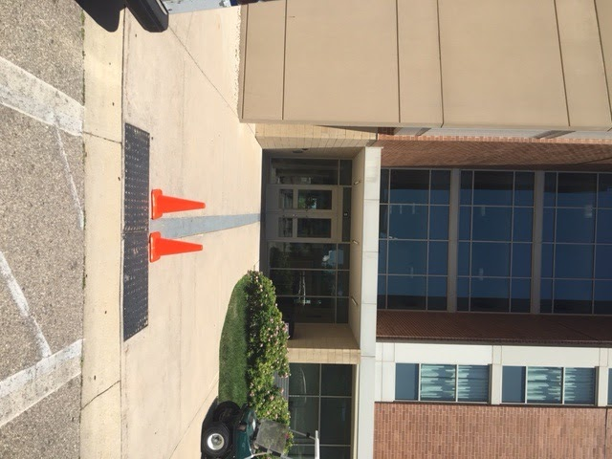
CONNECTION POINTS-HOUSING(Six pack)
Bigelow Hall
Starin Hall
Clem Hall

Slide 11
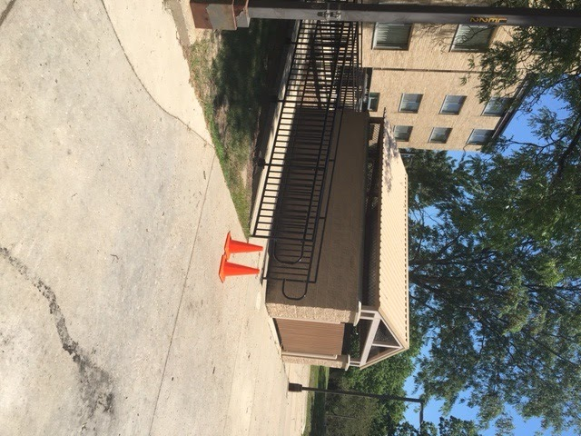
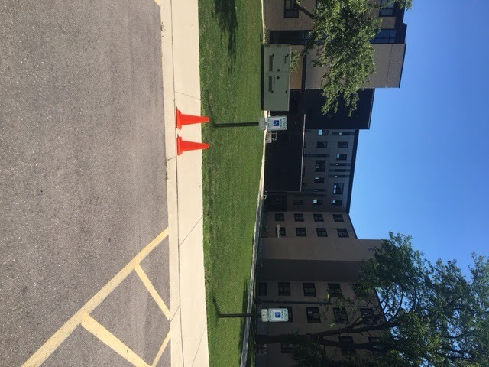
CONNECTION POINTS-HOUSING(Six pack)
Lee Hall
Fricker and Arey Hall

Slide 12
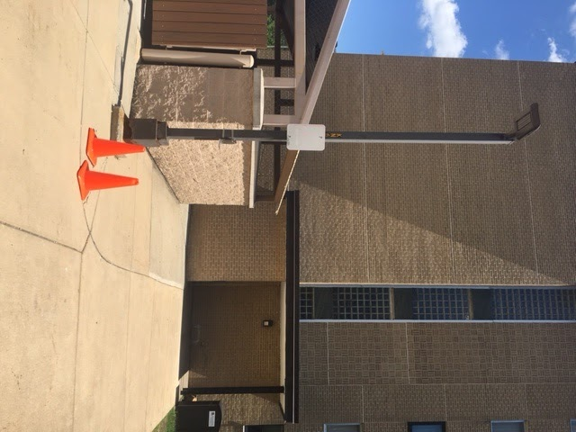
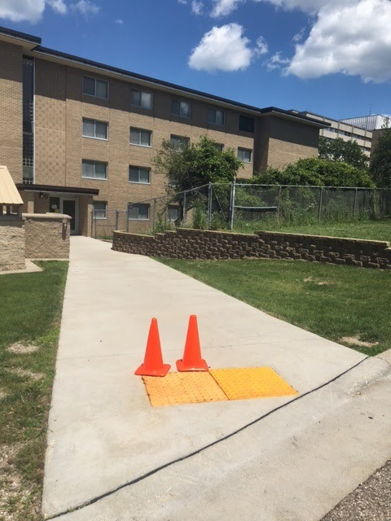
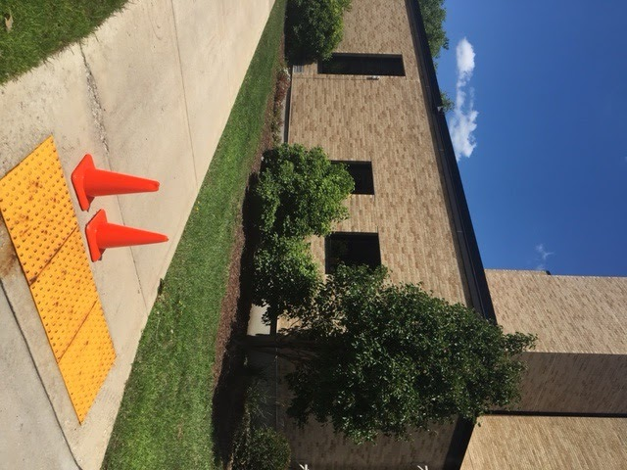
CONNECTION POINTS-HOUSING
Knilans Hall
Fisher Hall
Tutt Hall

Slide 13
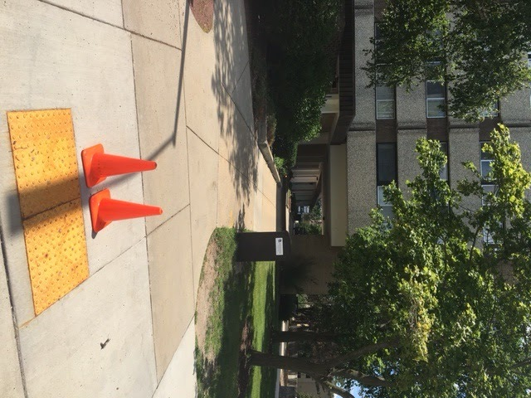
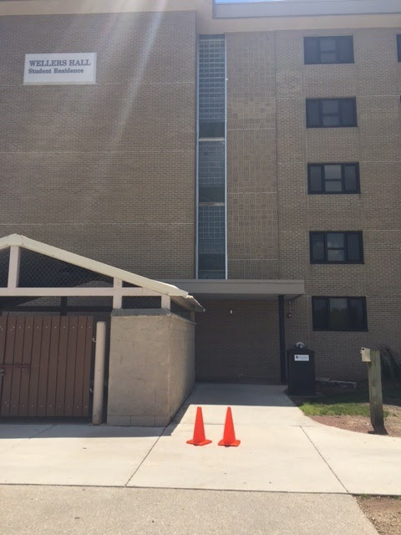
CONNECTION POINTS-HOUSING
Wells East and West Halls
Wellers Hall

Slide 14
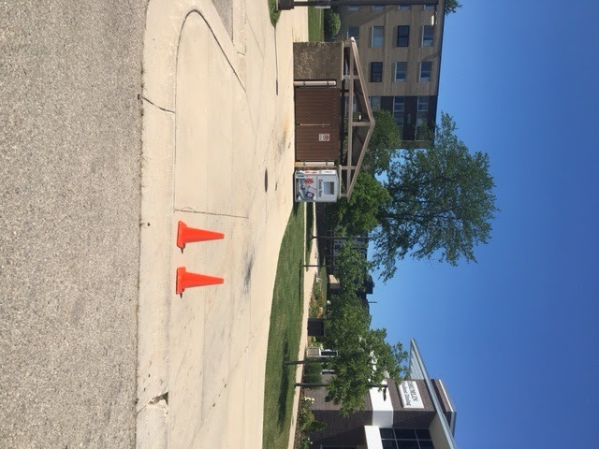
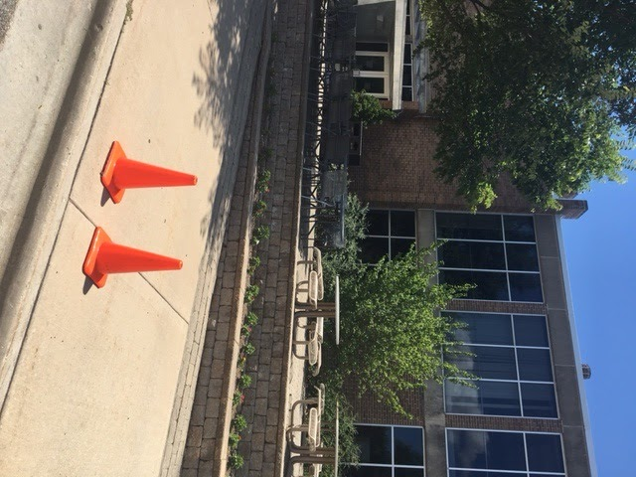
CONNECTION POINTS-DINING HALLS
Esker
Drumlin/ Benson Hall

Slide 15
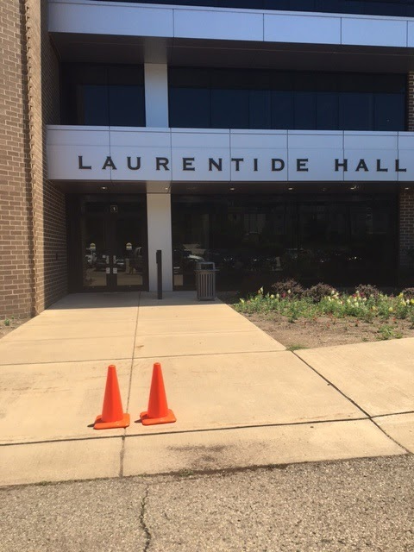
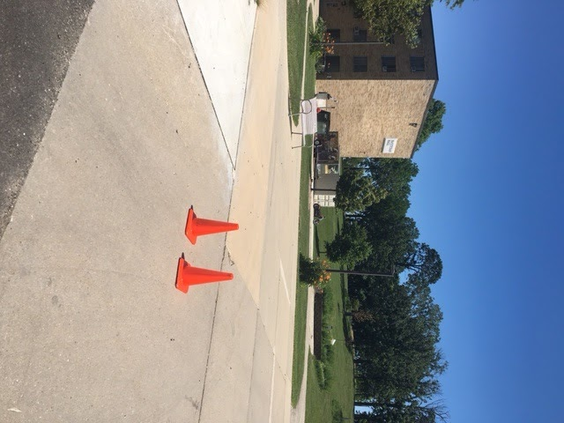
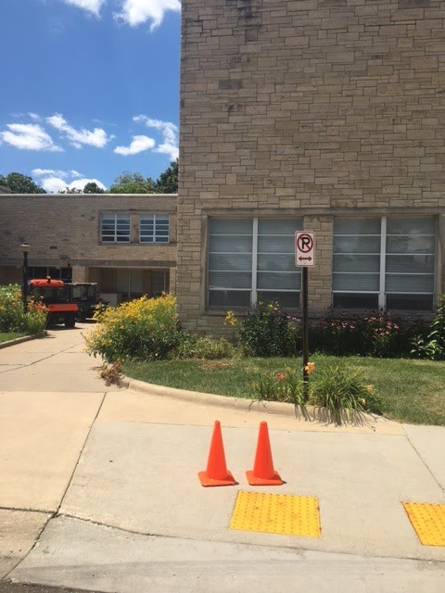
CONNECTION POINTS-ACADEMIC BUILDINGS
Laurentide
McCutchan
Andersen Library

Slide 16
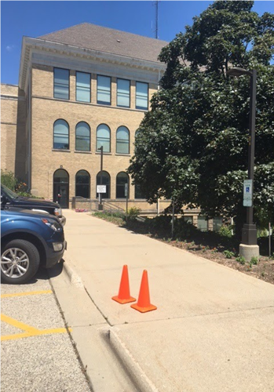
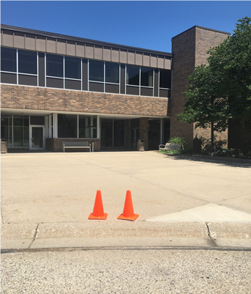

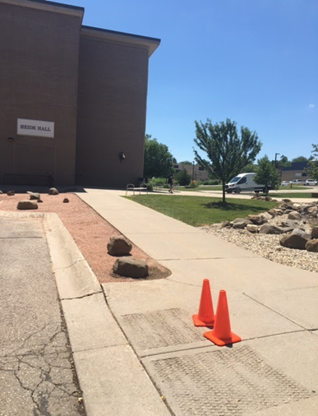
Connection Points-Academic Buildings
Center of the Arts
Hyer

Slide 17
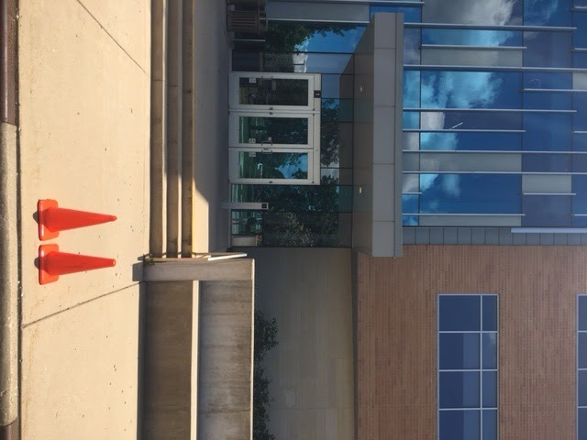
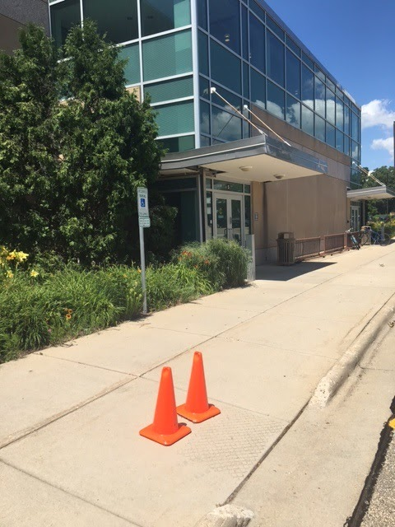
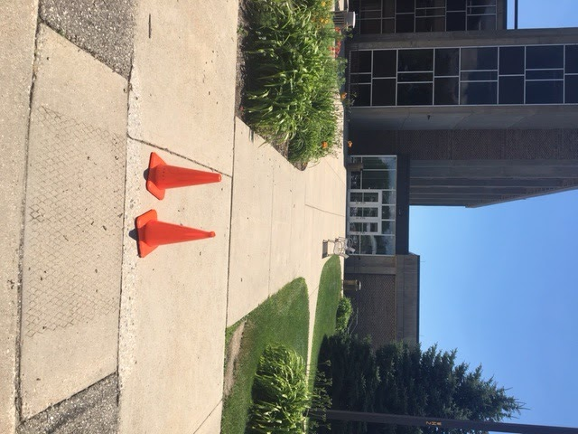
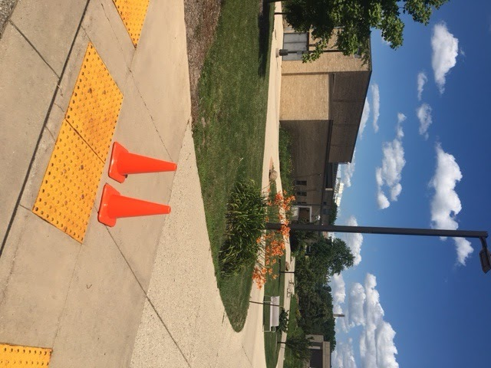
CONNECTION POINTS-ACADEMIC BUILDINGS
Hyland
Winther
Roseman
Upham

Slide 18
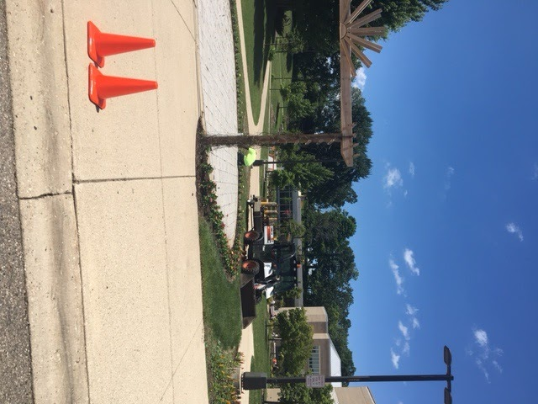
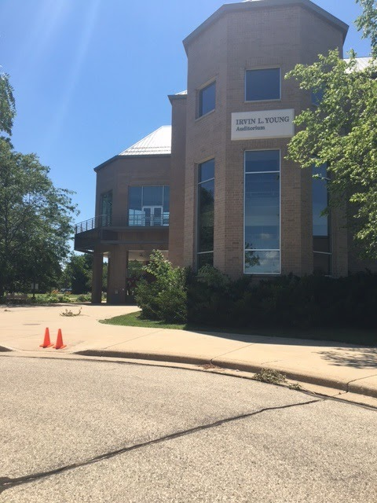
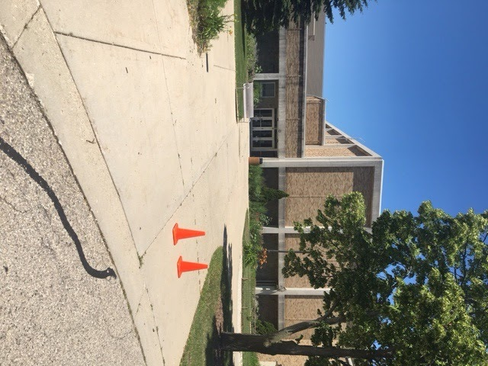
CONNECTION POINTS-RECREATION
UC/ McGraw
Young Auditorium
William Center

Slide 19
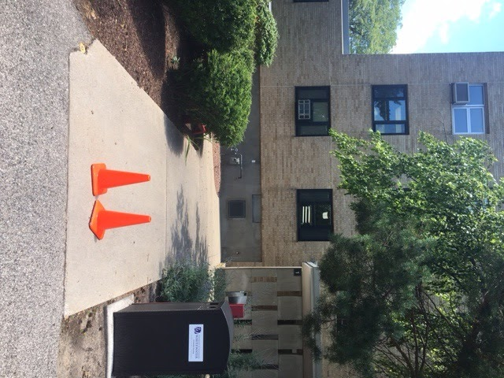
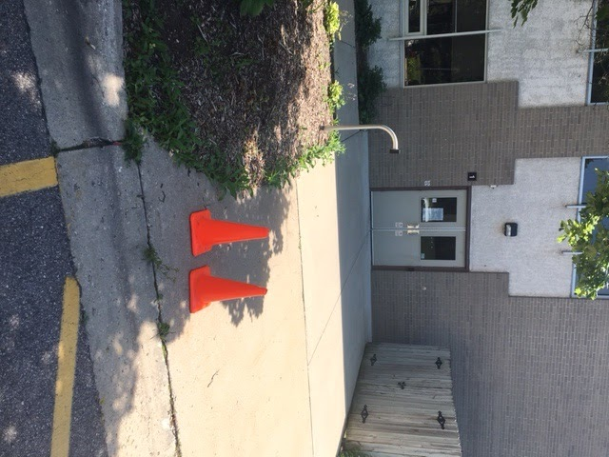
CONNECTION POINTS-RECREATION
Health/Counseling Center
Bookstore/Goodhue

Slide 20
Your Next Steps
Step 1: TO RECEIVE SERVICES- Fill out Contract for Adaptive Transportation Services. CSD will determine eligibility.
  Riders are required to read all policies and return a signed contract, rider policy agreement, and provide a copy of their academic schedule
Step 2: Send In Your Ride Schedule
  Riders will be getting an email of their schedule when to expect the drivers will pick/drop them off. PLEASE BE READY FOR YOUR RIDE
Step 3: Review Connection Points

Slide 21


PLEASE CONTACT US AT
Transportation Coordinator’s e-mail address:
transcsd@uww.edu
CSD Transportation General Number
      262.472.4712

