Slide 1
Academic Transformation Project:
Refocused Intermediate Algebra
Presentation at the UWW Chairs’ Council
October 24, 2012

Slide 2
Math 141 – Intermediate Algebra
One of two proficiency courses at UW-Whitewater to fulfill general education requirements.
Prerequisite to other math and science courses: Finite Mathematics, Math for Elementary Teachers, Elementary Functions, Introductory Statistics, Intro to Chemistry
43 sections offered each year; 1400-1500 students; high failure rate (25% – 30%); frustrating for both students and instructors

Slide 3
Pipeline to where?
Percentage of students (out of 1132) who took a math class after M141
1214 students took M141 for the first time in F2000 or in S2001
1132 eventually passed with a D or higher
M243 – 106
M250 – 17
M253 – 14

Slide 4
M141 and General Education
The main goal … is to provide all students with the tools they need to improve their thinking, reasoning, and problem-solving skills so that they can continue to succeed in the world ….

Slide 5
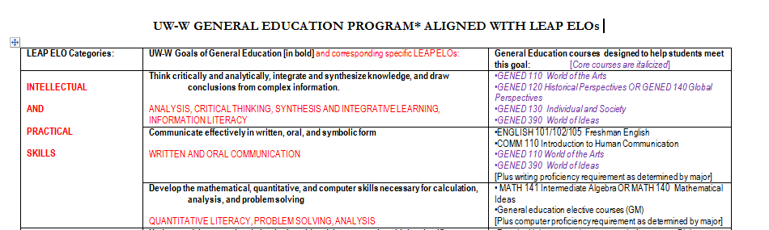

Slide 6
Academic Transformation Project (ATP)
2009-2011
Math Dept. team of 8 people
Math 041 and Math 141
Math 141 team: Fe Evangelista, Geetha Samaranayake, Joan Stamm, Ruth Whitmore, Peter Lampe

Slide 7
ATP Math 141 Goals
Develop a course that more closely aligns with GenEd goals and LEAP.
Increase the percentage of students getting a grade of C or higher in M141.
Maintain the same success rate for students in subsequent math courses.
Improve student motivation and interest in the class.

Slide 8
Other Influences
CUPM (Committee on the Undergraduate Program in Mathematics) Curriculum Guide 2004 by CBMS – recommendations for students taking general education or introductory courses
Refocused College Algebra Movement – MAA/CUPM subcommittee
National Center for Academic Transformation (NCAT)

Slide 9
Goal of Refocused M141:
Solve problems presented in the context of real world situations by modeling them using functions. Interpret and communicate the results.

Slide 10
Refocused Course Emphasizes:
Creating and analyzing graphs.
Interpreting the results of mathematical procedures.
Working with different representations of data.
Modeling real-world situations mathematically.
Communicating mathematics orally and in writing.

Slide 11
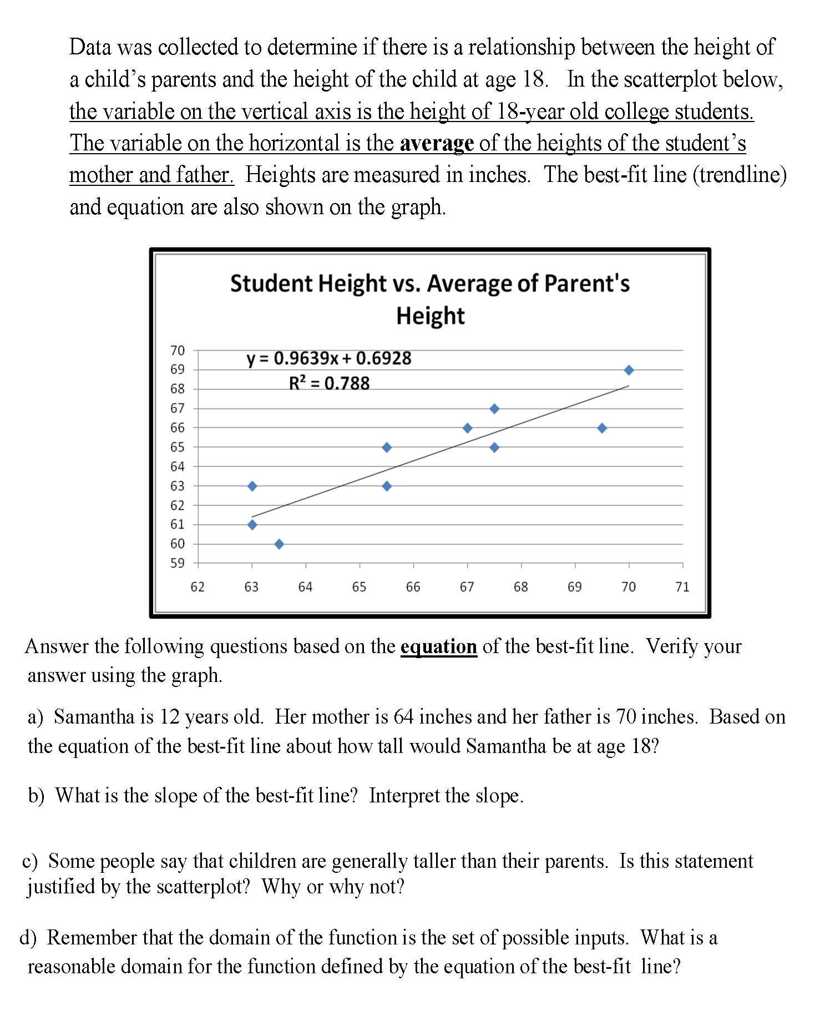
Sample Question

Slide 12
Change in Pedagogy
Reduced time spent on lecture; more group activities
Focus on teaching students strategies for mathematically interpreting verbal problems
Analysis and modeling of data by hand
and by using EXCEL.

Slide 13
Strategies to read and analyze
A vacuum cleaner salesman has fixed weekly costs associated with car maintenance, office staff, telephone bills, and so on. His profit for each vacuum cleaner sold is the same.
His weekly profit is given by P(x)=64 x – 384, where x is the number of vacuums sold.
(a) Explain what the slope of your function means in terms of the vacuum cleaners.
(b) What is the vertical intercept (y-intercept) of your function and what does it mean in terms of the profit and expenses of the salesman.
(c) Find the horizontal intercept (x-intercept) and explain what it means in terms of the salesman’s profit and sales.
Number of vacuum cleaners sold per week
Profit per week

Slide 14
Connections to Current Issues
Use the Internet to search for historical data for the number of hybrid cars sold each year for the years 2000 to 2007.
(a) Use EXCEL to create a scatterplot of the data, and sketch a trendline.
(b) Suppose that you were writing an article about hybrid cars. Use the data and the equation of the trendline to fill in the blanks in the paragraph below. Show your work at the bottom of this page.
Paragraph frame: Hybrid cars have been gaining in popularity. In 2000, _________________hybrid cars were sold. This number has been increasing at the rate of _______________ per year. If this trend continues, the number of hybrid cars sold will reach __________________in 2015.

Slide 15
Modeling Data
The following table gives US health care spending in billions of dollars.
t years since 1960 | 0 | 10 | 20 | 30
H = US health care spending | 27.6 | 75.624 | 207.210 | 567.755
(a) Is the data in the table linear or exponential? Explain or show how you make your decision.
(b) Find the model that gives US health care spending in billions. Let t represent years since 1960

Slide 16
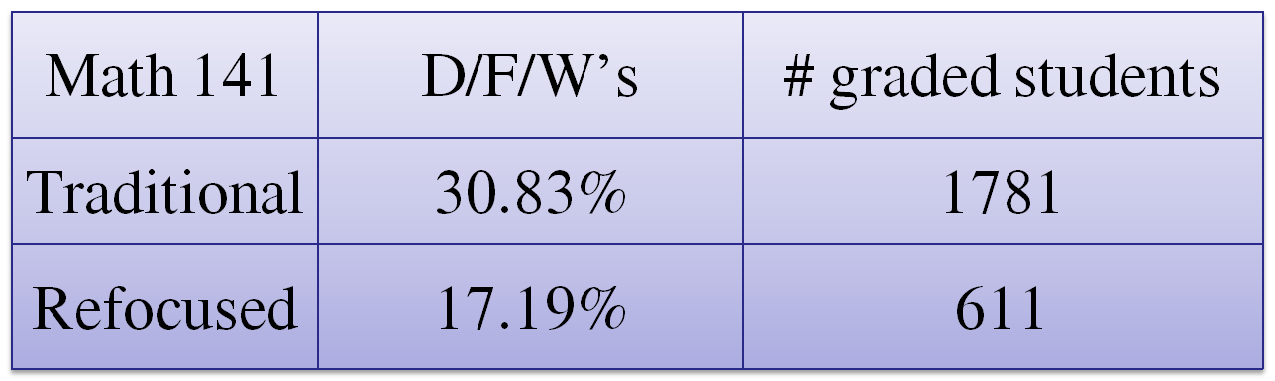
D/F/W Rates
The proportion of D/F/W’s in the traditional sections is nearly twice that in the refocused sections.
  A two-sample test of proportions yields a z-score of 6.53 which corresponds to p-value very close to zero.

Slide 17
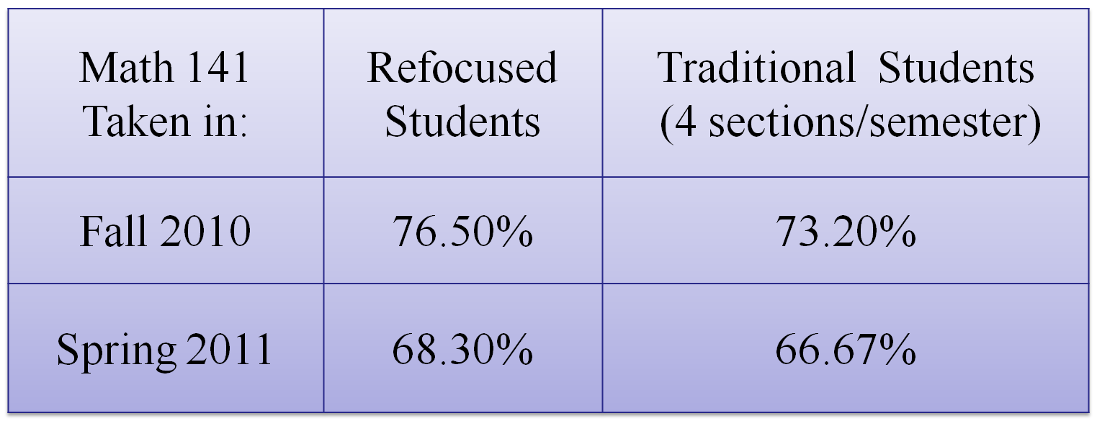
Success in Subsequent Courses
Students in the refocused sections perform at least as well as students in the traditional classes.

Slide 18
Refocused vs. Traditional
On Common Final Exam Questions

Slide 19
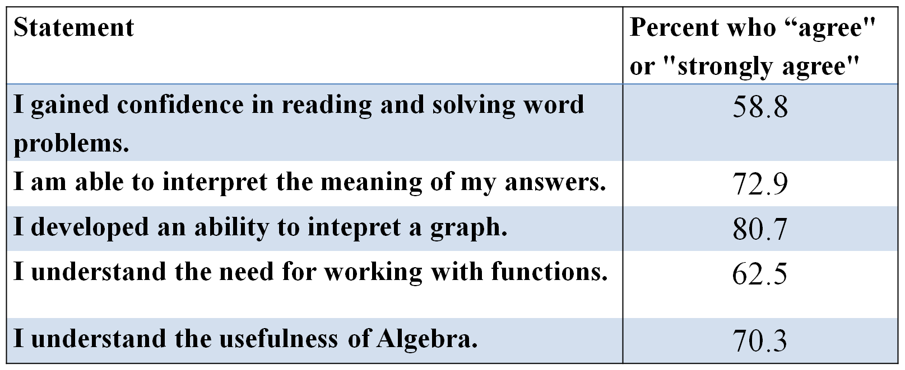
Student Confidence and Skills

Slide 20
Challenges
Textbook
It was difficult to find the right balance between teaching symbolic manipulation skills and addressing LEAP ELOs.
Both students and instructors had to shift their way of thinking about the teaching and learning of math.
More dedicated classrooms with appropriate technology need to be acquired.
Instructors must be trained so that we can transition from offering several pilot sections to almost all sections of the course.

Slide 21
ATP, Part II
Provide support for instructors teaching the course.
Develop critical thinking assessment instrument.
Continue to find ways to provide feedback to students in an efficient manner.

