Slide 1
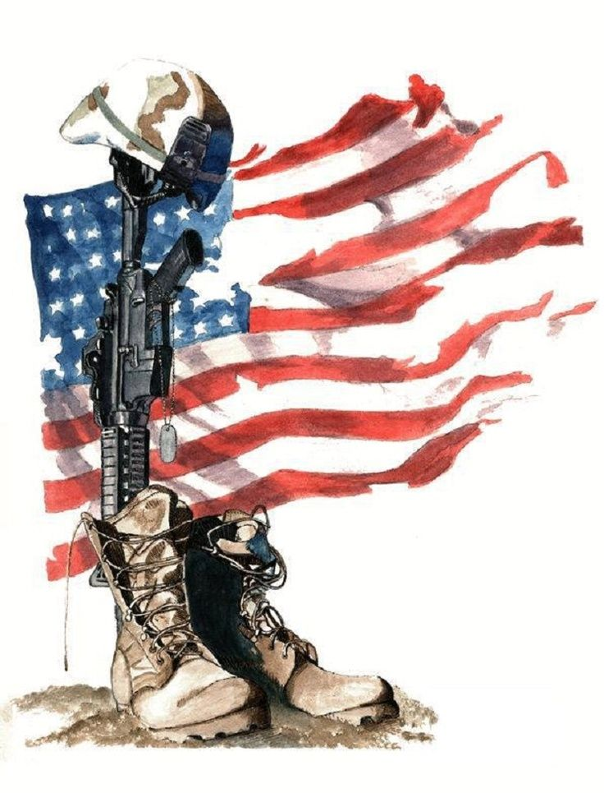
The term “The War at Home” is often used to describe Veterans and Military Service Members that have come home from the battlefield only to be casualties of an epidemic of suicide here at home. The most comprehensive study ever conducted by the Department of Veterans Affairs has concluded that twenty Veterans a day take their own lives. The study covered the years 1979 through 2014 and included the records of more than 50 million Veterans from every state in the nation.
Source: Suicide Among Veterans and Other Americans, 2001-2014

Slide 2
“The War at Home on Campus”
Nearly half of college students who are military veterans reported contemplating suicide
Approximately 20% reported having a plan to commit suicide
Slightly more than10% reported having thoughts of committing suicide very often
Nearly 8% reported a suicide attempt
Almost 4% reported a suicide attempt was either likely or very likely
Source: American Psychological Association: Suicide Risk High for War Veterans in College Study Finds (October, 2011)

Slide 3
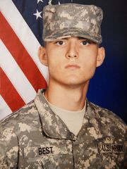
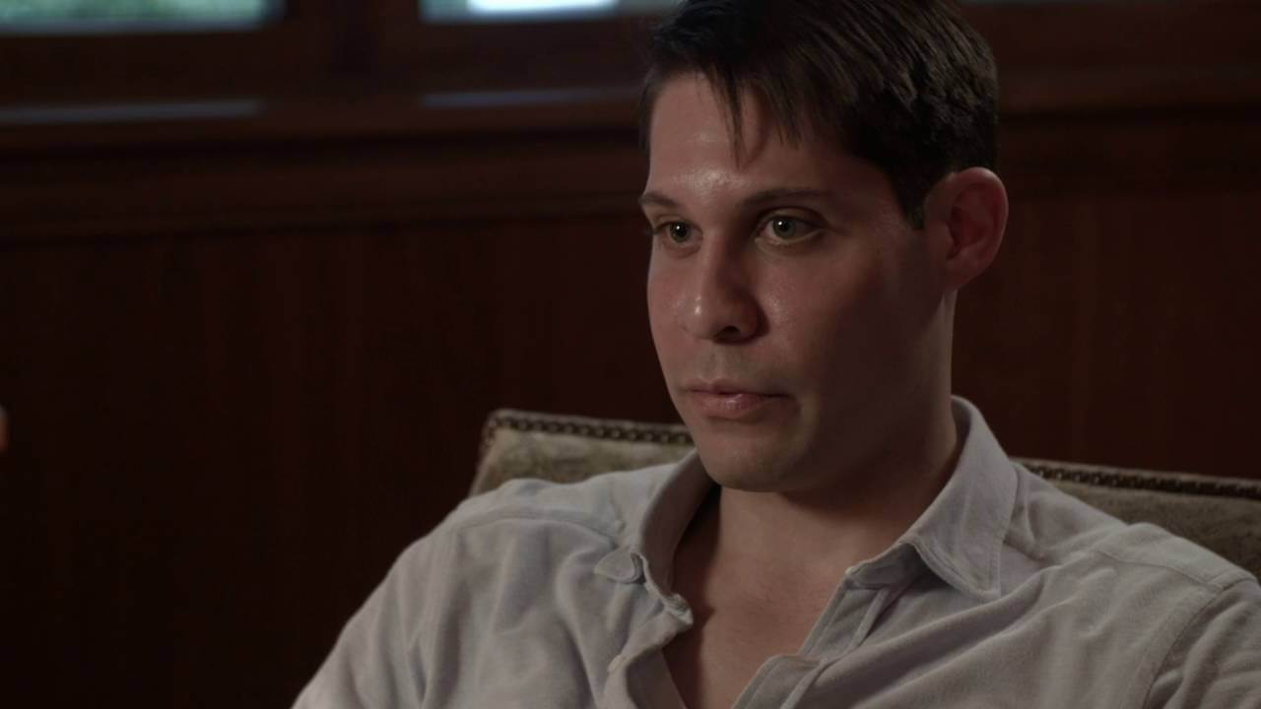
“Casualties of the War at Home on Campus”
Jared Best was a six year Army Veteran, married, working full time and taking welding classes at Haywood Community College when he took his own life at the age of 26 on December 31, 2016
Uriel Florez, 29, was a political science major at Columbia University in New York and a Navy corpsman who served in Iraq. Uri committed suicide on Sept. 6, 2016
In September, 2017 Marine veteran and Pasadena City College student Efren “Ren” Celestino took his own life at 31 years old

Slide 4
A survey of 14,673 Faculty and Staff at 20 Colleges and Universities revealed:
More than 70% do not feel adequately prepared to recognize when a student veteran is exhibiting signs of psychological distress including depression, anxiety, and thoughts of suicide
More than 75% do not feel adequately prepared to approach a student veteran if the signs of psychological distress including depression, anxiety, and thoughts of suicide were recognizable
Only 42% said that they feel prepared to manage a classroom discussion around a veteran sensitive issue
Just 44% said that they are not knowledgeable about the common challenges facing the student veteran population
Almost 94% said that all faculty, staff and administrators in my academic institution should take a course on military competency and veteran’s mental health
Source: National Center for Veterans Studies, University of Utah/Kognito: Are Faculty and Staff Ready to Support Student Veterans?

Slide 5
Red Flags
Student-Veteran/Military
Service Members who have been victims of Military Sexual Trauma
Student Veterans/Military
Service Members with a history of same sex partners
Female Student-Veteran/Military Service Members with a
history of sexual abuse
Source: (Ray-Sannerud et al., 2015); (Rolbiecki, Pelts, & Albright, 2015); and (Bryan, Theriault, & Bryan, 2015)

Slide 6
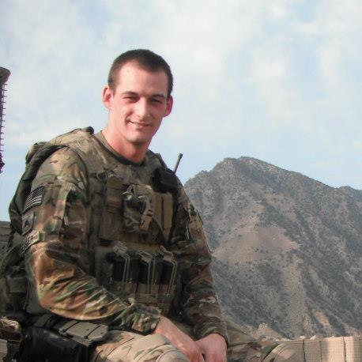
Veterans Peer Support Saves Lives
Marine Veteran and former UW-Whitewater Student, Ryan Krebs: I began having dark thoughts about hurting myself. One day, I decided that I would go home after school and put a bullet in my brain.
But, a friend, Dylan Sessler interviewed me on the same day about my military service for a class project. He asked me if I ever thought about suicide and I confided that I had, but I did not say anything about my suicide plan.
Dylan said something that will never forget. He said “I'm glad you are still with us.”
I had convinced myself that I was alone and that no one cared about me.
But, I was wrong.
I began thinking about how it would impact my friends if I took my own life. I realized I could not bring them that kind of pain.
“There's no one closer in life than your fellow vets.”
Source: https://www.gazettextra.com/archives/student-veteran-talks-about-suicide-i-felt-the-world-get/article_13c5b7b1-a7b1-5c96-bbb9-7a49b4c38525.html

Slide 7
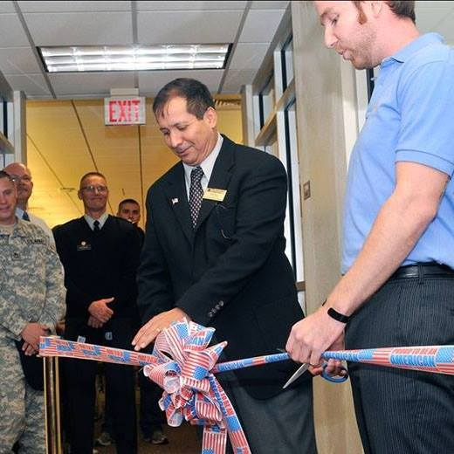
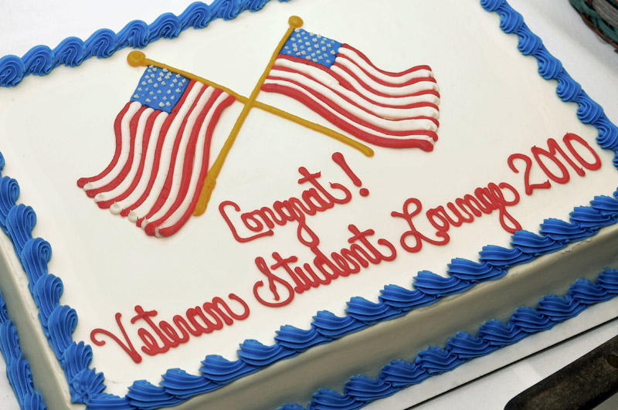
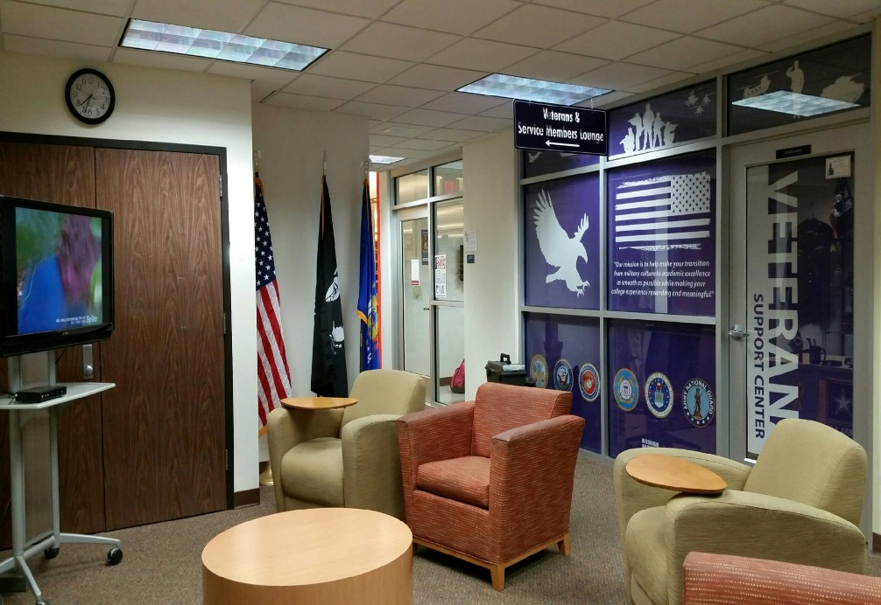
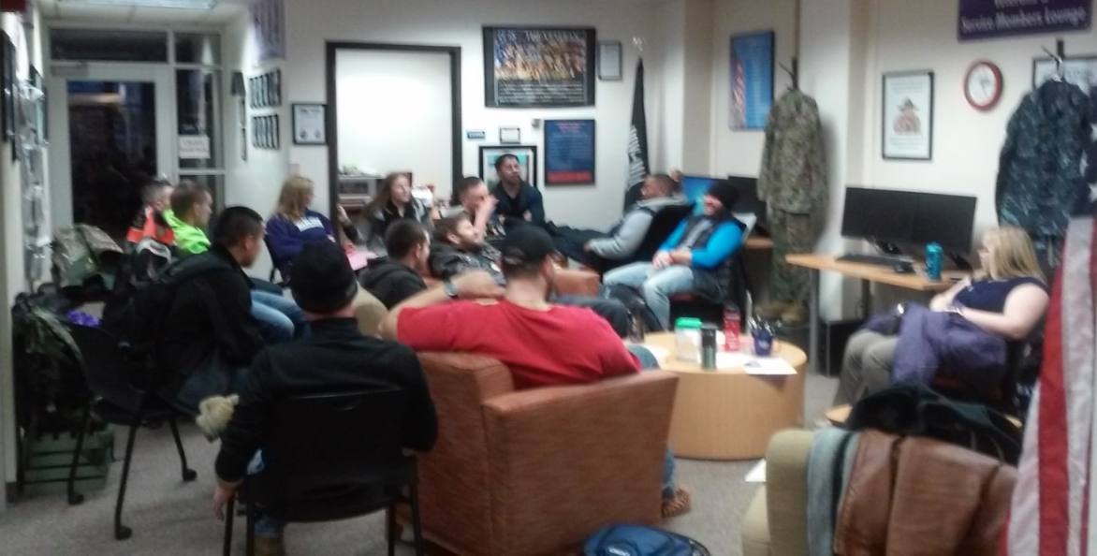
Veterans Safe Space
UW-Whitewater’s Veterans, Military Service and Family Members Lounge provides a safe environment
Marine Veteran and former UW-Whitewater Student Ryan Krebs credits the Lounge with helping to prevent him from committing suicide

Slide 8
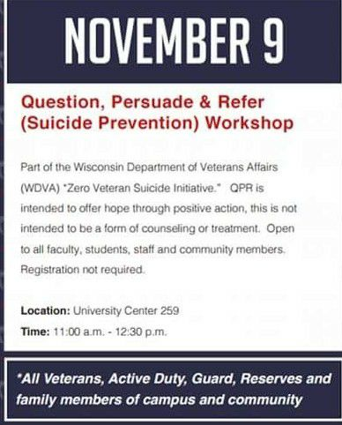
Raising Awareness on Campus

Slide 9
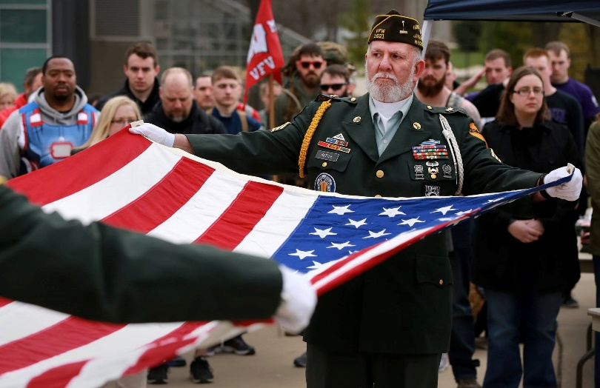
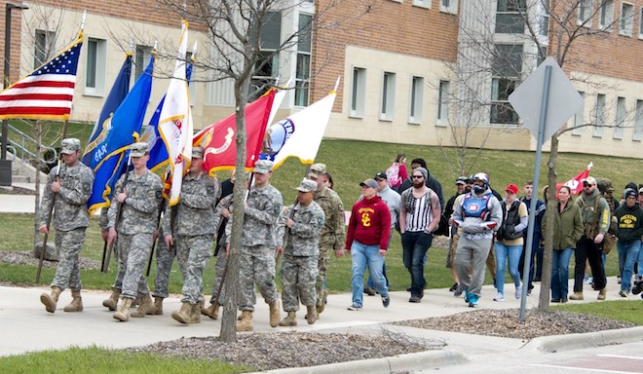
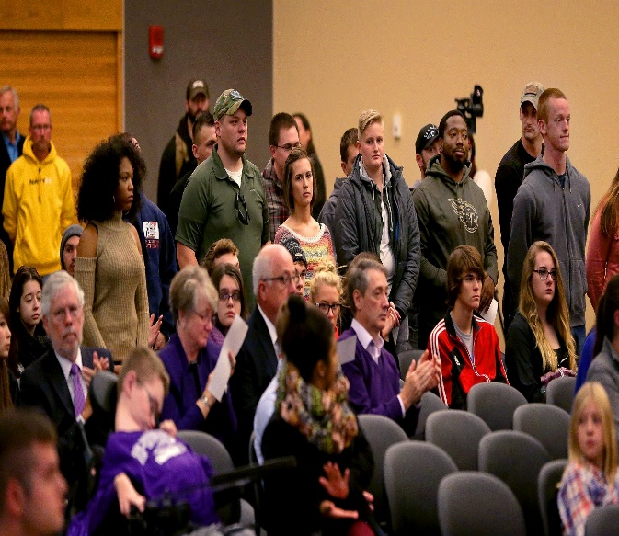
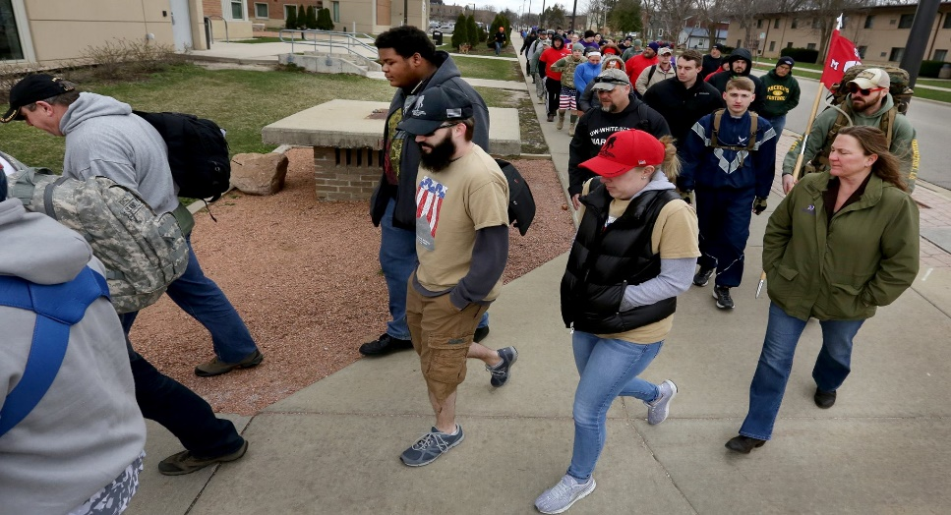
Going the Distance for Veterans

Slide 10
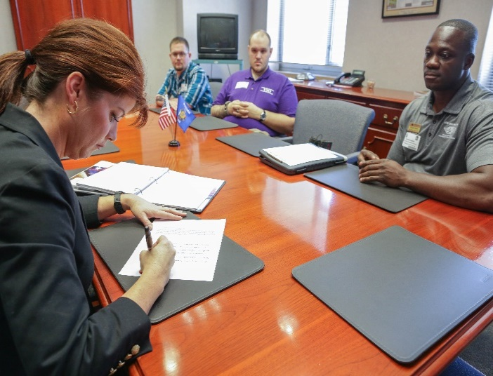
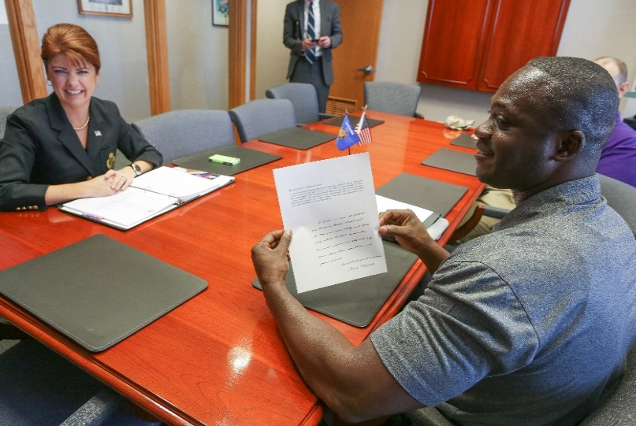
Support of Elected Officials
Meeting with former Wisconsin Lt. Governor Rebecca Kleefisch regarding her support for UW-Whitewater’s efforts to end suicide among Veterans in the State of Wisconsin and presenting her with UW-Whitewater’s Chancellor’s Gratitude Coin for supporting our efforts!

Slide 11
Cross-Campus Collaboration
Goal | Objectives
Utilize Campus-Based resources to address the concern reported in recent research findings that indicate Student-Veterans and Military Service Members are at greater risk of suicide attempts and suicidal ideation than their non-veteran college counterparts. | Collaborate with the following Campus-Based resources to address the concern reported in recent research findings that indicate Student-Veterans and Military Service Members are at greater risk of suicide attempts and suicidal ideation than their non-veteran college counterparts: University of Wisconsin-Whitewater Health & Counseling Services Jim Freiburger, Executive Director freiburj@uww.edu (262) 472-1305 University of Wisconsin-Whitewater CARE Team Andrew Browning, Case Manager BrowningAR29@uww.edu (262) 472-1533 University Wisconsin-Whitewater’s Police Services Chief, Matthew Kiederlen kiederlm@uww.edu (262) 472-4660

Slide 12
Community-Based Collaboration
Goal | Objectives
Utilize Community-Based resources to address the concern reported in recent research findings that indicate Student-Veterans and Military Service Members are at greater risk of suicide attempts and suicidal ideation than their non-veteran college counterparts. | Collaborate with the following Community-Based resources to address the concern reported in recent research findings that indicate Student-Veterans and Military Service Members are at greater risk of suicide attempts and suicidal ideation than their non-veteran college counterparts: Madison VA Hospital Andrea Bailey, LCSW Suicide Prevention Coordinator Andrea.Bailey@va.gov (608) 256-1901 ext 11778 Milwaukee VA Hospital Laura Acompanado, LCSW Suicide Prevention Case Manager Laura.Acompanado@va.gov (414) 384-2000 ext 42671

Slide 13
Service Delivery Model
Step #1
Coordinator of Student Veterans Military Services is Contacted
Step #2
Engagement and Needs Assessment Documented
Step #3
Appropriate Referrals are Made

Slide 14
Coordinator of Student-Veterans & Military
Services Outcome Measurement
Total Referrals Made to CSVMS | Self-Referrals Made to CSVMS | Third Party Referrals Made to CSVMS | CSVMS Referrals Made to Campus-Based Resources | CSVMS Referrals Made to Community-Based Resources
9 | 7 | 2 | 9 | 9

Slide 15
Q&A
University of Wisconsin—Whitewater Richard Harris, MSW, APSW HarrisR05@uww.edu (608) 718 - 6120

Slide 16
Works Cited
American Psychological Association (October 2011, Vol 42, No. 9): Suicide risk is high among war veterans in college study finds.
Bryan, A. O., Theriault, J. L., & Bryan, C. J. (2015). Self-forgiveness, posttraumatic stress, and suicide attempts among military personnel and veterans. Traumatology, 21, 40 – 46. http://dx.doi.org/10.1037/Trm0000017
Bryan, C. J., Bryan, A. O., & Clemans, T. A. (2015). The association of military and pre-military sexual trauma with risk for suicide ideation, plans, and attempts. Psychiatry Research, 227, 246–252.
Office of Suicide Prevention: Suicide Among Veterans and Other Americans, 2001-2014. https://www.mentalhealth.va.gov/docs/2016suicidedatareport.pdf
Ray-Sannerud, B. N., Bryan, C. J., Perry, N. S., & Bryan, A. O. (2015). High levels of emotional distress, trauma exposure, and self-injurious thoughts and behaviors among military personnel and veterans with a history of same sex behavior. Psychology of Sexual Orientation and Gender Diversity, 2, 130–137. http://dx.doi.org/10.1037/sgd0000096
Rolbiecki, A. J., Pelts, M. D., & Albright, D. L. (2015). Student veterans impacted by military sexual trauma. In J. E. Coll & E. L. Weiss (Eds.), Supporting veterans in higher education: A primer for administrators, faculty, and academic advisors (pp. 221–238). Chicago, IL: Lyceum Books.
Rudd, D. M., Goulding, J., & Bryan, C. J. (2011). Student veterans: A national survey exploring psychological symptoms and suicide risk. Professional Psychology: Research and Practice, 42, 354–360. http://dx.doi.org/10.1037/a0025164
The National Center for Veterans Studies, The University of Utah & Kognito (2017): Are Campuses Ready to Support Student Veterans?

