Slide 1
Budget Status

Slide 2
Budget Status – Details
The following items represent some detail around evaluating the compiled budget.
Confirm all budgets received
Evaluate different funds – example: cleanup of missing items, misalignment of allocations in funds, and any reserved allocations may change this picture
Evaluate each funding string at a detailed level
Cleanup budget for loading
Action for All: Evaluate if all funding strings you manage that have revenue and/or expenses has had a budget submitted.

Slide 3
Budget Status – Double Checks
The following additional checks must also be happening.
Payroll: A thorough review of every position on the budgets compared to HRS is in progress.
Fringe Benefit Calculation: In most cases, we are using standard fringe rates unless your past experience exceeded these standard rates. This is mostly complete.
Debt Schedule and Internal Loans: A review of all debt schedules including internal loans to appreciate the transfers are budgeted in total is in progress.
Segregated and Differential Fees: Ensure no double counting or missing revenue along with balancing with the central projection of revenue.

Slide 4
New Budget Concepts
The following is a new idea that has been discussed with various leaders and areas on campus and represents a rare exception.
Situation: An area wants to spend reserve to help gradually move to the sustainable budget over 1-3 years and has reserve to do this.
Old Possibilities: Reduce operating budget OR include over budget spending in budget
New Recommendation: An area buys additional budget
If this “buying budget” is needed, funds need to be available in April and the area must maintain positive balances at year end.

Slide 5
COVID-19 Budget Impact – Overall
The following is some guidance around the budget impact provided by UW System.
No changes to the FY21 budget submittal due to COVID-19.
Detailed tracking required for all expenses directly related to COVID
Detailed tracking required for all revenues lost (refunds) related to COVID. (Must be net against saved expenses.)
Not tracking some of these amounts will reduce how much we can claim of federal support.
The expenses should continue to be sent to Trisha Barber and revenues/refunds to me.

Slide 6
COVID-19 Budget Impact – Revenue Lost

Slide 7
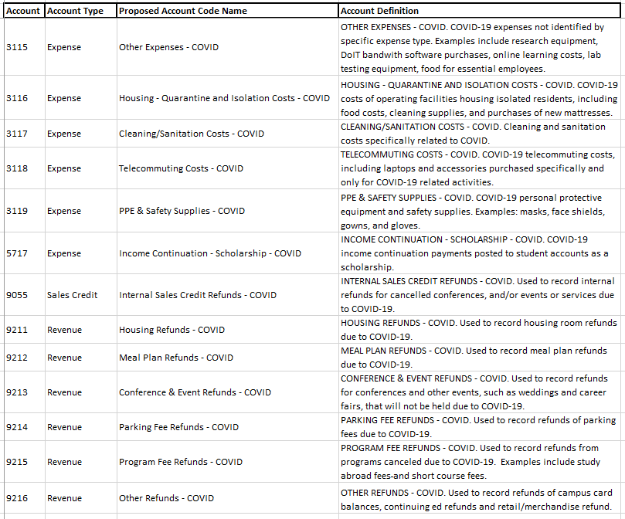
COVID-19 Budget Impact – Expenses

Slide 8
COVID-19 Budget Impact – Conclusion
If you have had expenses and/or lost revenues that haven’t been sent centrally and are not in these codes, contact Taryn Carothers immediately so we can support whatever needs to happen.

Slide 9
Other Budget and Finance Activities
System is moving forward with utility de-pooling– impact on campus is increased costs of $450,000 a year starting FY21 with a jump to $900,000 a year in FY23, in response we will be investing in energy efficiency projects.
COVID financial impact to campus to date is approximately $9m – impact is lost revenue and additional expenses, in response we are in the midst of analyzing our financial liquidity and conducting scenario modeling – actions to date include: spending down auxiliary reserves, stopping program revenue supported capital projects, reducing expenses, submitting for federal funding under the Cares Act, and focusing on enrollment and retention.
Once FY21 budget is submitted, will run financial models and will have better estimates of year end-balances.

