Slide 2
Strategic Planning
Update
November 14th, 2022
SPBC Fall Meeting

Slide 3
Strategic Planning Framework
Gather Stakeholder Input to Inform Campus Priorities
Accomplished through Open Forums (9/19/22 - 9/29/22)
Establish Top Themes
Accomplished through:
Review, Synthesis and Summary of Open Forum Data
Feedback from SPBC (10/25/22 & 11/14/22)
Feedback from Cabinet (10/24/22 & 11/7/22)

Slide 4
Theme Structure and Definitions
Themes
Key priority areas identified from broad campus input which define the Strategic Plan
Title
Concise aspirational phrase speaking to the main theme
Description
Qualitative explanation articulating areas where progress is intended under a theme
Metric
Quantitative goal(s) through which progress will be measured
Strategies
Actions implemented to deliver progress on the metric goals
Notes:
Metrics: 1.) Establish baseline (our current state) as well as allow a target goal to be determined 2.) Must be available and ready to go “day 1”
Strategies: 1.) These may only apply to a single theme, or they may impact several themes 2.) These may have their own metrics as well to measure progress 3.) Implementable “day 1”

Slide 5
Strategic Planning General Framework
Theme 1
Theme 2
Theme 3
Theme 4
Description
Description
Description
Description
Metric 1
Metric 2
Metric 2
Metric 1
Metric 2
Metric
Metric 1
Metric 3
Strategy 1
Strategy 2
Strategy 3
Strategy 4
Strategy 5
(metric)
(metric)
(metric)
Or Strategies May Impact Multiple
Strategies May Only Impact 1 Theme

Slide 6
Theme 1
Champion Diversity, Inclusion and Student Advocacy
Recognizing that our students have unique needs and individual strengths, we will embrace a university-wide, holistic approach to teaching and support services to meet students where they are and engage them accordingly. Channeling our core value of diversity, we will successfully recruit, retain and graduate students from all backgrounds, modeling the very best “people-first” approach to the delivery of our mission, where our employees are approachable and responsive, where our spaces are welcoming, and where students feel deeply connected and supported.
We will identify and address barriers to students enrolling in, continuing or finishing a program. To meet the ever-changing demands of the higher education landscape, we will adapt our program delivery models to address students’ desire for accessible and flexible programs of study.

Slide 7
Theme 2
Advance Co-Curricular Programs and Advising
To parallel our high-quality academic programs, we will offer highly effective co-curricular programs that enhance the student experience and contribute to learning.
In addition, we will initiate best practices in advising university-wide to ensure consistent advising quality across our institution – actions that will drive students to successful and timely program completion.

Slide 8
Theme 3
Enhance The Value of a UWW Education
We will improve our post-graduation outcomes consistent with an exceptional liberal arts education. From communication and problem solving ability, to critical thinking and intercultural competence, our students will develop valuable professional skills throughout their academic journey at UW-Whitewater that make them outstanding candidates for careers and advanced education opportunities.

Slide 9
Theme 4
Deepen A Culture of Collaboration
Driven by a shared institutional purpose to transform lives, we will build robust partnerships across colleges, divisions and departments to collaborate on projects and initiatives, to advance ideas and to share and grow resources.
With people as our most valuable resource, our workplace will serve as a regional exemplar that cultivates positive employee morale, and identifies issues and opportunities that arise and addresses them in a proactive and timely manner.

Slide 10
Theme Notes
Targeted
More focused and fewer in number
Complementary To
Academic Plan
Unit Missions and Strategic Plans
College Missions and Strategic Plans
Foundation Mission and Strategic Plan
UW-System Strategic Plan

Slide 11
SPBC Activity 1
Brainstorm Metrics For Each Theme
Must Be quantifiable
Must be available and ready to go “Day 1”
Don’t worry if you are unsure if the data currently exist
These Metrics Set The Goal(s) for a Theme
The current value of the selected metric(s) establish our baseline
The Theme Teams will select the final metrics and establish the target(s)

Slide 12
SPBC Activity 2
Review Provided Strategies List
Categorize Which Theme(s) Each Strategy Impacts
Strategies may have their own metrics which can be monitored (but don’t have to)
Implementable “Day 1”
Add strategies if you think something may be missing
Strategies may impact a single theme or multiple themes
Please note all themes which you believe a strategy may impact
These strategies will be provided to Theme Teams for review and selection

Slide 13
SPBC Activity 3
Recommend Theme Team Membership Around Each Theme
Theme Team Purpose and Role
Select strategies for each theme (informed by Open Forum/SPBC input)
Engage in implementation as appropriate
Monitor metric(s) and progress
Report back to SPBC, Cabinet, Governance Groups regularly
Composition
Comprised of Administration, Faculty, Staff, Students, SPBC Member, etc.
Members have interest, expertise and ability to implement

Slide 14
Theme Team Structure Possibilities
Theme 3 Team
Administrator
SPBC Rep
Faculty Rep
Staff Rep
Member 1
Member 2
Theme 2 Team
Administrator
SPBC Rep
Faculty Rep
Staff Rep Student
Member 1
Member 2
Member 3
Theme 2
Theme 3
Description
Description
Metric 2
Metric 2
Metric 1
Metric 2
SubTeam 1
SubTeam 2
Metric 1
Metric 3
Metric 3
Strategy 2
Strategy 3
Strategy 3
SubTeam 1
SubTeam 2
Strategy 4
(metric)
(metric)

Slide 15
Conclusion
For Updates and More Information:
https://www.uww.edu/strategic-plan

Slide 17
Financial Update

Slide 18
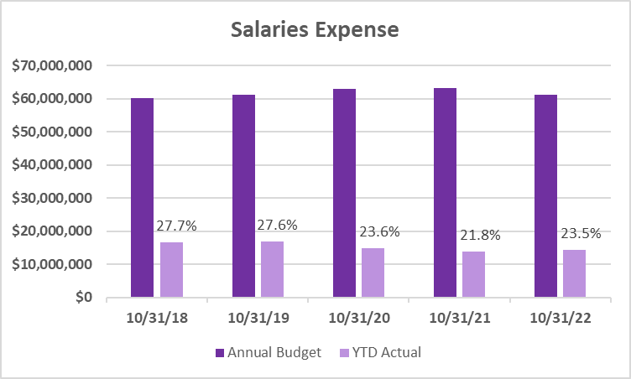
Expense Trends

Slide 19
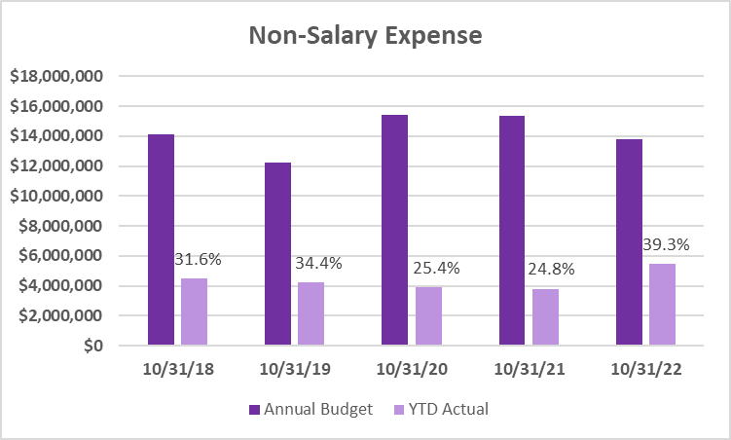
Expense Trends

Slide 20
Reminders

Slide 21
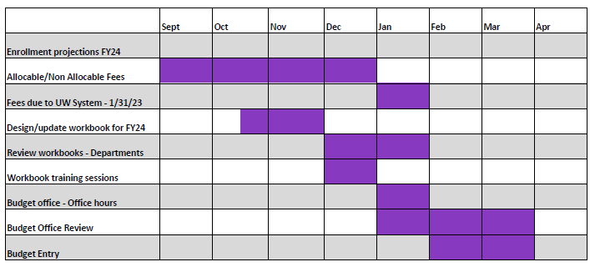
Budget Timeline FY 2023-24

Slide 22
Pay Plan 2023
2% of base salary at October 1, 2022
Timeline
Eligibility determined October 1, 2022
Mandatory training - due by December 1, 2022
Performance evaluations - due by December 1, 2022
Effective January 1, 2023 (pay checks dated 1/26/23)

