Slide 1
Recycling in Whitewater!
Wesley Enterline
Students Allied for a Green Earth (S.A.G.E.)
Notes:
http://vimeo.com/57211338
http://vimeo.com/26764989
http://www.johnsdisposal.com/site/wp-content/uploads/2013/01/whitewater-City-2013.pdf

Slide 2
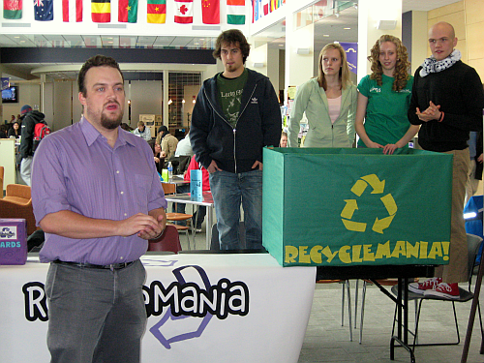
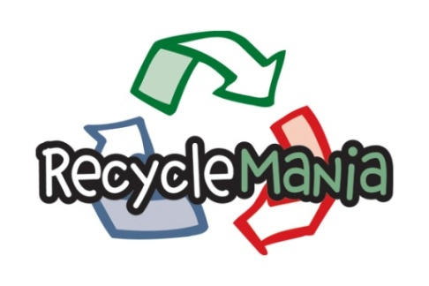
Waste - RecycleMania
Competition each spring
Two Divisions
Residence Hall Competition
Measure
% of waste stream being recycled
Reduction of total waste
Results
2009: 28.7% recycling rate (82/206)
2010: 29.3% recycling rate (102/267)
2011: 25.5% recycling rate (165/288)
2012: 27.0% recycling rate (143/275)
2013: 32.4% recycling rate (103/273)
Greatest success in Waste Minimization category
Notes:
Currently generate about 1000 tons annually, about 25% of it is recycled

Slide 3
What CAN You Recycle?
Recyclables are COMMINGLED – put in same bin, no bag
Paper
Newspaper, magazines, and catalogs
Paper bags
Office paper, including notebooks, folders, envelopes, and printer paper
Any type of cardboard, including chipboard (dry food boxes) and relatively clean pizza boxes, juice boxes/food cartons
Shredded paper (in clear bags), junk mail, phone books and even paper back books
Plastic
Any type of container with the number #1-7, including lids but NOT Styrofoam
Metal
Aluminum, tin, and steel cans – includes larger amount of foil balled up
Glass
Green, brown and clear containers, including lids
Notes:
Paper is probably the easiest and most inclusive thing that can be recycled, but is probably one of the most common things that isn’t recycled – over 60% of the recycled material on the UW-Whitewater campus is paper… about 150 tons per year!
Most recycling companies only take #1 and #2 plastics, but John’s currently takes any kind of plastic as long as it isn’t contaminated with food, oil, or other stuff
Metal and glass containers are commonly recycled in almost all cities

Slide 4
What CAN’T You Recycle?
Paper
Dirty or contaminated items with food or grease
Wax or plastic lined boxes and paper
Plastic
Thin film, such as Saran Wrap or plastic bags and Styrofoam
Metal
Random hunks of metal confuse or damage the recycling machines, but are harvested by magnets at landfills
Glass
Panes of glass like windows and mirrors and broken glass cannot be recycled
Notes:
Paper needs to be mostly clean and pure paper, not composite materials – paper is often lined with plastic or wax to avoid leakage
Things like plastic windows on envelopes is fine
Plastic needs to have a shape to it or the machines mistake it for paper and it contaminates the paper
Metal and glass also need to be containers
Both metal and plastic lids are fine – just leave them on the container if you can to help cut back on smells!

Slide 5
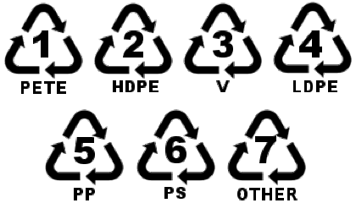
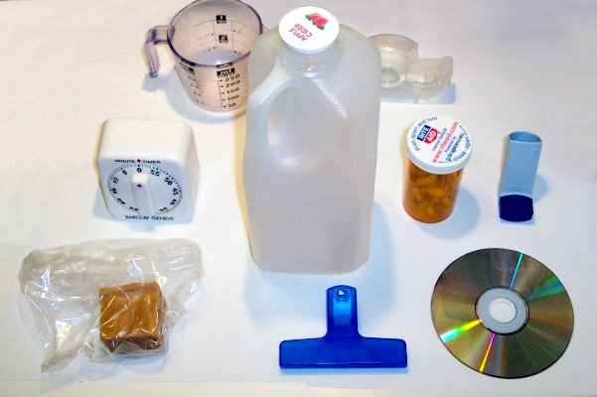
What Do the Numbers Mean?
Not all plastics are the same –different polymers
Seven types of polymers:
1 – PET, polyethlyene terephthalate
2 – HDPE, high-density polyethylene
3 – PVC, polyvinyl chloride
4 – LDPE, low-density polyethylene
5 – PP, polypropylene
6 – PS/PS-E, polystyrene / expanded polystyrene
7 – OTHER, resins or multi-materials
Notes:
Plastic polymers refer to their chemical structure – gives them different properties such as flexibility, hardness, durability, and if they will break down naturally – many plastics break down slowly
Called the resin identification code
Most common plastics are #1 and #2 – also easiest to recycle because they are the hardest and most durable. Other plastics break down too easily when they are melted down and cannot be reformed into new items

Slide 6
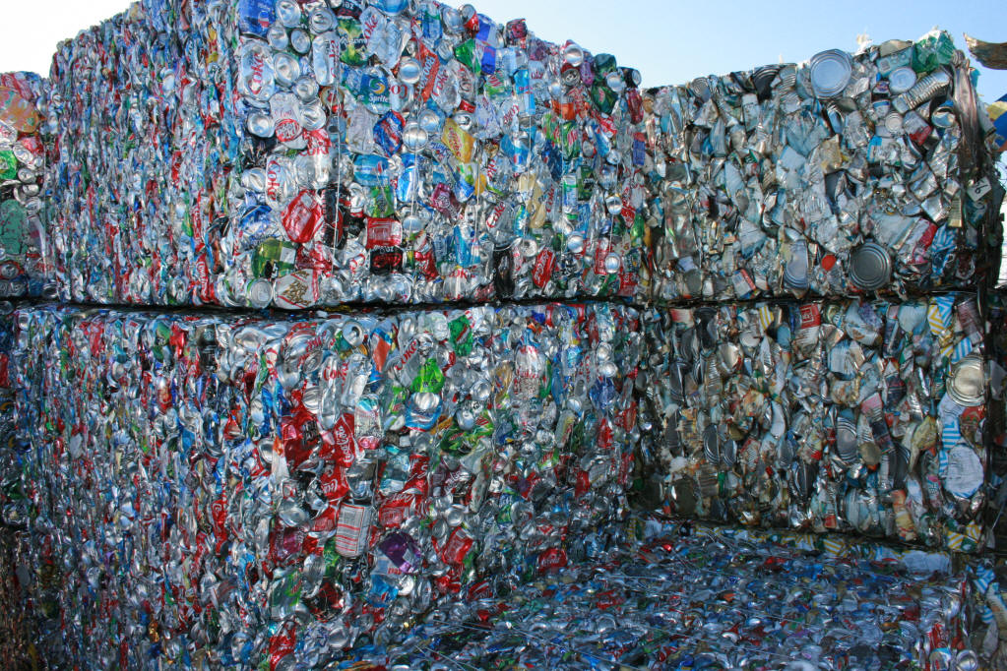
QUIZ: Is this recyclable?
On a piece of paper numbered 1-10, please write YES if an item can be recycled and NO if it can’t be recycled

Slide 7
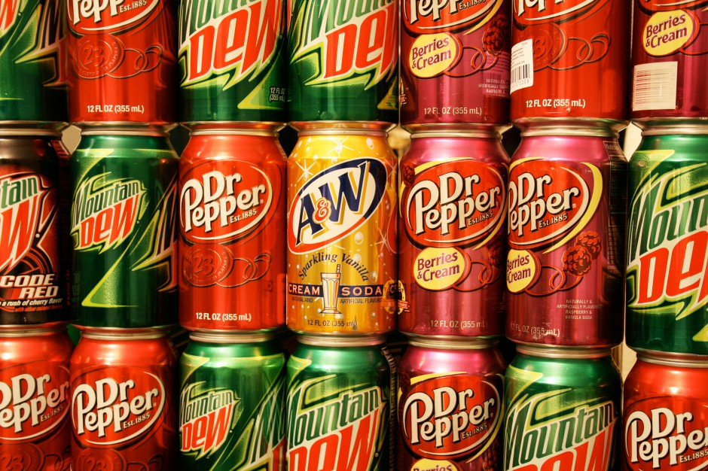
Question #1: Dew you Recycle?
Notes:
Yes

Slide 8
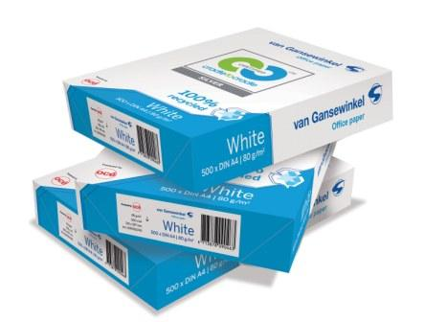
Question #2: Throw away the old homework in…?
Notes:
Yes

Slide 9
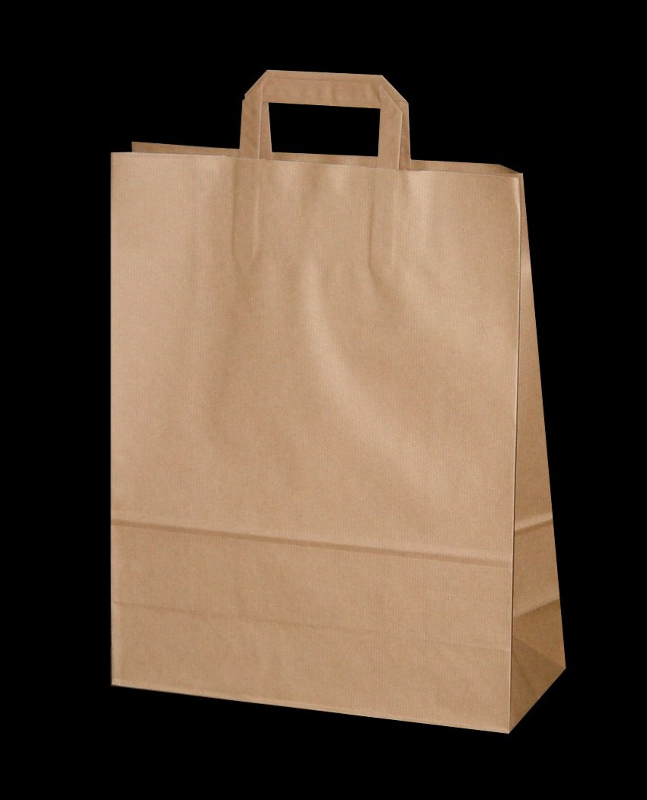
Question #3: Paper…
Notes:
Yes

Slide 10
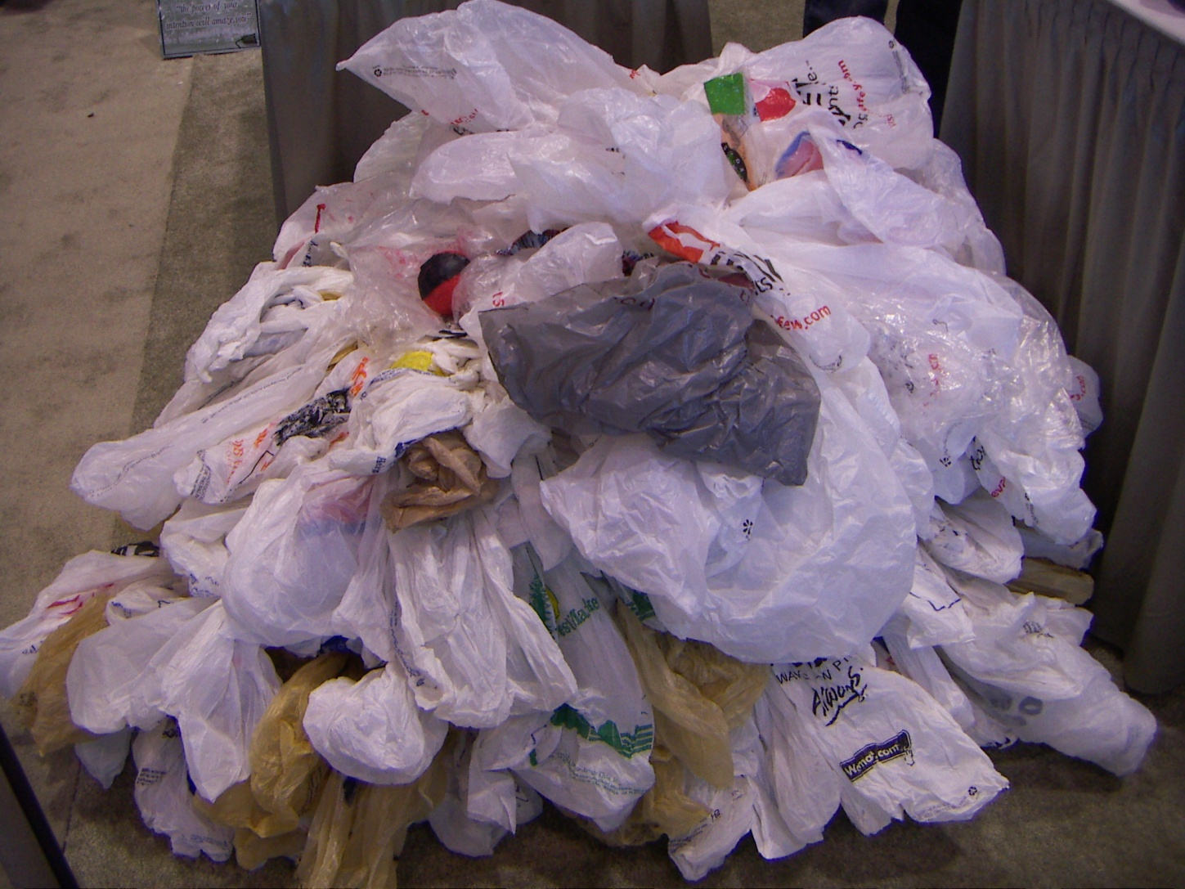
Question #4: … Or Plastic?
Notes:
No, unless bundled in large quantities for Johns or brought to participating retail stores. Also good to donate to thrift stores.

Slide 11
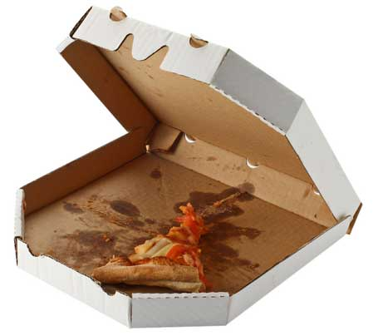
Question #5: Recycling bin’s favorite food?
Notes:
Top of box yes, bottom no

Slide 12
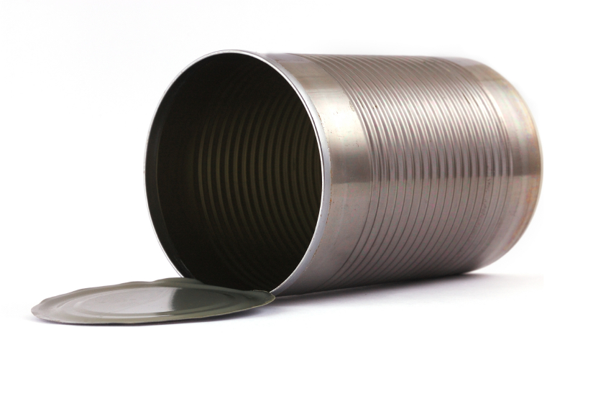
Question #6: Tin can? Steel can? Recyclable can?
Notes:
Yes

Slide 13
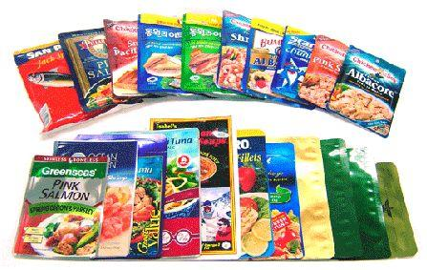
Question #7: Recycle the fish pouch?
Notes:
No, it is a compound material (paper layered with plastic)

Slide 14
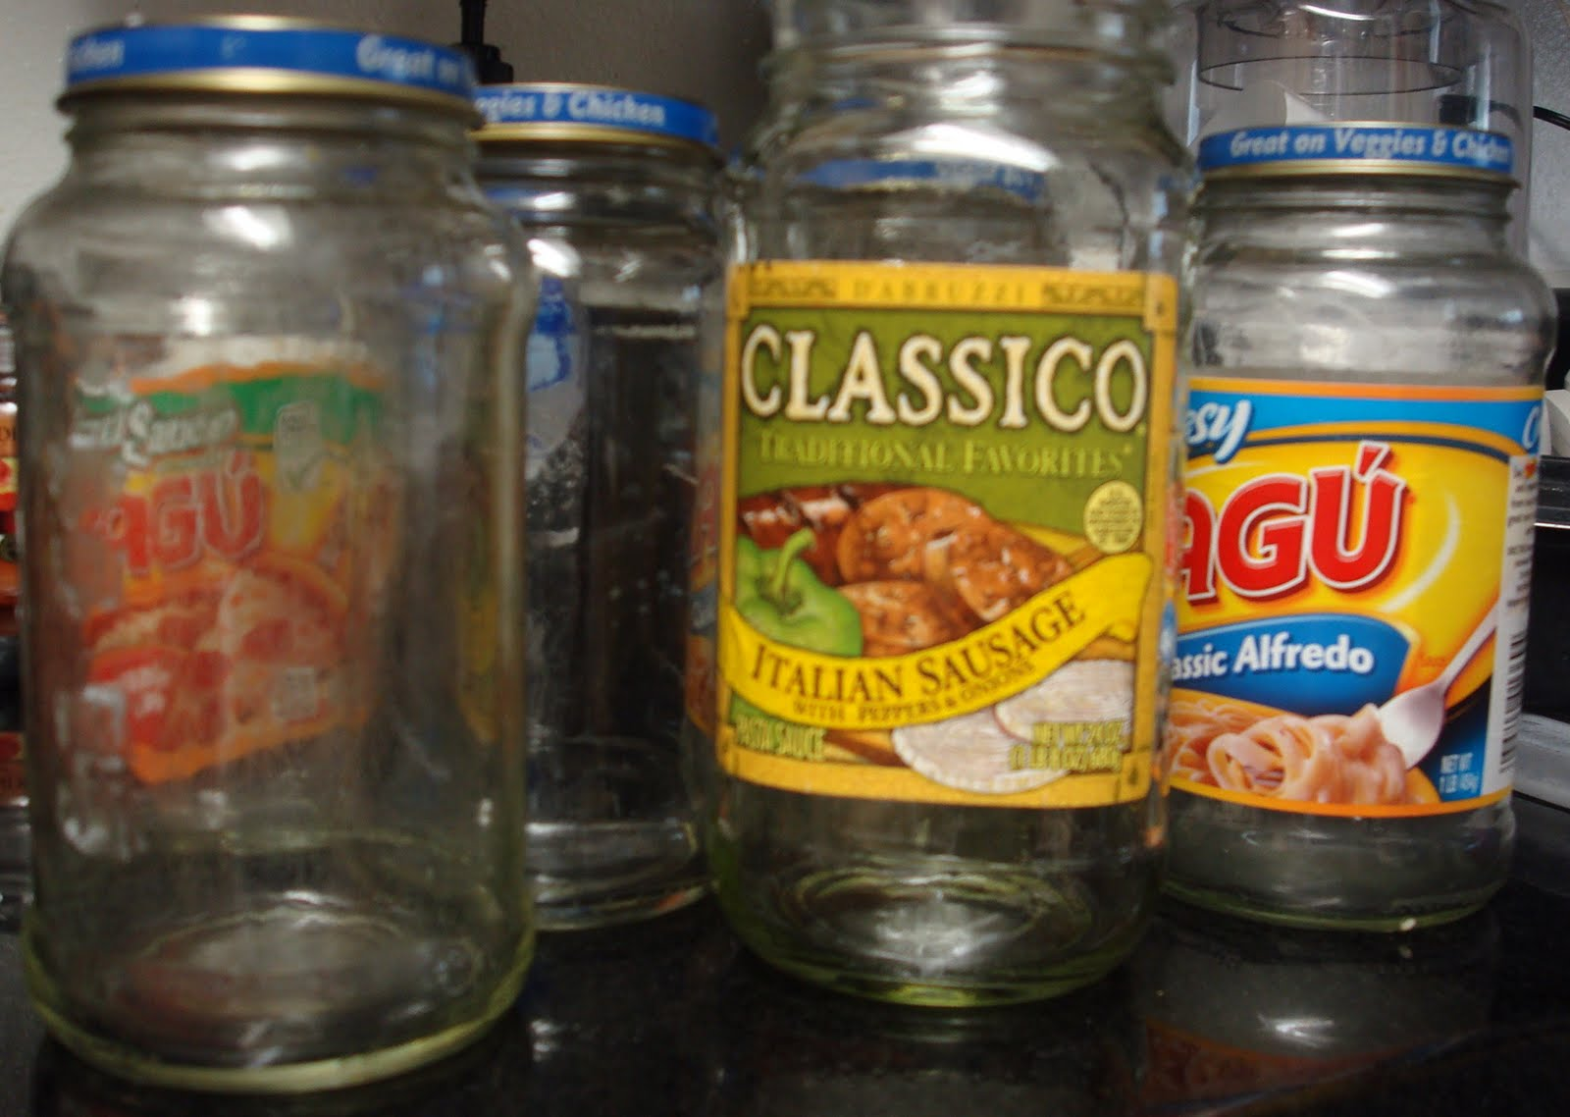
Question #8: Trusty jars again and again?
Notes:
Yes

Slide 15
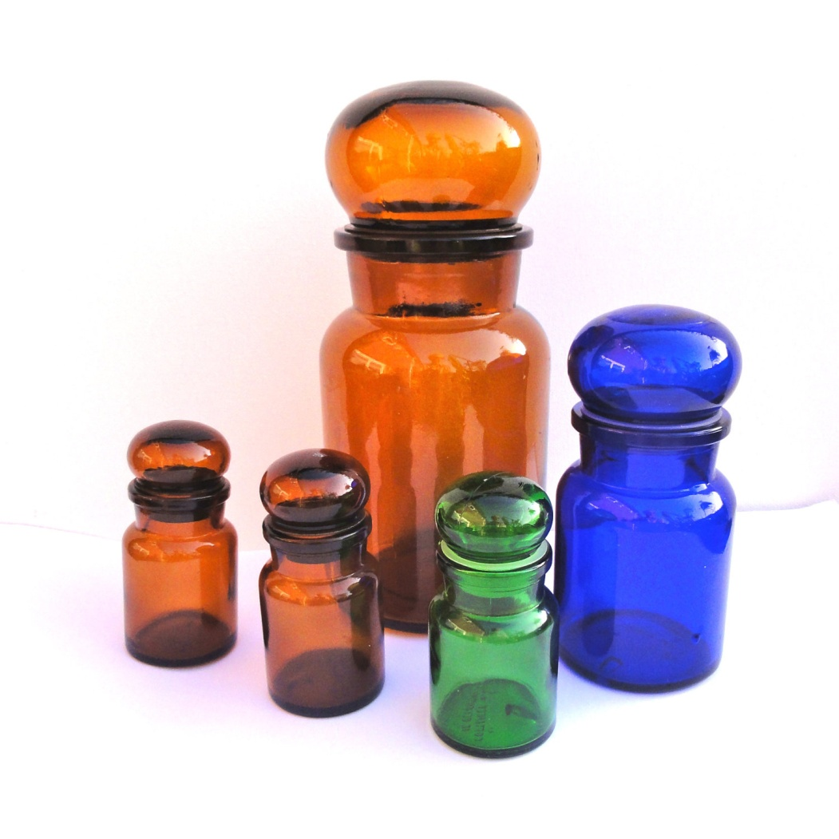
Question #9: Color?
Notes:
Yes

Slide 16
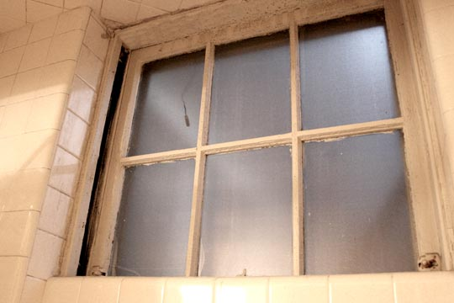
Question #10: Shape?
Notes:
No

Slide 17
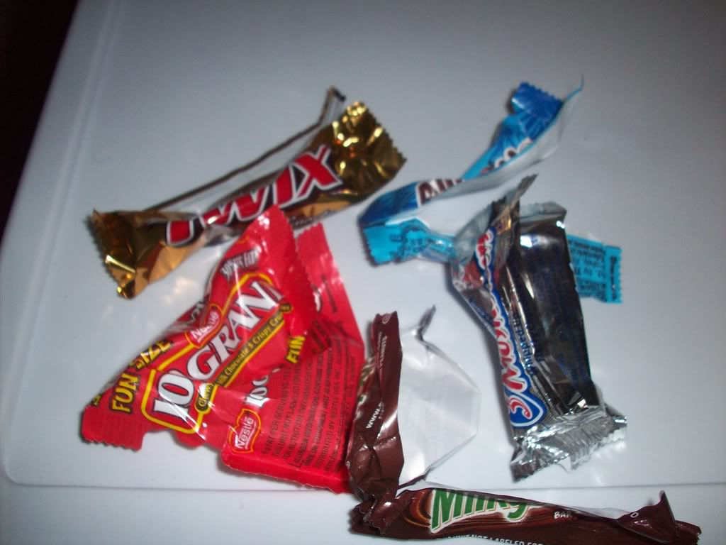
Question #11: Trick or treat?
Notes:
No

Slide 18
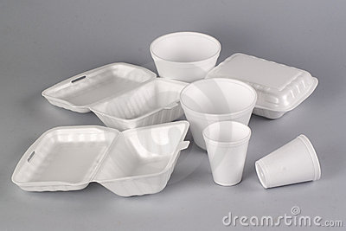
Question #12:An Ancient Evil…
Notes:
No

Slide 19
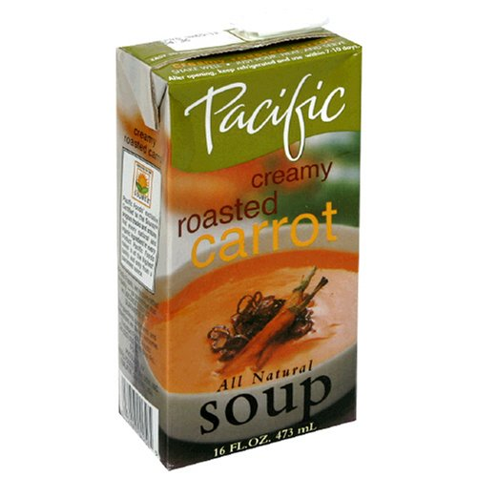
Question #13: Souper Recyclable?
Notes:
Yes

Slide 20
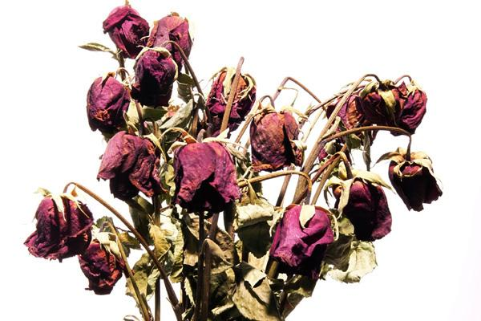
Question #14: Dead and Shriveled Love?
Notes:
No

Slide 21
BONUS: Is my meal recyclable?
Tonight I went to Culver’s and got a Veggie Burger Basket with a side salad and an order of fries. What of the following materials can be recycled?
Paper bag and receipt
Used napkins
Plastic salad container and lid
Plastic dressing container
Plastic silverware
Drink cup
Drink lid and straw
Burger and fries wrapper
Ketchup packet
Ok… I got a small plastic dish of custard too ☺: Can I recycle the container and lid? Spoon?
Notes:
No math class is any good without a story problem…
Yes – paper bag and receipt, plastic salad container and lid, custard dish and lid, plastic dressing container
No – used napkins, plastic silverware, drink cup, drink lid and straw, food wrappers, ketchup packet,

Slide 22
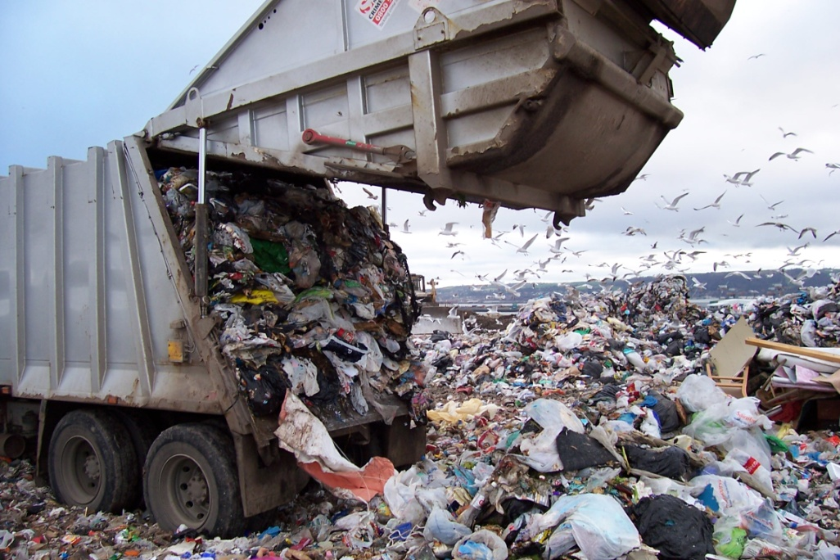
Questions? Dump them on me!
Think of something later? Send me an email: sustainability@uww.edu
Types of plastics accepted changes based on market prices, so contact John’s if you aren’t sure or want an update

