Slide 1
The Savannah Project
Sustainability Curriculum Workshop
University of Wisconsin-Whitewater

Slide 2
Overview
Purpose: Training and discussion forum for expanding the role of sustainability in teaching and learning on the UW-Whitewater campus.
Goal: Each participating faculty member must modify the syllabus of an existing course to incorporate a sustainability concept relevant to their discipline and class topic.
Modifications could include:
Incorporating new readings
Adding case material
Identifying guest lectures
Collaborating with other colleagues
Format: Three meeting format with two on campus discussions, one off-campus fieldtrip.

Slide 3
Fall 2009 Schedule
Friday, Oct. 2, 9am to 2pm – Irvin L. Young Memorial Library (downtown Whitewater)
9:00: Continental breakfast
9:30: Introduction (goals of training, history and context of project, participant introductions)
10:30: Case study #1 – Glacial Drumlin Heritage Area, John Pohlman, WI DNR
11:30: What’s happening on our campus? Wes Enterline
Noon: Catered lunch
1:00: “Speed” networking and discussion
2:00: Break for the day
Friday, Oct. 9, 8:30 to 1pm – Off-campus field trip
8:30: Meet in Upham Hall parking lot (note that breakfast will not be provided)
9:00: Depart
9:30: Case study #2 – Jefferson Renew Energy ethanol plant
11:00: Case study #3 – Restored oak savanna in Kettle Moraine State Forest
Noon: Box lunches at Kettle Moraine
1:00: Arrive back at campus
Friday, Oct. 16, 8:30 am to 1 pm – Hyland Hall, 4303, Executive Conference Room
8:30: Continental breakfast
9:00: Curricular changes, example ideas
9:30: Case study #4 – City of Whitewater and sustainability, Kevin Brunner, City Manager
10:00: Case study #5 – Tallgrass Restoration LLC, Ron Adams
10:30: Walking exercise – example in-class project
11:00: Group learning outcomes work and presentation
Noon: Catered lunch
1:00: Break for the day

Slide 4
Spring 2010 Schedule
Wednesday, May 12, 9am to 2pm – Cravath Lake Community Center (341 Fremont Street)
9:00: Continental breakfast
9:30: Introduction (goals of training, history and context of project, participant introductions)
10:30: What’s happening on our campus? Wes Enterline
Noon: Catered lunch
1:00: “Speed” networking and discussion
2:00: Break for the day
Thursday, May 13, 8:30 to 3pm – off-campus field trip
8:30: Meet in Upham Hall parking lot (note that breakfast will not be provided)
8:40: Depart
10:00: Case study #2 – Crave Brothers Cheese Factory and biodigestor
Noon: Case study #3 – Faville Prairie State Natural Area (box lunches at the prairie)
3:00: Arrive back at campus
Friday, May 14, 8:30 am to 1 pm – Location TBD
8:30: Continental breakfast
9:00: Curricular changes, example ideas
9:30: Case study #4 – City of Whitewater and sustainability, Kevin Brunner, City Manager
10:00: Walking exercise – example in-class project
11:00: Group learning outcomes work and presentation
Noon: Catered lunch
1:00: Break for the day

Slide 5
Common Events
Introduction to Savannah Project and Participants
Speed Networking
Extremely beneficial at both sessions
Feedback indicated time allotted was not sufficient
Presentation on Campus Sustainability
Done by on-campus expert (Sustainability Coordinator)
Connect faculty to sustainability efforts that might be “under the radar” to inspire ideas for class projects
Case Study: Community Sustainability
Encourage faculty to branch out to local community
Connect faculty to community sustainability for class projects and internships
Walking Exercise
?
SP10: Visit Physics Lab to learn about vertical wind turbine project
Group Learning Outcomes Work
?
Food!
Provide continental breakfasts
Provide lunch where applicable (brown bag for field trip)

Slide 6
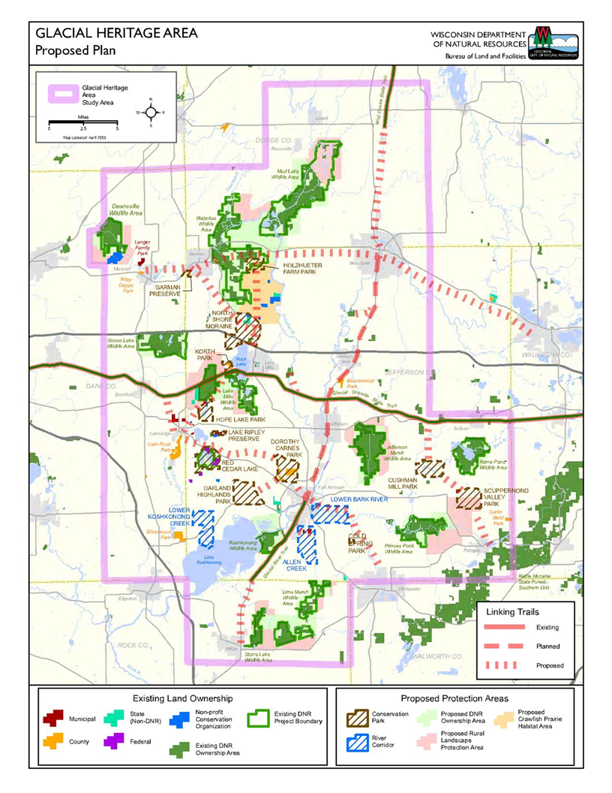
Fall 2009: Glacial Drumlin Heritage Area
Presentation to discuss plan by John Pohlman, WI DNR
http://dnr.wi.gov/org/LAND/facilities/glacial/documents.html

Slide 7
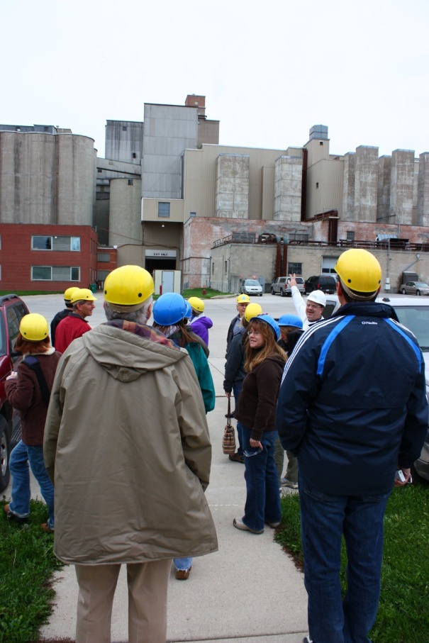
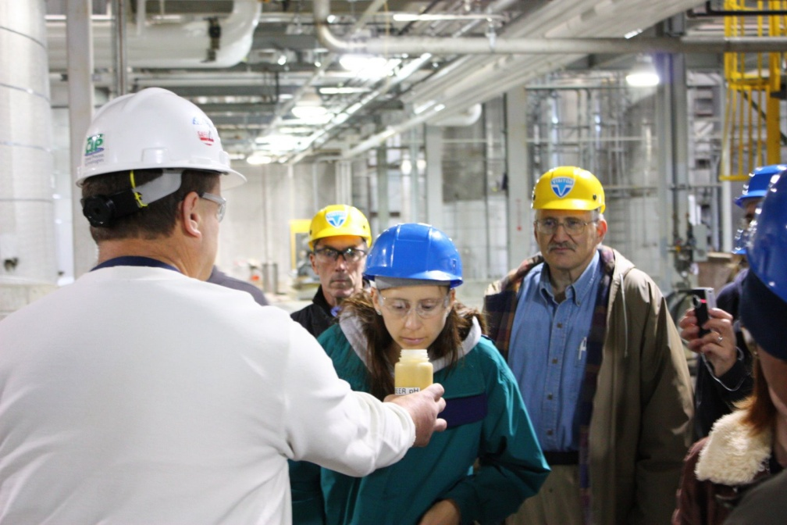
Fall 2009: Jefferson Renew Energy ethanol plant
Largest state ethanol plant
Processes about 52 million bushels of corn into 130 million gallons ethanol
Filed for banruptcy protection after 2008 economic collapse

Slide 8
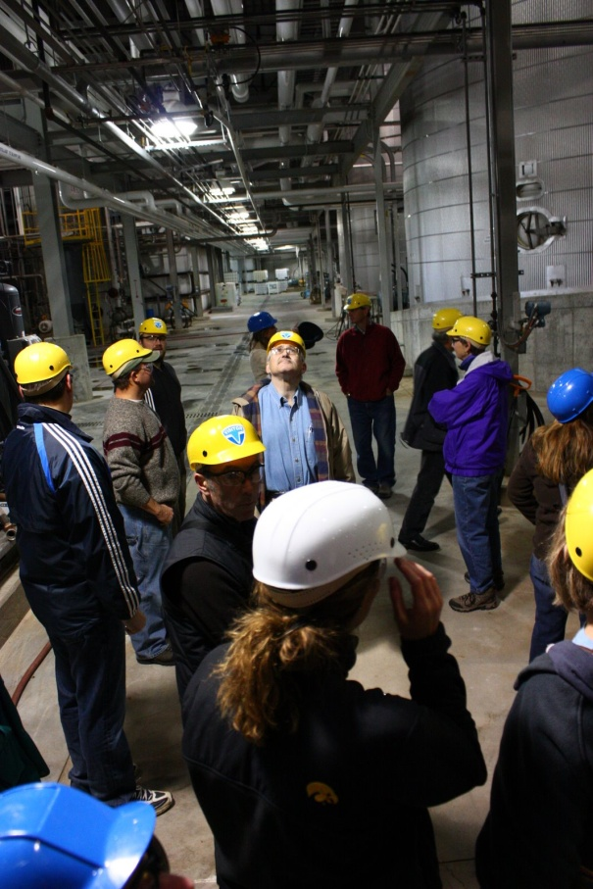
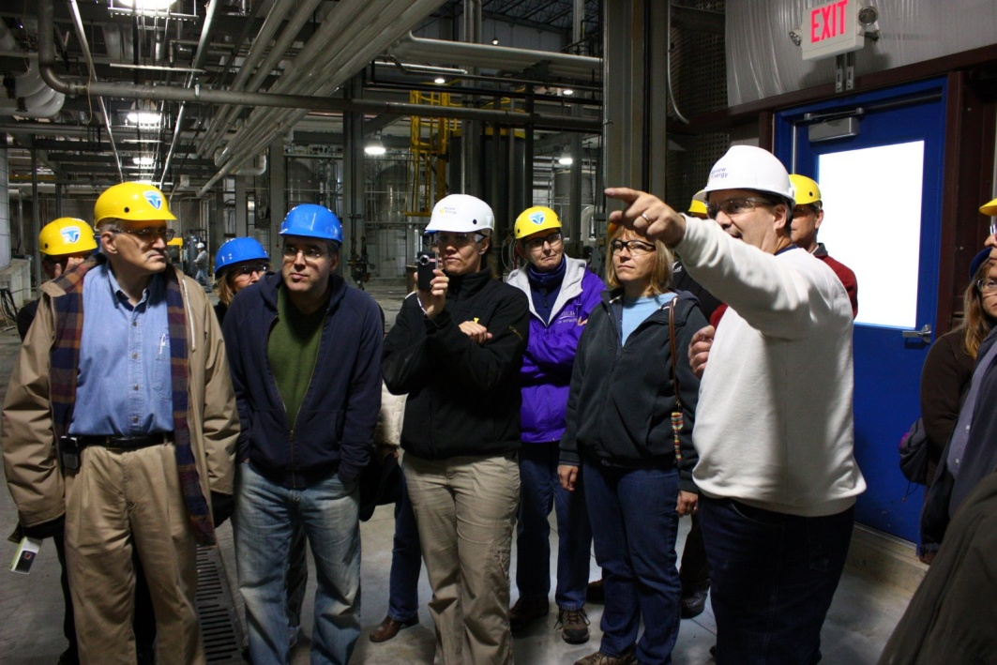
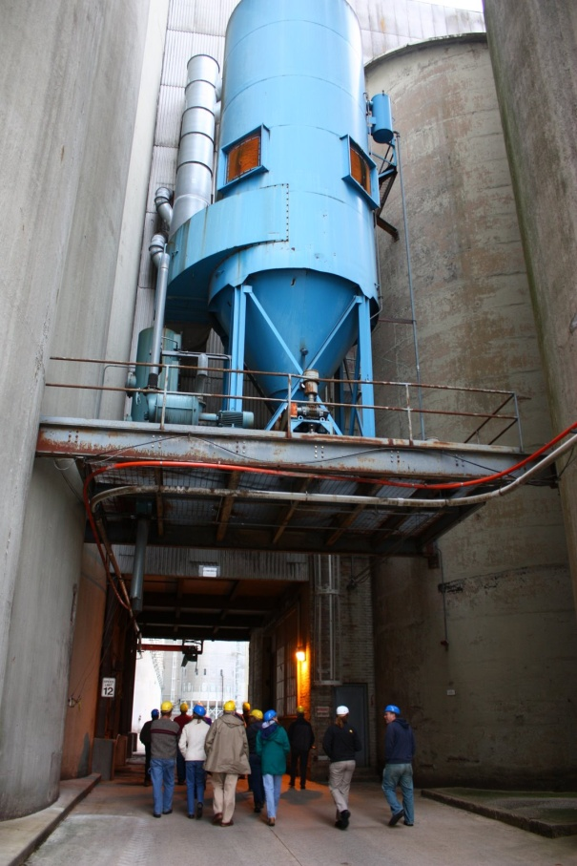
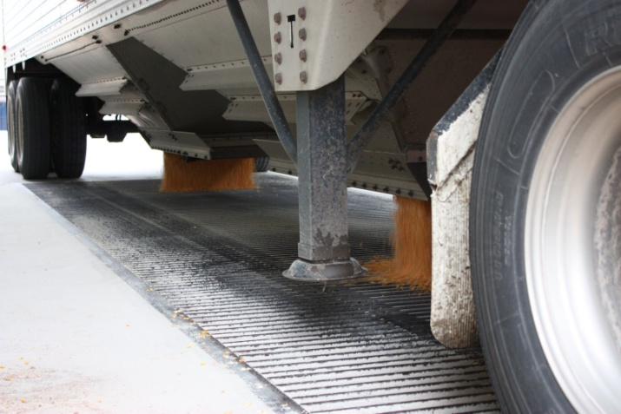
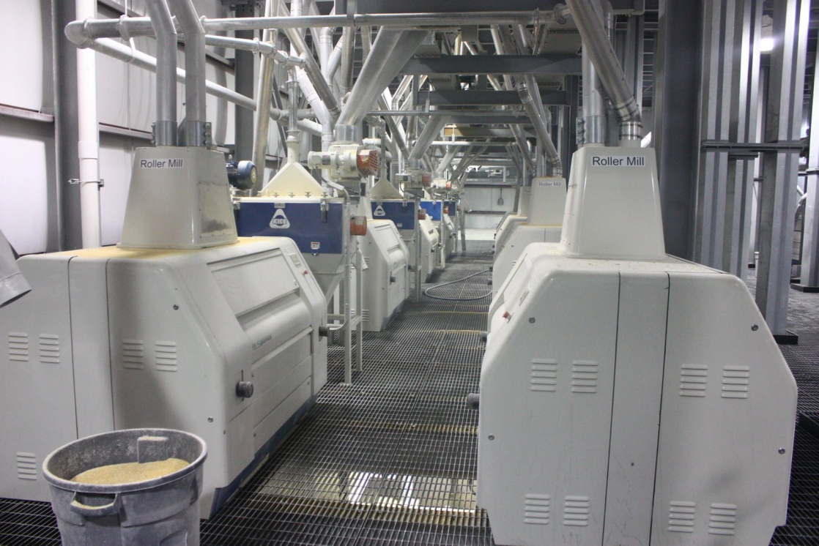
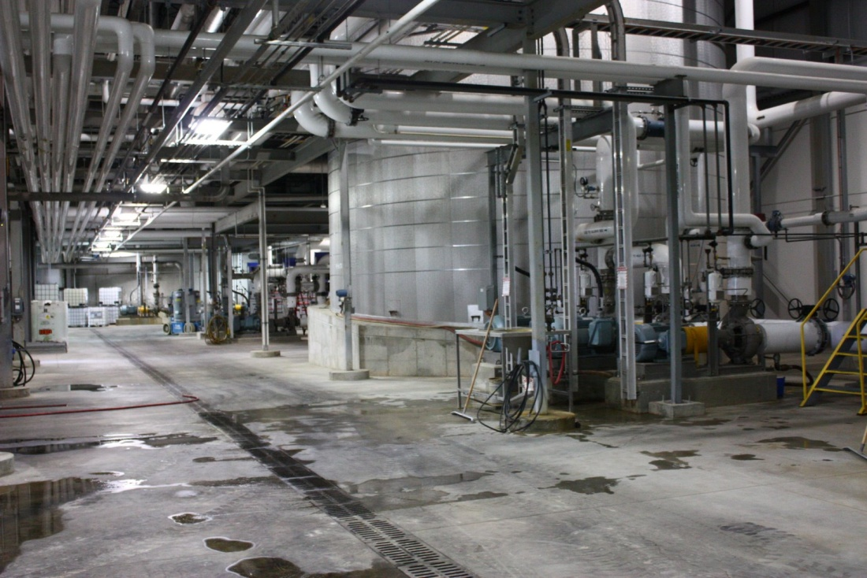
Fall 2009: Jefferson Renew Energy ethanol plant

Slide 9
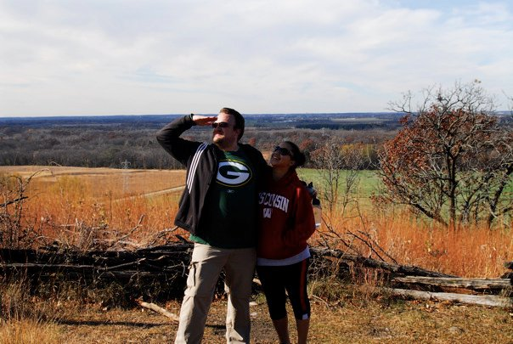
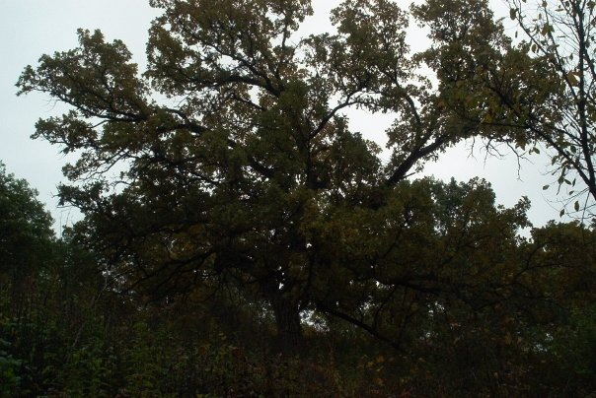
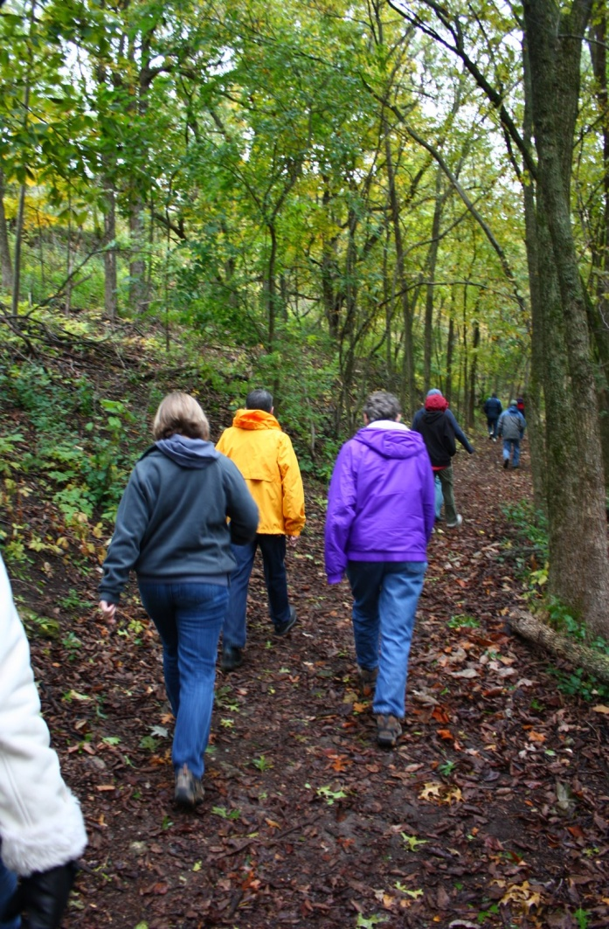
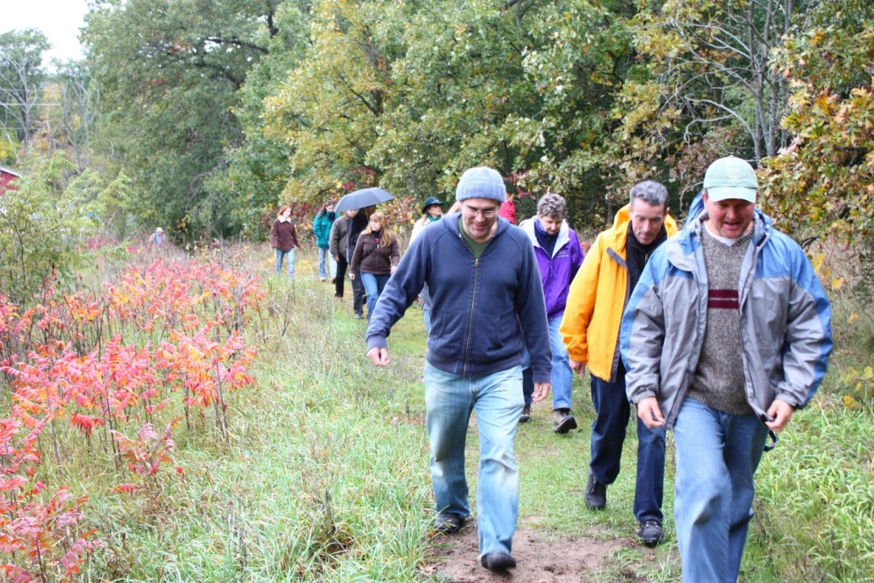
Fall 2009: Restored oak savanna
Bald Bluff Scenic Overlook
Located in Kettle Moraine State Forest along Ice Age Trail

Slide 10
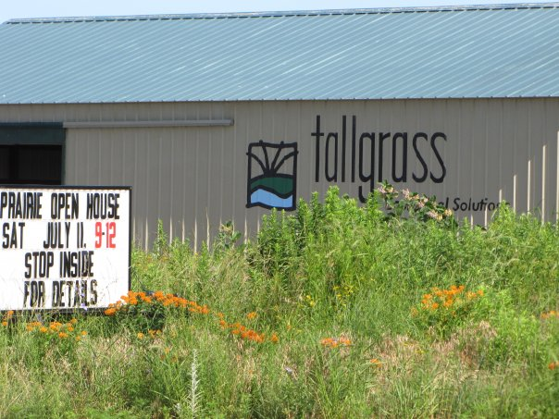
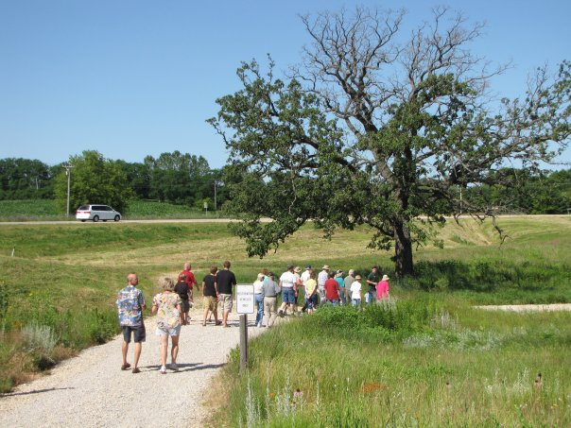
Fall 2009: Tallgrass Restoration LLC
Presentation by local prairie management company with services that include:
Native Plant Installation
Invasive Species Control & Natural Area Stewardship
Buckthorn Clearing
Shoreline Erosion Control
Ravine Erosion Control
Controlled Burns
Ecological Consulting
Rain Garden Design and Installation
Naturalized Detention Basins
Benefits of Prairie Over Turf
Bridge Building

Slide 11
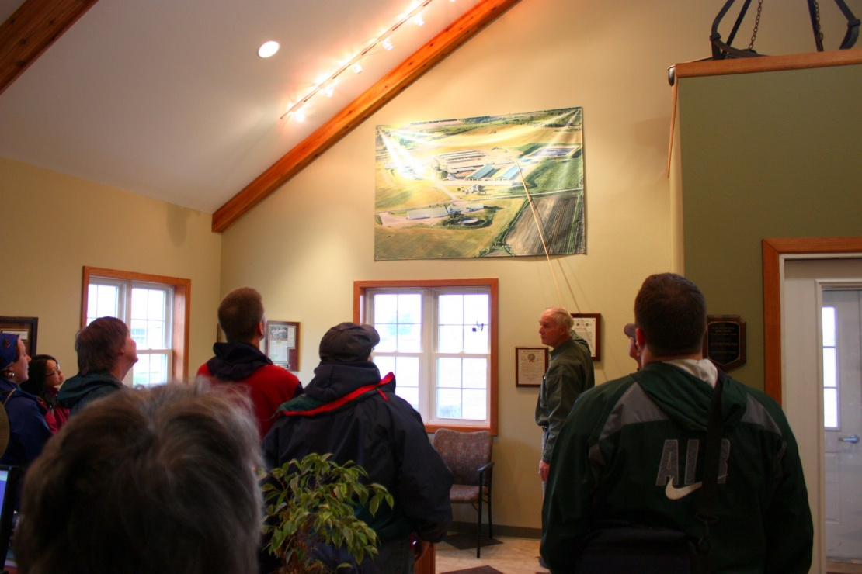
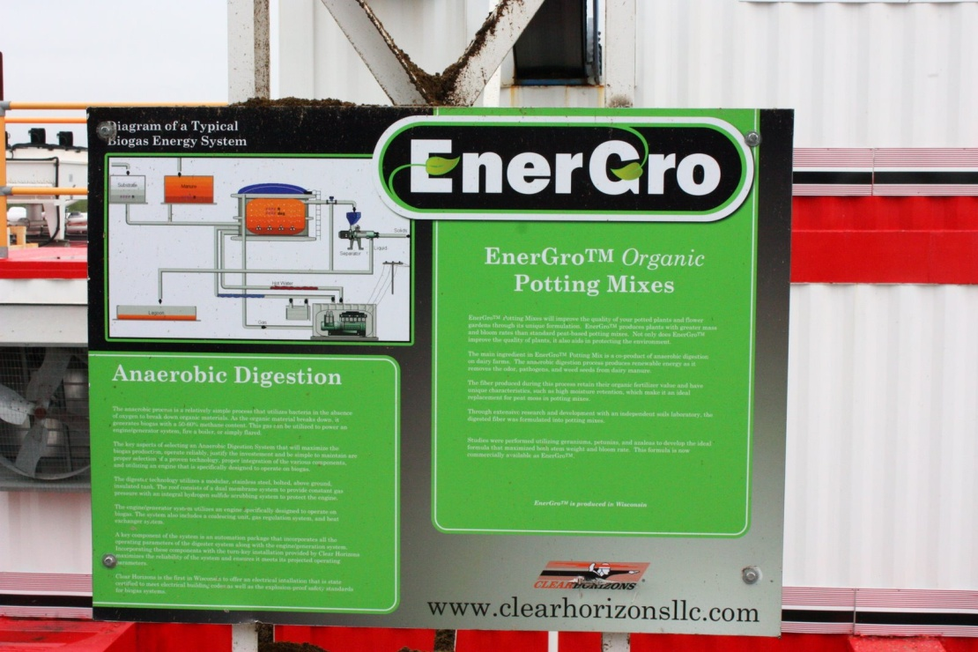
Spring 2010: Crave Brothers Cheese Factory
Local dairy farm with anaerobic digester from Clear Horizons
Generates enough electricity to power farm, cheese factory, and an additional 300 area homes
Byproducts are used as fertilizer, animal bedding, and organic potting soil
http://cravecheese.com/dairy-farm.php?Sustainable-Story-3

Slide 12
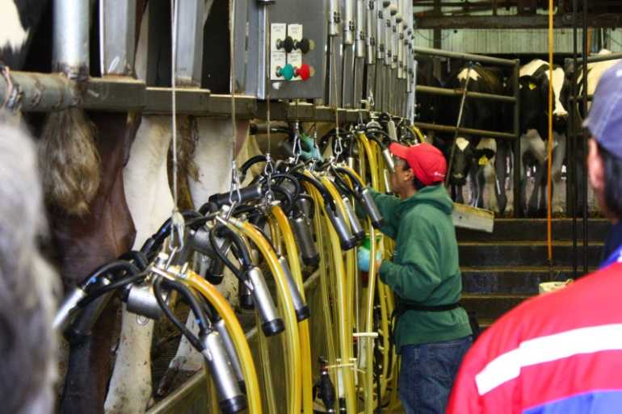
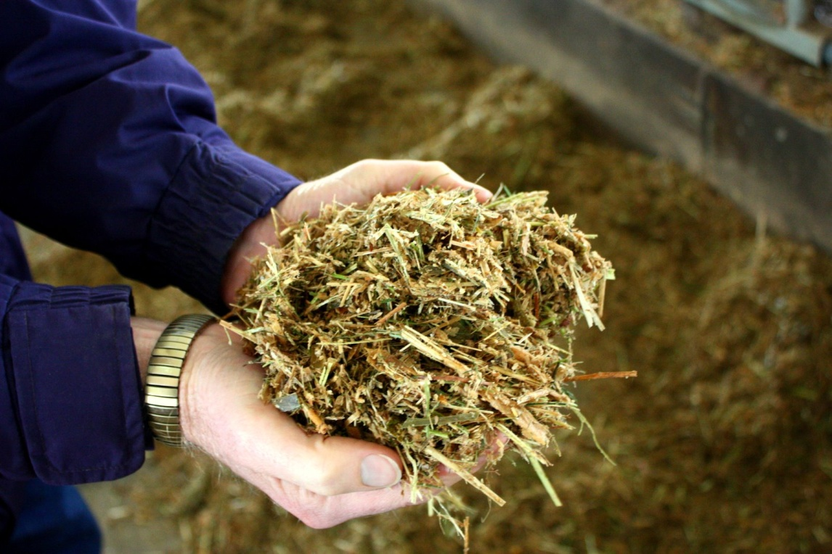
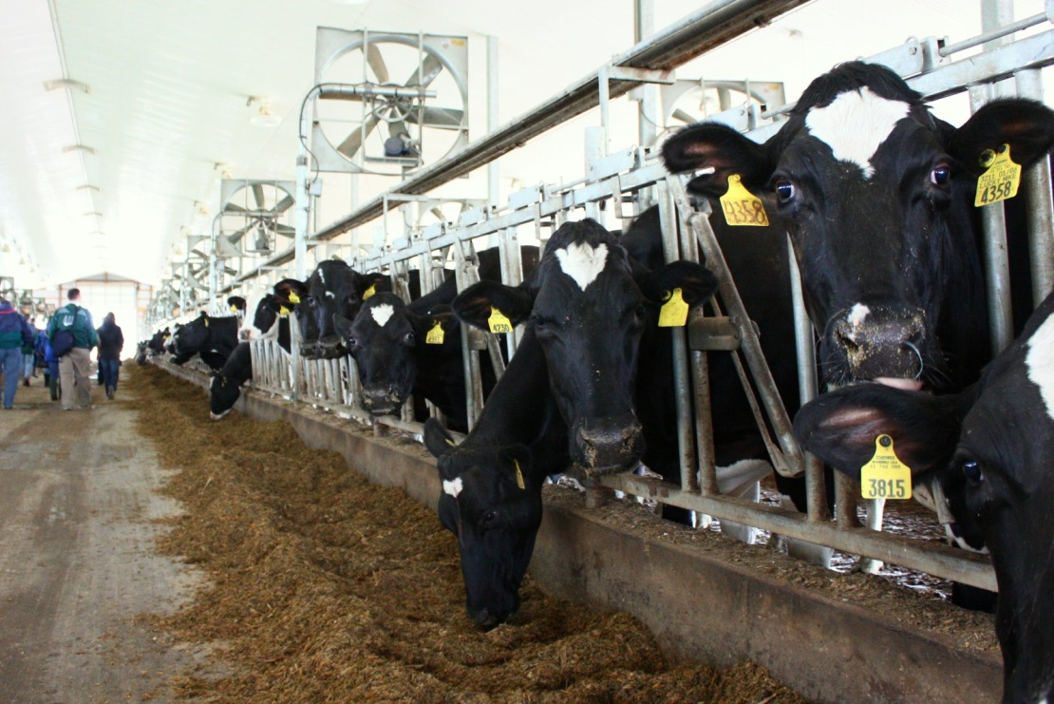
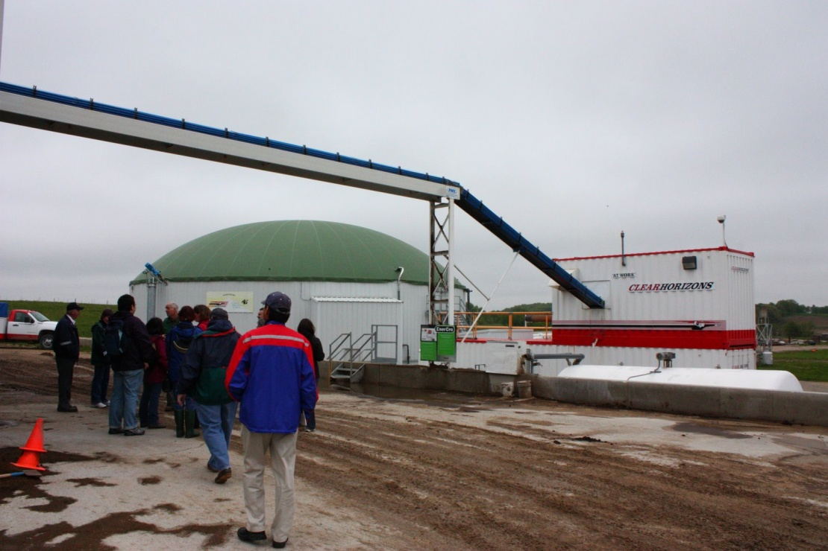
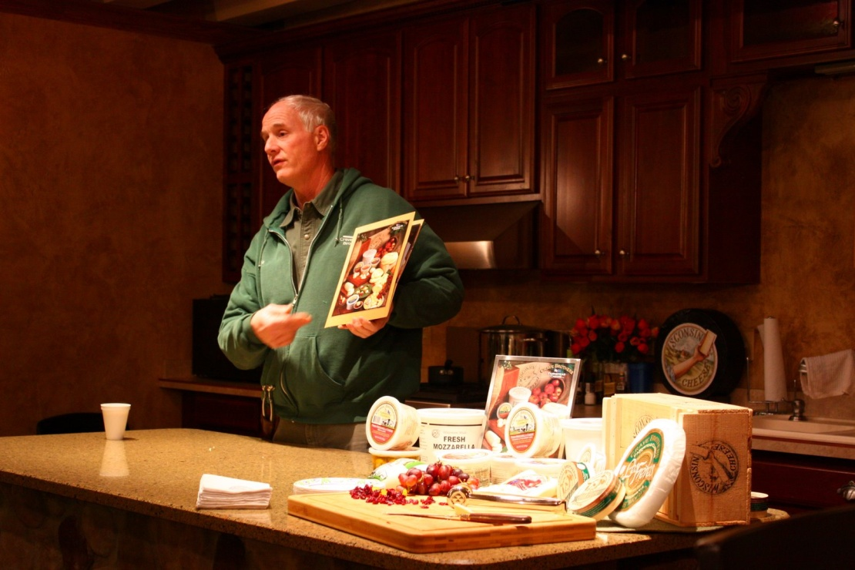
Spring 2010: Crave Brothers Cheese Factory

Slide 13
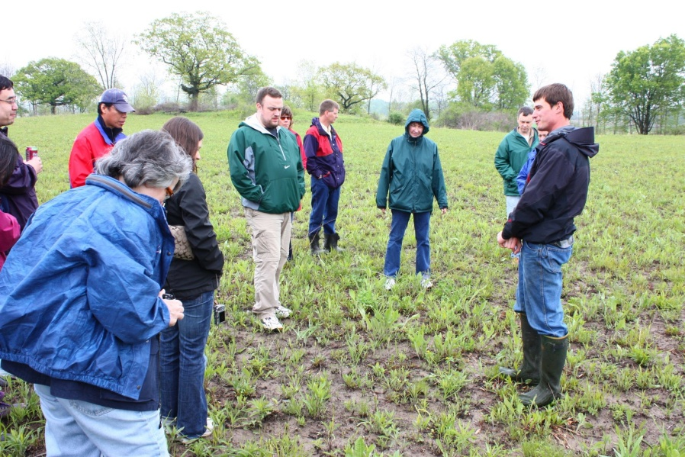
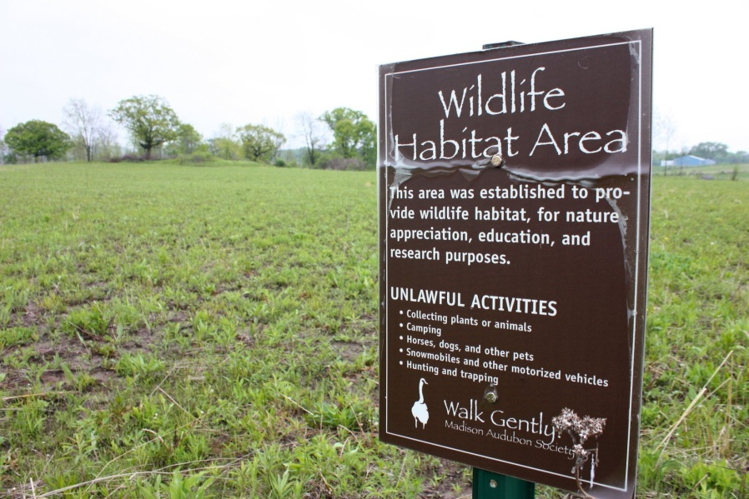
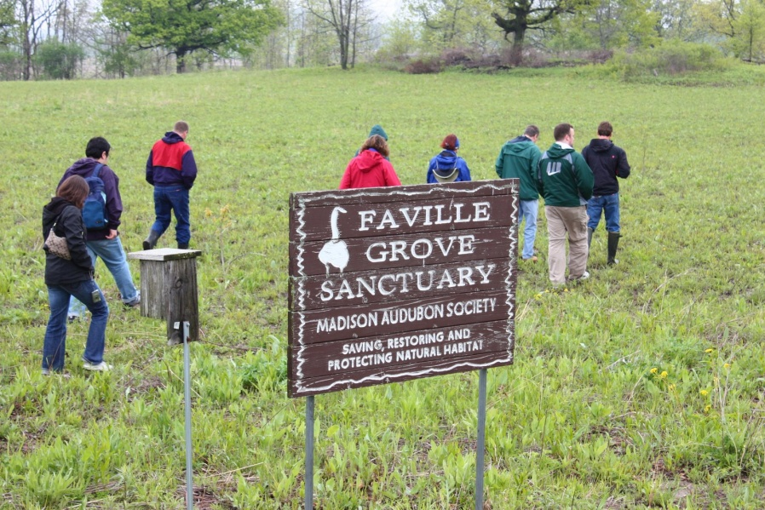
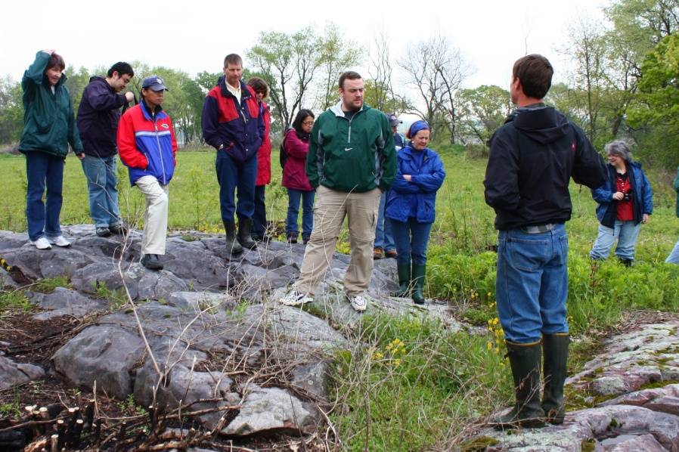
Spring 2010: Faville Prairie State Natural Area
http://www.dnr.state.wi.us/org/land/er/sna/index.asp?SNA=3

Slide 14
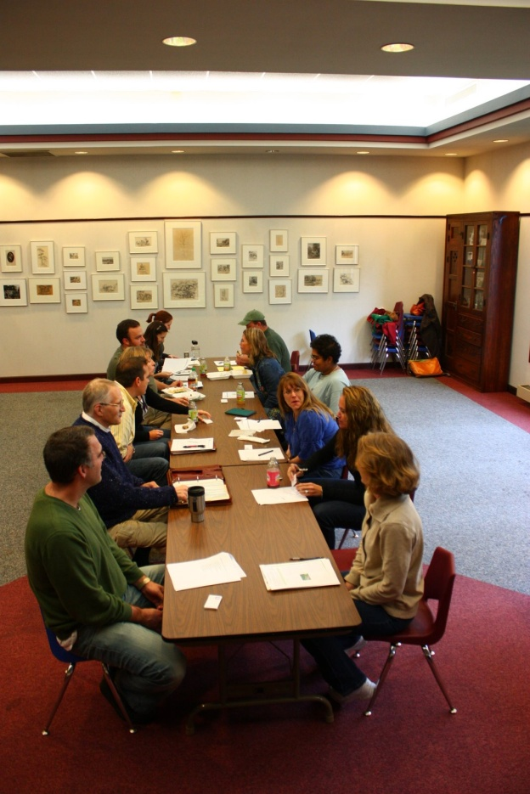
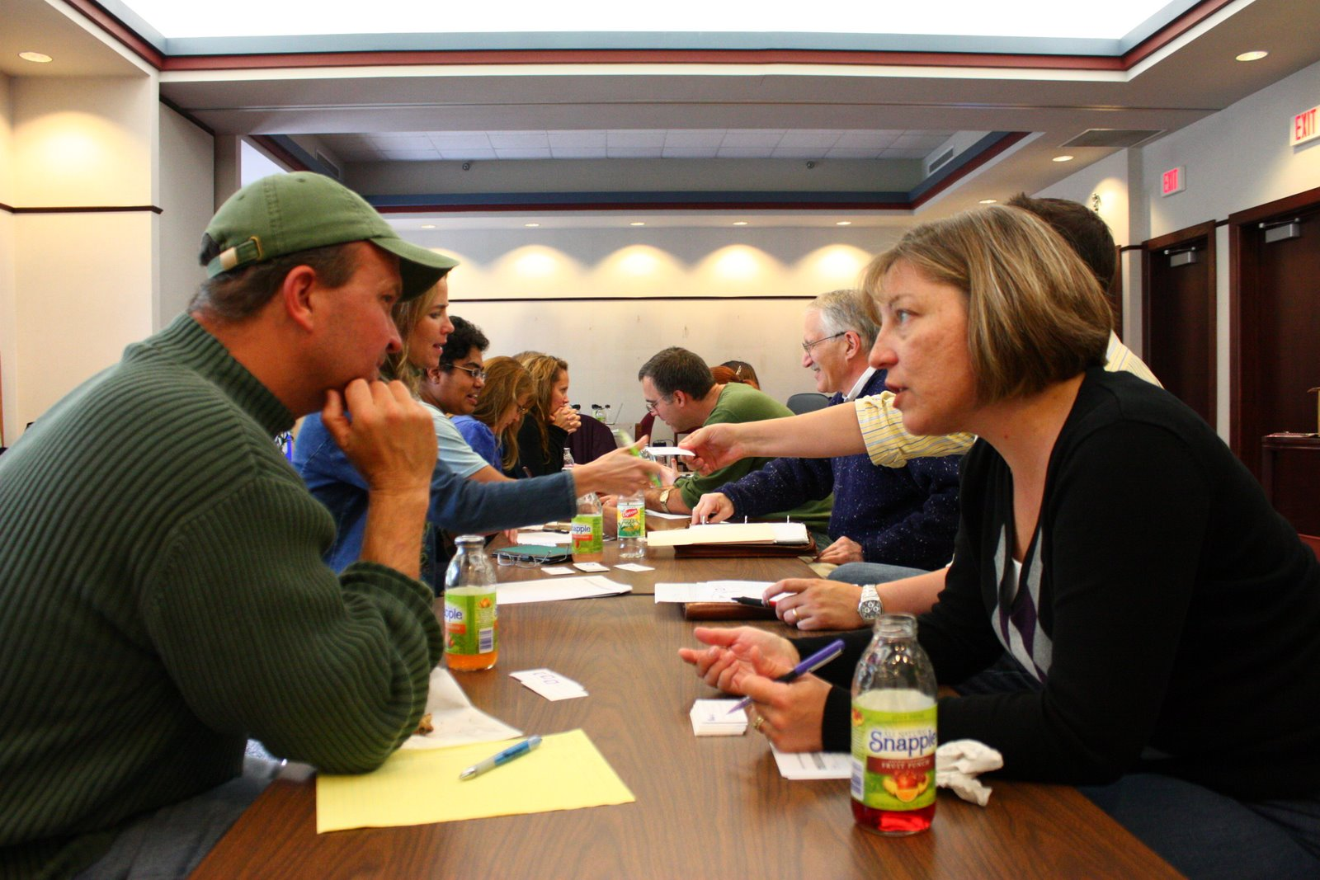
Communication and Interaction
Avoid over-scheduling time within the sessions
Provide an ice-breaker and other activities for participants to get to know each other better
Notes:
many of our most fruitful conversations came about spontaneously and we took time to let them develop
We provided a “speed networking” session the first day
Getting to know their colleagues better was one of the most often benefit identified in our evaluations. Faculty often know little about what faculty outside their department or college are doing and our session provided a window of opportunity. Some of the most innovative projects involved exchanges between two disparate disciplines.

Slide 15
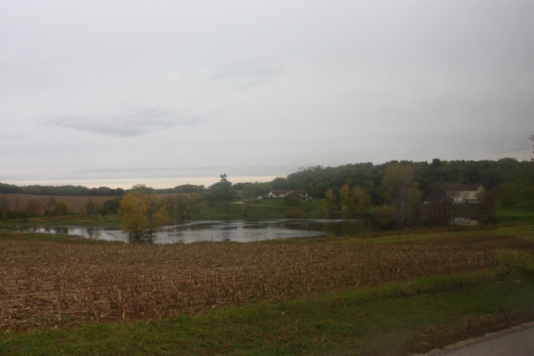
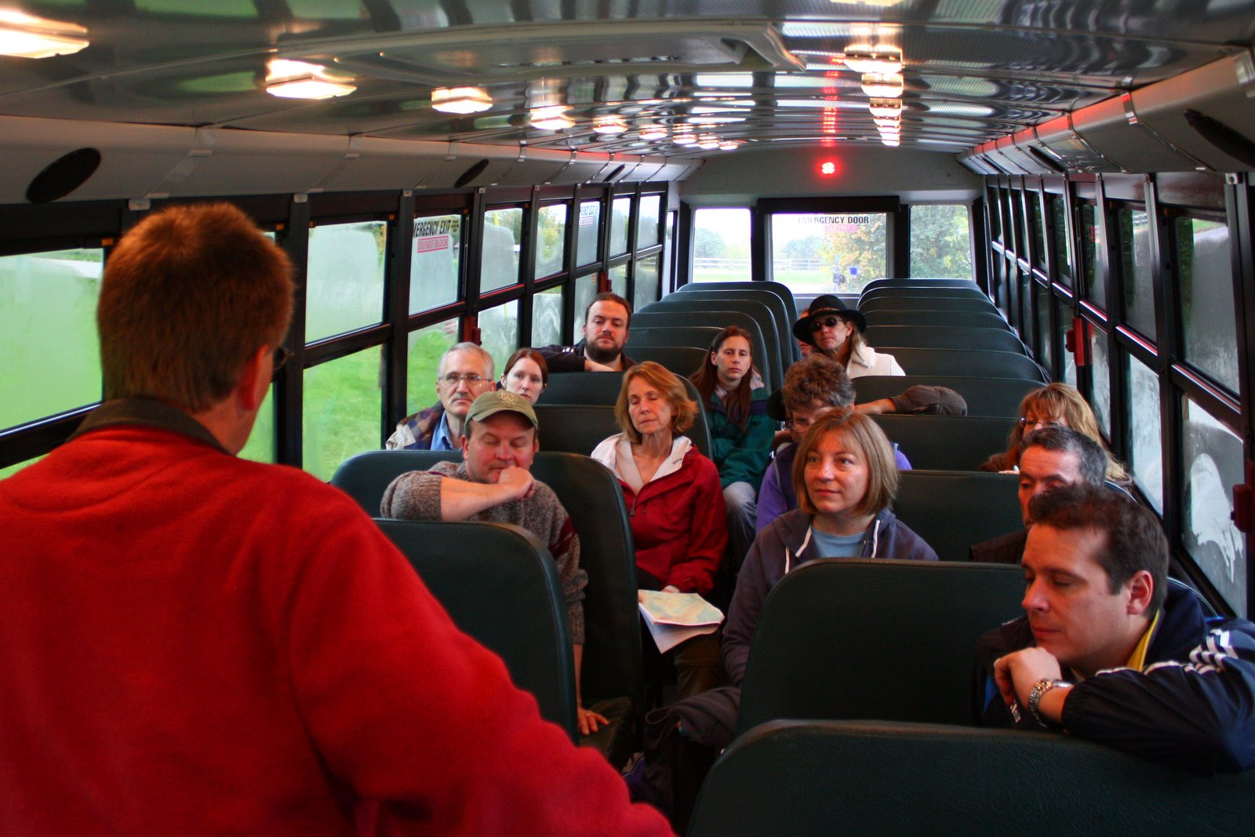
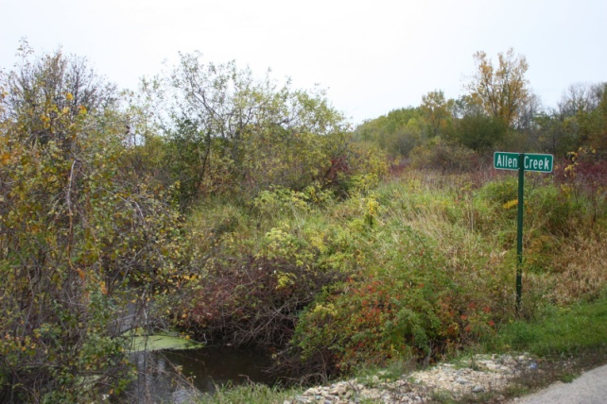
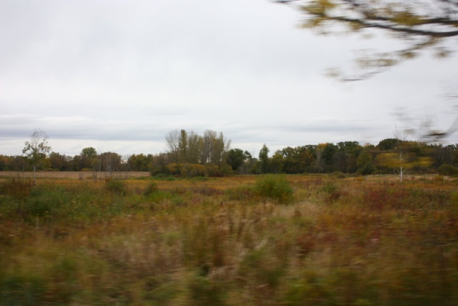
Everyone Loves a Field Trip!
Very popular and achieved several of our goals:
Exposed faculty to nearby off-campus resources.
Moving faculty outside of their traditional academic surrounding.
It further created connections between colleagues.
It was an enjoyable experience to associate with sustainability!

Slide 16
Homework is Good?
“Homework” at the end of each day to complete by the next session.
Homework was intended to meet certain objectives:
Forced participants to further reflect on the discussions of the day.
Encouraged to develop their “craziest” idea to increase the likelihood they actually carry them out.
Homework was submitted online and provided good feedback to how discussion could be led the next day.
Began work on final objective of syllabus change.

Slide 17
Lessons Learned
More follow up after the session
Check on progress
Solicit longer-term reflection
Connect participants from the current session to previous participants
Create more robust networking and collaboration
Revitalize past participants
Market the program earlier to potential future participants
Numbers have declined after initial audience of “willing” participants
Give ample notice to accommodate schedule for field trip and day-long meetings
Notes:
-- one month later, one semester later -- to check in on progress and solicit a longer-term reflection

Slide 18
New Direction – Student Ideas
New take was implemented in Fall 2010 – 3 day student retreat at Camp Edwards YMCA: http://campedwards.org/
Applications were taken and scholarships were awarded to attend free of charge
Student Feedback:
Sell reusable water bottles ($2.00)
Put up posters w/ stats & crazy facts about wasting water/electricity
On recycled paper
Water facts on bathroom stalls in dorms
Put extra garbage bins in dorm rooms. Now, one person uses the garbage bin for garbage and the other person uses the recycling bin for garbage. If we had two garbage bins and a recycling bin, we’d recycle.
Compost!
No more Styrofoam (in Jitters)
Lessons Learned:
TOO LATE IN SEASON!
Needed more publicity to wider range of students
More structured approach

Slide 19
New Direction – Student Ideas
Friday, November 12, 2010
2:00 – 4:00: Check in, find assigned bunkhouses, settle in
4:00 – 5:00: Snack, ice breaker, round of introductions
5:00 – 6:30: Introduction to the Savanna Project, local environmental issues
6:30 – 7:15: Dinner; Chris from Tallgrass gives a talk
7:30 (or 8:00) – 9:30: Night hike weather permitting, movie if weather is bad
9:30 – 11:00: Campfire, bring musical instruments to jam, ‘smores
11:00 - : Astronomy, sit around campfire
1:00: Lights out
Saturday, November 13, 2010
8:00 – 9:00: Breakfast, get ready for nature hike and trail clean-up
9:00 – 12:30: Invasive species clean-up, photo-ops
12:30 -1:30: Lunch, group check-in, feedback
1:30 – 2:00: Quiet reflection time with no electronic or face-to-face conversation (read, write poetry, create, draw)
2:15 – 3:00: Walk to Elegant Farmer
3:00 – 4:00: Guest speaker on local, organic, sustainable products???
4:00 – 4:30: Buy your own snacks, get back to camp
4:30 – 6:30: Fun and games, dance, “Sally in the Alley,” team time to plan after dinner performance
6:30 – 7:30: Dinner
7:30 – 9:00: Group performance skit, poetry slam, song and dance…
9:00 – 10:00: Work on retreat outcomes individually or in groups
10:00 – 11:00: Share ideas on how to incorporate sustainability-related topics in courses they are planning to take… class projects/term paper/honors , projects/undergraduate research projects/brainstorm with professor ; Watch movie, popcorn
11:00 - : Campfire, bring musical instruments to jam, ‘smores
1:00: Lights out
Sunday, November 14, 2010
8:00 – 9:00: Breakfast, get ready for nature hike and trail clean-up
9:00 – 10:30: Group meeting, submit ideas on how to incorporate sustainability-related topics, discuss future activities and how to promote this among peers; Retreat evaluation
10:30 -11:30: Clean-up, leave camp

Slide 20
Spring 2011
Program involves a less centralized approach
Initial meeting
Options for integrating sustainability into your curriculum
Presentation on campus sustainability
Review Andersen Library’s Films on Demand program
The popular speed networking session
Attend an Earth Week Event
Includes Bill McKibben lecture April 5
Variety of speakers, films and other events April 19-21
Attend one event and one meal with speakers
http://www.uww.edu/sustainability/earthday
Field Trip
Ice Age Trail local tour
http://walworthjefferson.iceagetrail.org/home

Slide 21
Questions?
Wesley Enterline
sustainability@uww.edu
enterlinwj03@uww.edu
262-472-6709

