Slide 1

Getting to know your WRS Statement of Benefits
Presented By: Steve Marshall
Director of Human Resources - UW Whitewater

Slide 2
You can access your ETF Annual Statement of Benefits directly from Workday following the directions below, or you can access at etf.wi.gov/my-benefits, then follow the last bullet point
Universities of Wisconsin employees covered by the Wisconsin Retirement System (WRS) can view their WRS Statement of Benefits by logging into Workday (myworkday.wisconsin.edu).
Once in Workday, from the Menu in the left go to Personal, then select Benefits and Pay.
In the Suggested Links select, My Benefits which will take you to the My Benefits for Members web page.
From the My Benefits for Members web page go to My Annual Statement of Benefits then select Go to Annual Statement.
Updated WRS Statement of Benefits are provided annually, typically in April of each year.

Slide 3
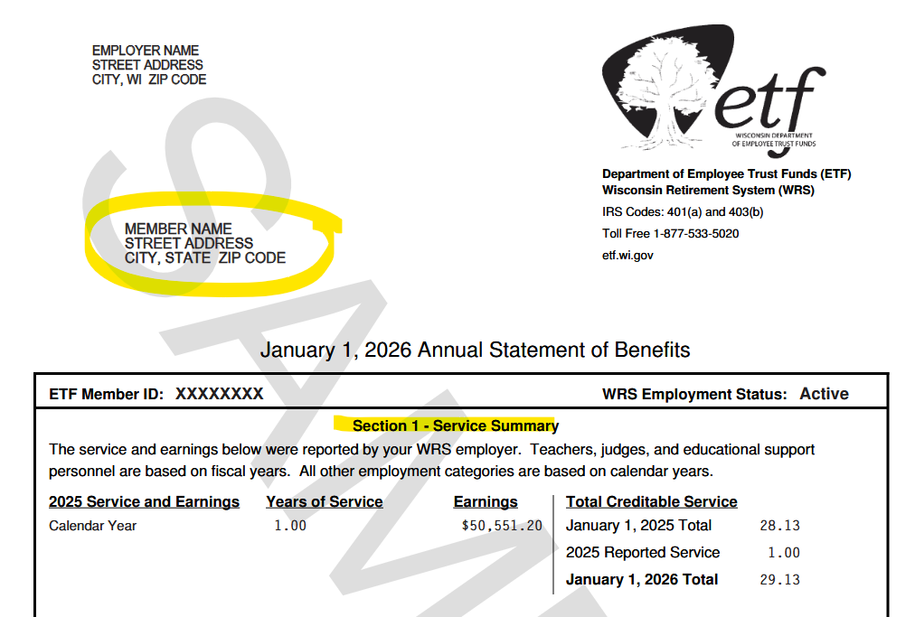
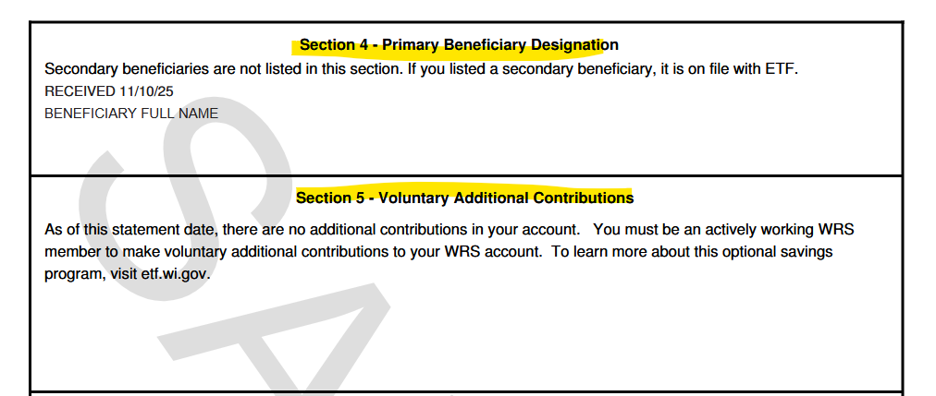
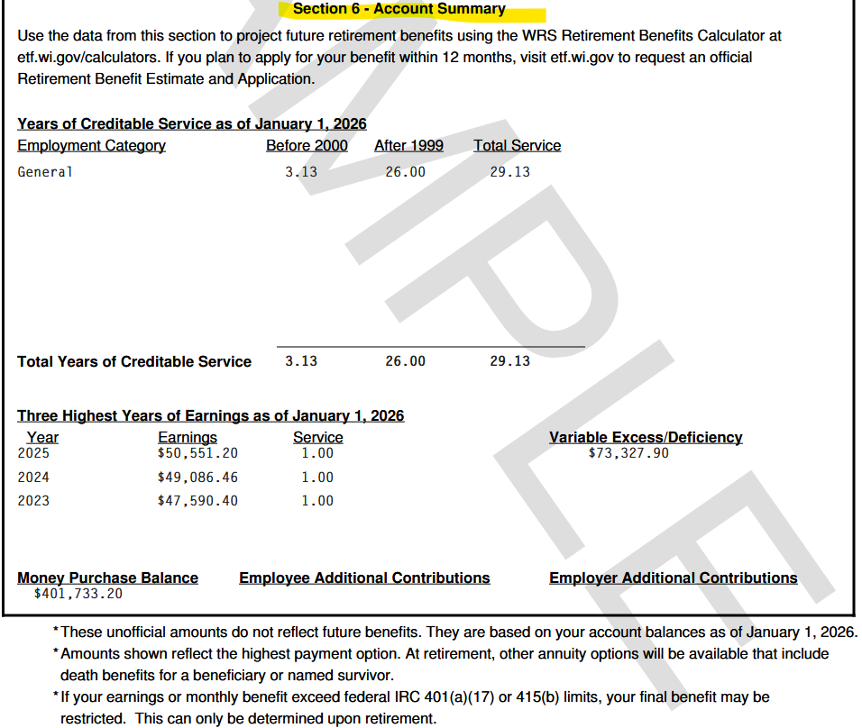
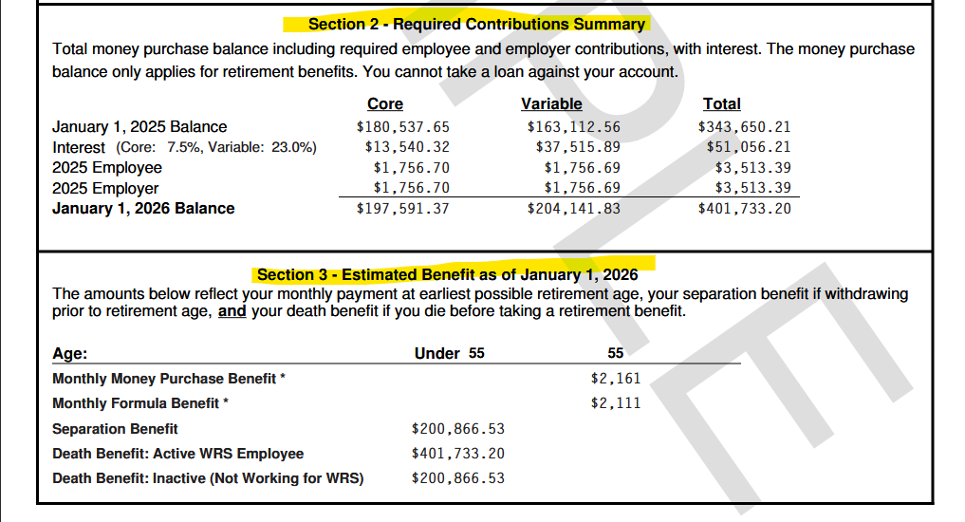

Slide 4
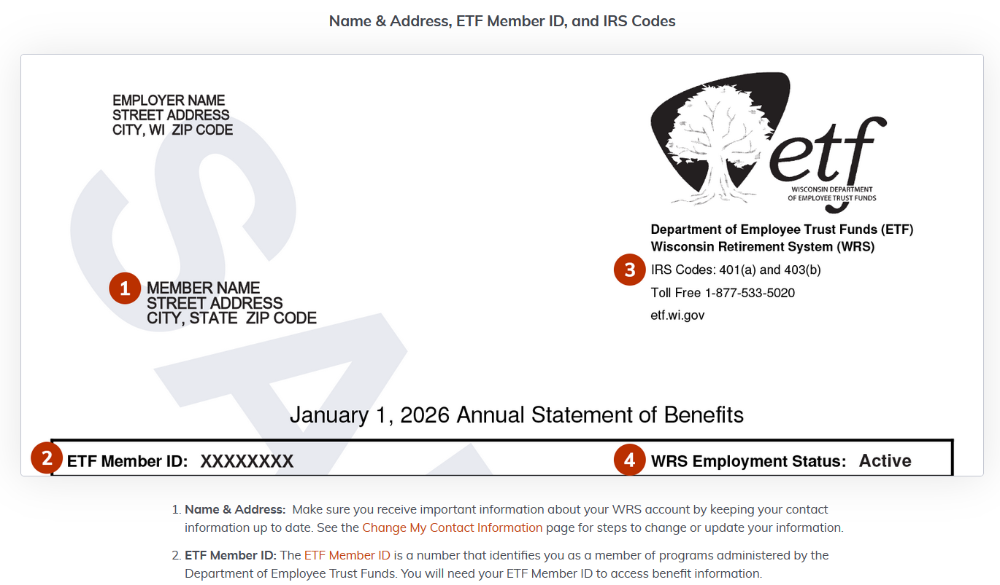
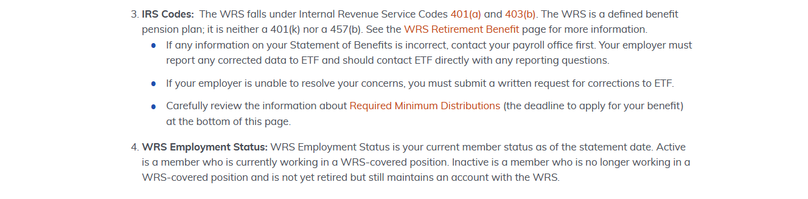

Slide 5
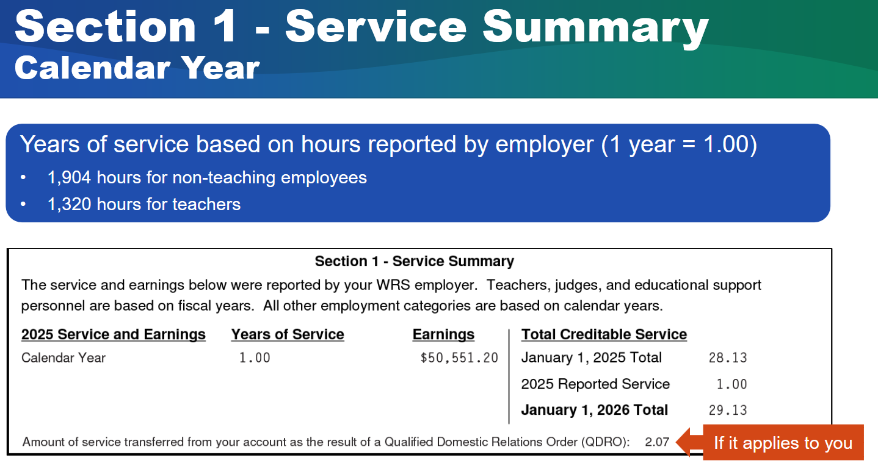
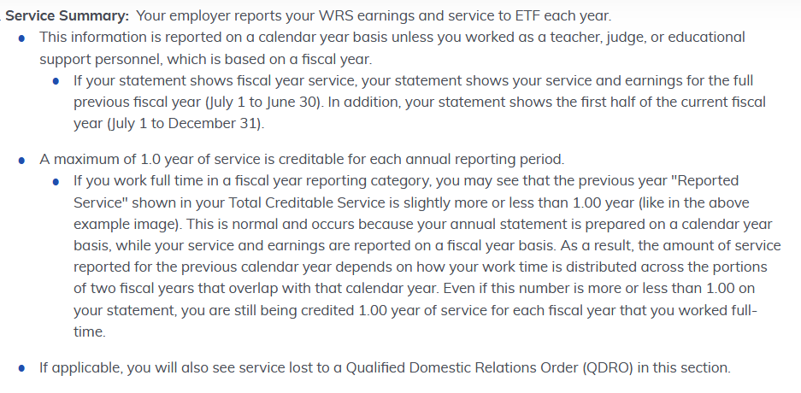

Slide 6
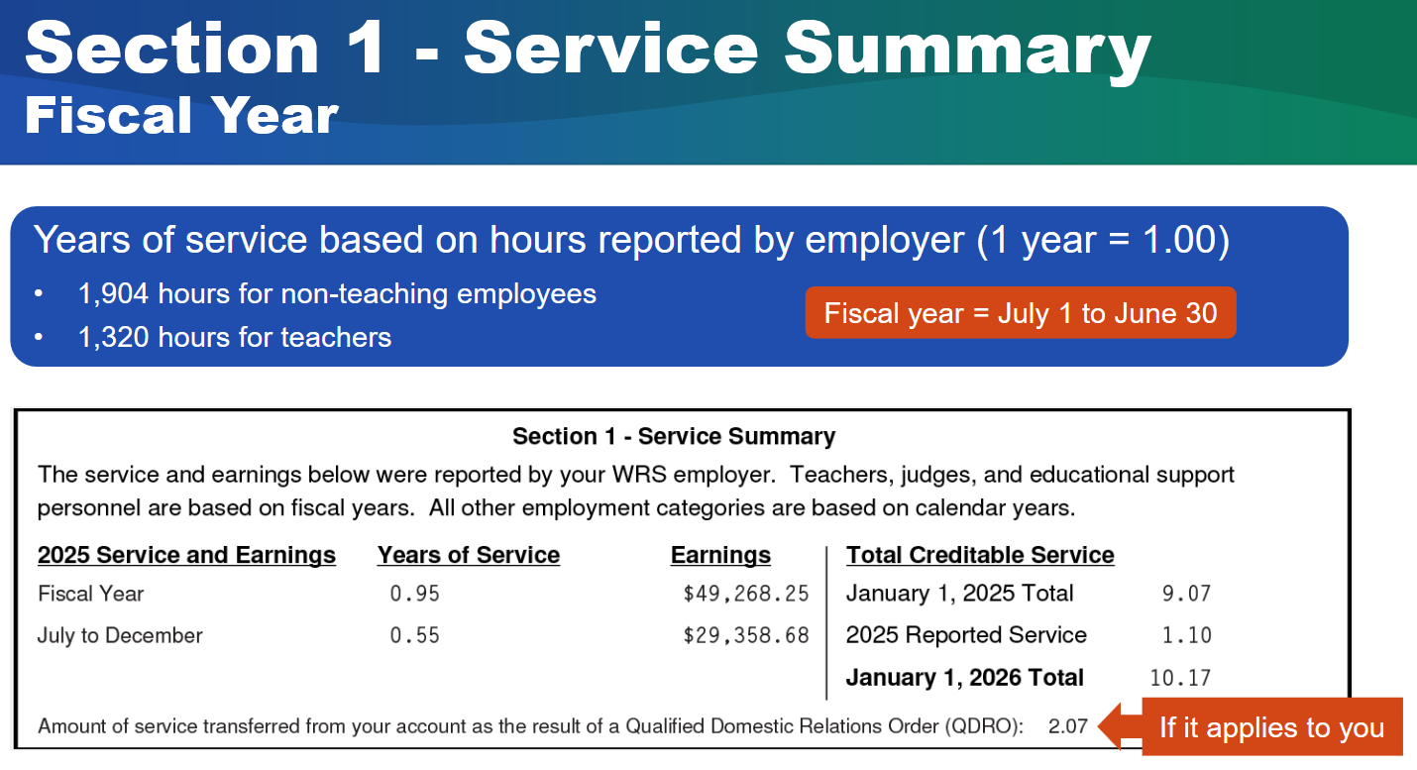

Slide 7
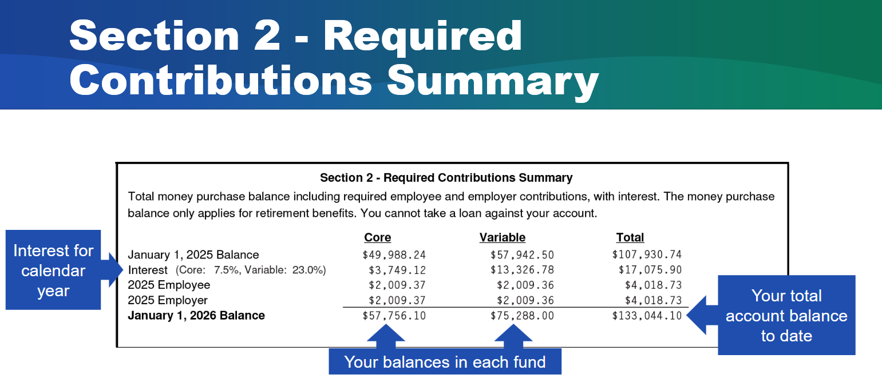
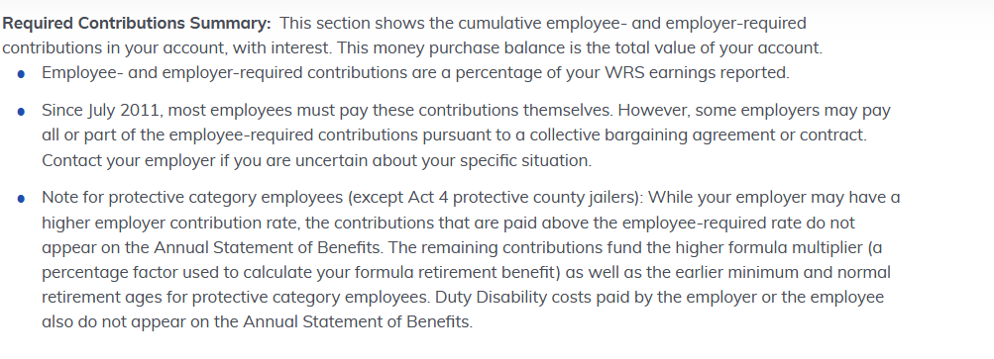

Slide 8
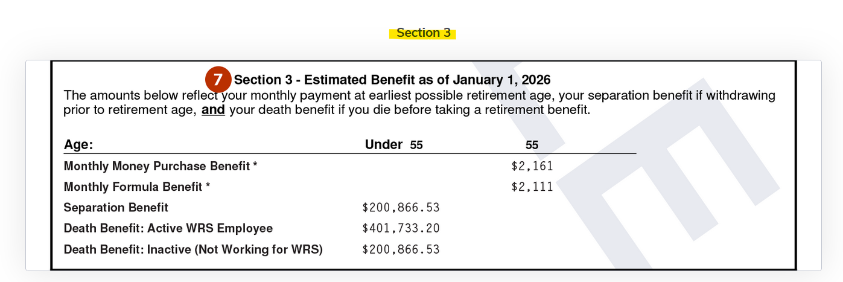
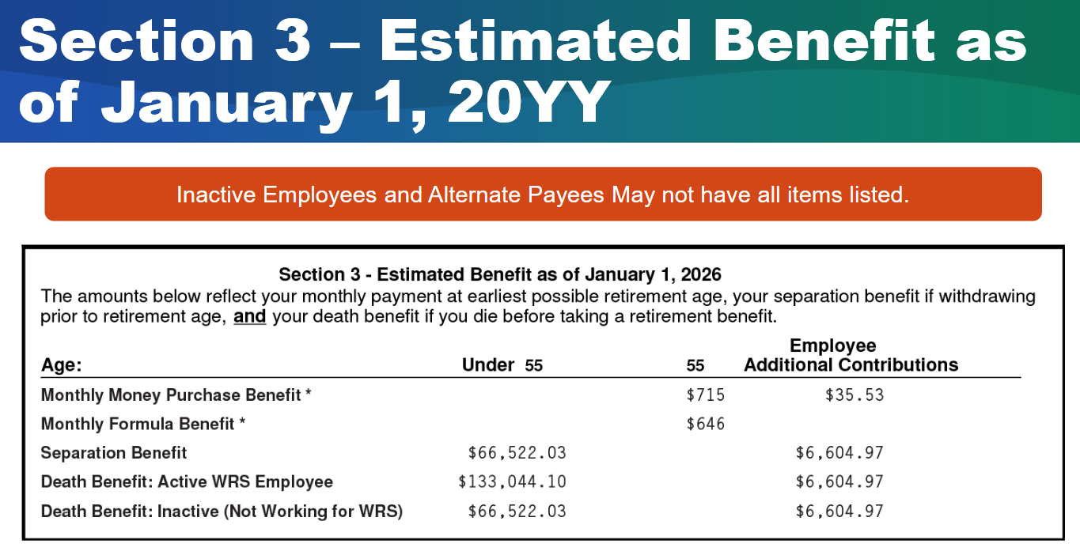

Slide 9
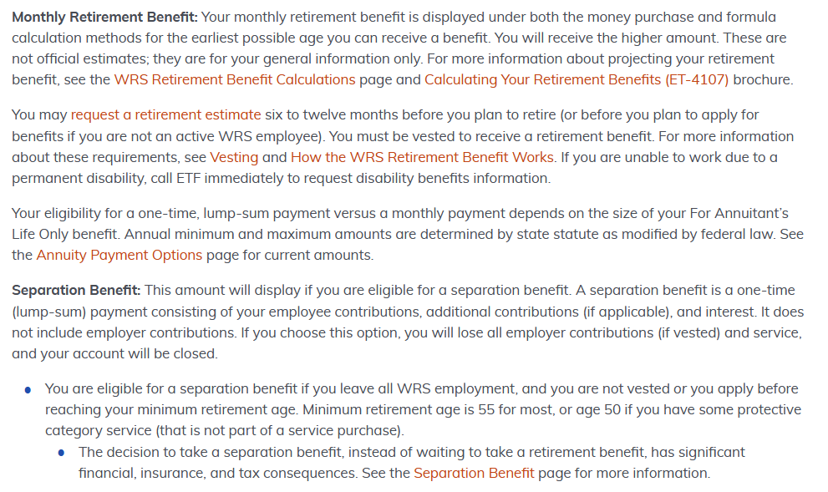

Slide 10
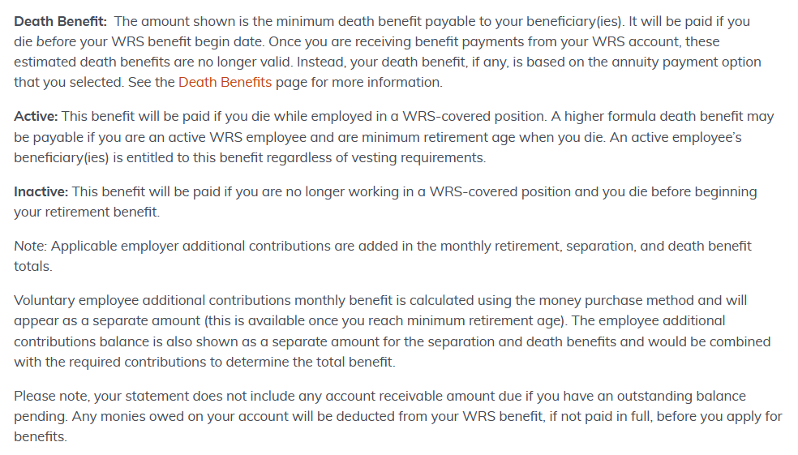

Slide 11
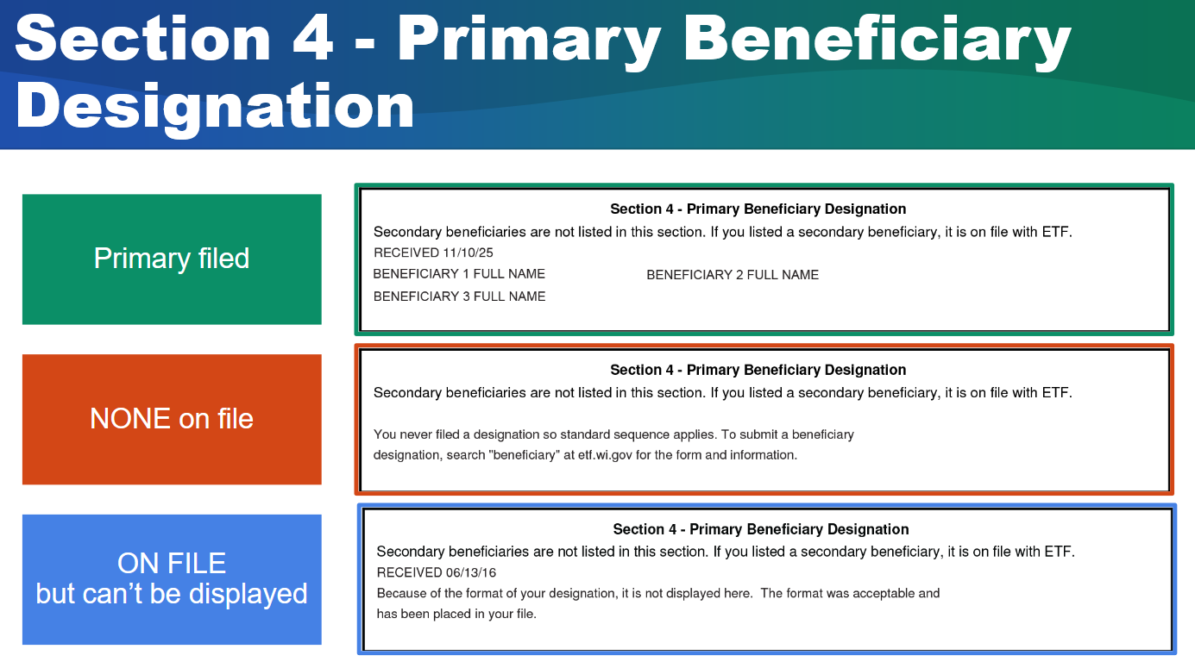

Slide 12
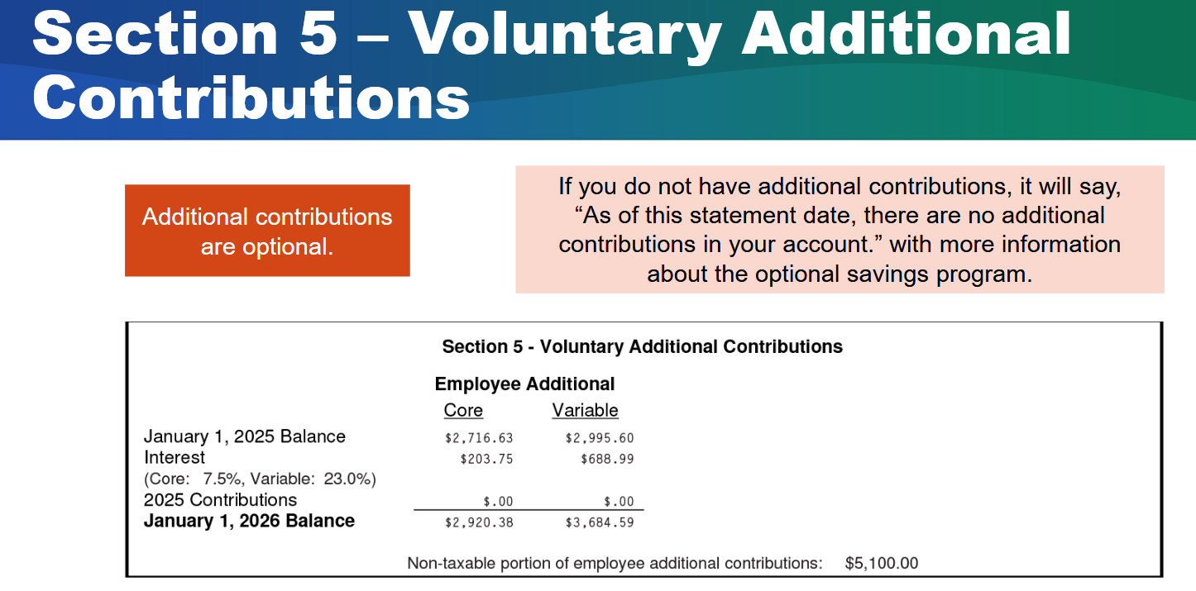
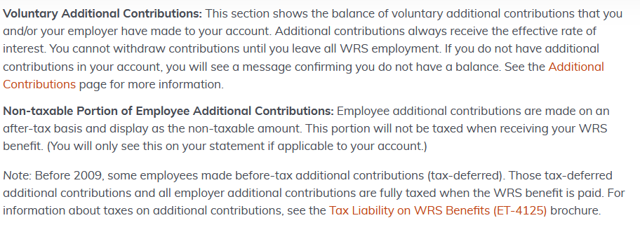

Slide 13
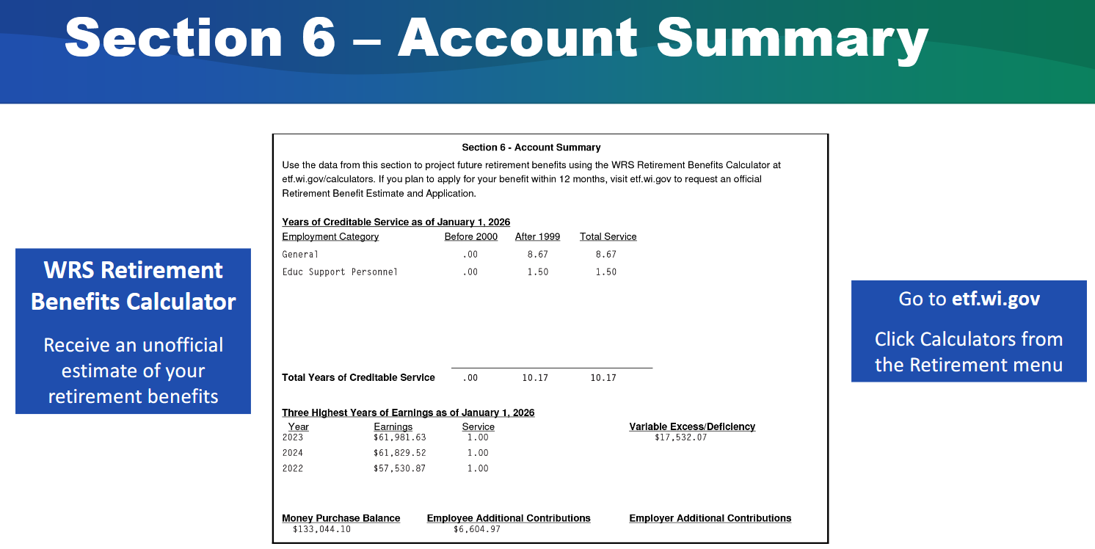

Slide 14
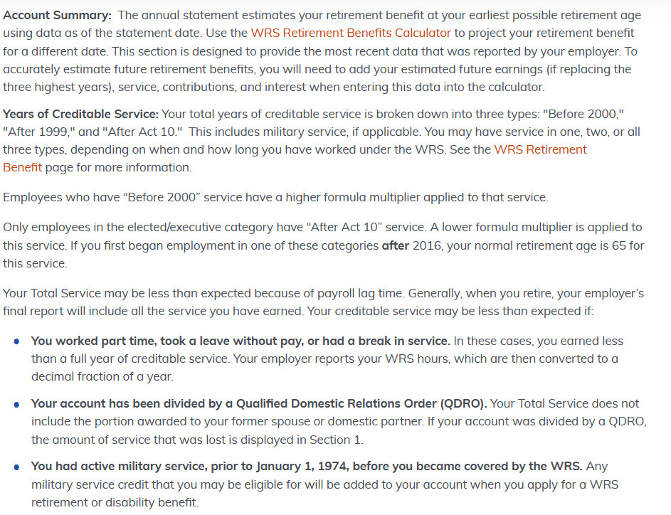

Slide 15
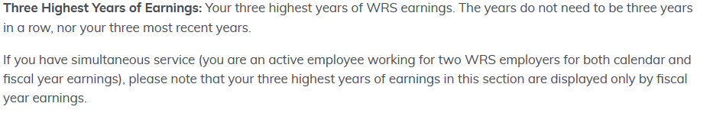
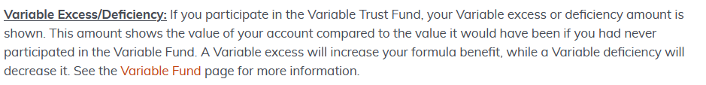
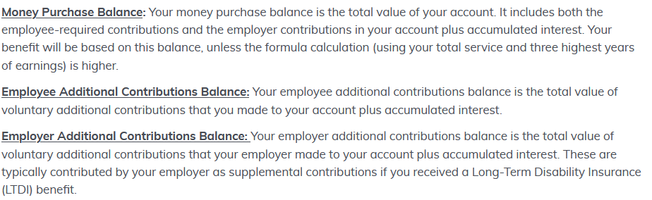

Slide 16

Contact ETF:

Slide 17


Steve Marshall
marshals@uww.edu

