Slide 1
Blood Pressure
UW-Whitewater Presentation
Tiffany Pernat – Fort HealthCare

Slide 2

What is Blood Pressure?
Blood Pressure = how hard your blood pushes against your arteries
Each time your heart beats, it pushes blood through your blood vessels and blood pressure is measured in two numbers to indicate how hard the push is.
Numbers are called Systolic and Diastolic

Slide 3
Understanding the Two Numbers
Systolic = top number
Pressure when the heart beats
“The Push”
Diastolic = bottom number
Pressure when the heart rests
“The Pause”
Written as one number over the other
120/80
Both numbers matter!

Slide 4
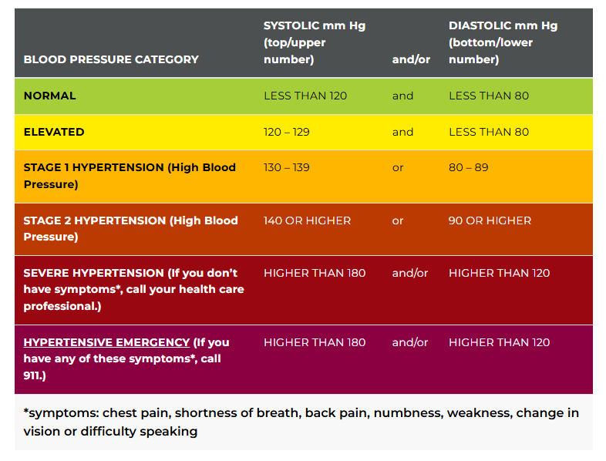
Blood Pressure
Categories
High blood pressure often has no symptoms, which is why it’s called “The silent killer”

Slide 5
Why Blood Pressure Matters
Over time, uncontrolled high blood pressure can increase the risk for:
Heart disease
Stroke
Kidney disease
Vision problems

Slide 6
Hypertension Risk Factors
Non-modifiable
Age
Family History
Genetics
Modifiable
Physical inactivity
Poor nutrition (high sodium!)
Excess weight
Smoking
High stress
Poor sleep
Excess alcohol

Slide 7
Lifestyle Factors that Can Raise Blood Pressure
Sitting most of the day (physical inactivity)
Processed and many restaurant foods (nutrition/high sodium)
Chronic stress/poor coping
Skipping sleep
Alcohol, smoking, vaping, etc.
Not knowing your blood pressure/addressing it

Slide 8
Simple Ways to Support Healthy Blood Pressure
Move your body regularly
Even short walks or standing!
Eat more fruits, vegetables, whole foods
Watch sodium
Label reading!
Does anyone know the daily limit of sodium in mg?
Manage stress
Stress management tips, breathing, recognition, acceptance
Aim for 7-9 hours of sleep
Check your blood pressure regularly

Slide 9
Simple Ways to Support Healthy Blood Pressure: Movement
Take short 5–10-minute walks throughout the day
Recommended amount of exercise per week is 150 minutes
Cardiovascular, Strength training and Flexibility!
Park further away = extra steps
Take the stairs when you can
Stretch while watching tv

Slide 10
Simple Ways to Support Healthy Blood Pressure: Nutrition
Add
Add one fruit or vegetable (or both!) to each meal
Choose
Choose whole grains when possible
Watch
Watch sodium on packaged foods
Drink
Drink more water throughout the day
Add
Add more good before focusing on what to take away

Slide 11
Simple Ways to Support Healthy Blood Pressure: Sleep
Aim
Aim for 7-9 hours a day
Keep
Keep a consistent bedtime
Power down
Power down screens 30 minute before sleep
Engage in
Engage in calming activity prior to sleep
Cool
Cool, dark, quiet space
Watch
Watch sleep saboteurs
Sleep
*Sleep helps regulate blood pressure, stress hormones and heart health!

Slide 12
Simple Ways to Support Healthy Blood Pressure: Manage Stress
Deep breathing
Practicing gratitude
Move your body to release tension
Connect with someone you enjoy
Grounding / Redirect
Practice a hobby
Listen to music

Slide 13
Simple Ways to Support Healthy Blood Pressure: Avoid or Reduce Tobacco & Alcohol
Avoid smoking or vaping
Limit alcohol intake

Slide 14
Simple Ways to Support Healthy Blood Pressure: Healthy Heart Habits
Laugh often!
Stay socially connected
Do things that bring joy
Give yourself grace

Slide 15
Know Your Numbers
Get your blood pressure checked at:
Provider visits
On campus! Health center
Community screenings
Home monitors
Track trends, not just one reading
Can take at different times of day

Slide 16
Blood Pressure Myth Busters
“I feel fine, so my Blood Pressure must be fine!”
“Only older adults have high blood pressure”
“Medication is the only solution”
Lifestyle + awareness = powerful tools

Slide 17
Takeaways
Blood pressure is important, and manageable
Knowing your numbers is step one
Small, consistent habits matter
You have more control than you think

Slide 18
Class Close
What is one small heart-healthy habit you could start this week?

